Slide 1
hgAi and a bunch of new code
Angie Hinrichs
March 11, 2015

Slide 2
Outline
Why do we need an Annotation Integrator?
hgAi demo
A brief history of javascript in kent/src
Enlightening info from Brian Craft
New code in kent/src
New dev dependencies and types of bugs

Slide 3
Why do we need hgAi?
We send too many users to Galaxy for a commonly requested operation
“I am having trouble pulling out gene names for the corresponding probes. ... I've tried many of the settings, changing the group from custom to all tables, but still I don't get any gene names, just an output of position. ... Am I doing something wrong?”

Slide 4
Why do we need hgAi?
“When I make a custom tract ... I am interested in getting the intersection of that with the TFBS track, is there some easy way to label the output with the gene? I get a bed file that does not directly indicate which gene it is associated with. Am I missing something?”

Slide 5
Why do we need hgAi?
“There must be an easier way to fill in the human gene symbol on each line of a bed file than to manually look it up on the browser.”
“However, when I get the output it doesn’t match the gene name to the input list, I only get the gene name.”
“This gives me the regions that have genes, but not which ones in the Table output.”
…

Slide 6
ulterior motives
More modern interactive interface
More elegant UI code

Slide 7
Demo time!

Slide 8
A brief history of JS in kent/src
Before JS: all <FORM>s and submit buttons
Minimal inline JS in HTML:
cgiMakeCheckBoxJS(buf, shared, "onchange=\"document.mainForm.submit();\"");
More inline JS in HTML:
char *onChangeClade = "onchange=\"document.orgForm.clade.value = document.mainForm.clade.options[document.mainForm.clade.selectedIndex].value; document.orgForm.org.value = 0; document.orgForm.db.value = 0; document.orgForm.submit();\"";

Slide 9
A brief history of JS in kent/src
More and more inline JS in HTML:
// __detectback trick from http://siphon9.net/loune/2009/07/detecting-the-back-or-refresh-button-click/
printf("<script>\n"
"document.write(\"<form style='display: none'><input name='__detectback' id='__detectback' "
"value=''></form>\");\n"
"function checkPageBackOrRefresh() {\n"
" if (document.getElementById('__detectback').value) {\n"
" return true;\n"
" } else {\n"
" document.getElementById('__detectback').value = 'been here';\n"
" return false;\n"
" }\n"
"}\n"
"window.onload = function() { "
" if (checkPageBackOrRefresh()) { window.location.replace('%s?%s'); } };\n"
"</script>\n", getScriptName(), cartSidUrlString(cart));
Notes:
This is C code that writes out HTML code…

Slide 10
A brief history of JS in kent/src
More and more inline JS in HTML:
// __detectback trick from http://siphon9.net/loune/2009/07/detecting-the-back-or-refresh-button-click/
printf("<script>\n"
"document.write(\"<form style='display: none'><input name='__detectback' id='__detectback' "
"value=''></form>\");\n"
"function checkPageBackOrRefresh() {\n"
" if (document.getElementById('__detectback').value) {\n"
" return true;\n"
" } else {\n"
" document.getElementById('__detectback').value = 'been here';\n"
" return false;\n"
" }\n"
"}\n"
"window.onload = function() { "
" if (checkPageBackOrRefresh()) { window.location.replace('%s?%s'); } };\n"
"</script>\n", getScriptName(), cartSidUrlString(cart));
Notes:
… that really is mostly Javascript code…

Slide 11
A brief history of JS in kent/src
More and more inline JS in HTML:
// __detectback trick from http://siphon9.net/loune/2009/07/detecting-the-back-or-refresh-button-click/
printf("<script>\n"
"document.write(\"<form style='display: none'><input name='__detectback' id='__detectback' "
"value=''></form>\");\n"
"function checkPageBackOrRefresh() {\n"
" if (document.getElementById('__detectback').value) {\n"
" return true;\n"
" } else {\n"
" document.getElementById('__detectback').value = 'been here';\n"
" return false;\n"
" }\n"
"}\n"
"window.onload = function() { "
" if (checkPageBackOrRefresh()) { window.location.replace('%s?%s'); } };\n"
"</script>\n", getScriptName(), cartSidUrlString(cart));
Notes:
… which in turn writes some new HTML to the page!

Slide 12
A brief history of JS in kent/src
Javascript in .js files!
setByCoordinates: function (chrom, start, end)
{
var newPosition = chrom + ":" + commify(start) + "-" + commify(end);
genomePos.set(newPosition, commify(end - start + 1));
return newPosition;
},

Slide 13
A brief history of JS in kent/src
JQuery
Finding DOM elements is easy!
Changing DOM elements is easy!
AJAX is easy!
Helps w/browser incompatibilities!
JQueryUI plugins!
Autocomplete
Drag & drop reordering
Tabs
Context menu (right-click)

Slide 14
A brief history of JS in kent/src
Using DOM elements as storage for app state
// Only look at visible views
subCBs = $(subCBs).not('.disabled').not(":disabled");
if (subCBs.length > 0) {
var CBsChecked = subCBs.filter(":checked");
if (!isABC) {
if (CBsChecked.length === subCBs.length) {
matCbComplete(matCB,true);
$(matCB).attr('checked',true);
} else if (CBsChecked.length === 0) {
matCbComplete(matCB,true);
$(matCB).attr('checked',false);
} else {
matCbComplete(matCB,false);
$(matCB).attr('checked',true);
}
}
…

Slide 15
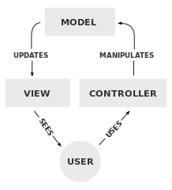
There are other ways…
MVC: Model-View-Controller (1970s)
Model: application state & logic
View: display rendering
Controller: dispatch input from user
http://en.wikipedia.org/wiki/Model-view-controller

Slide 16
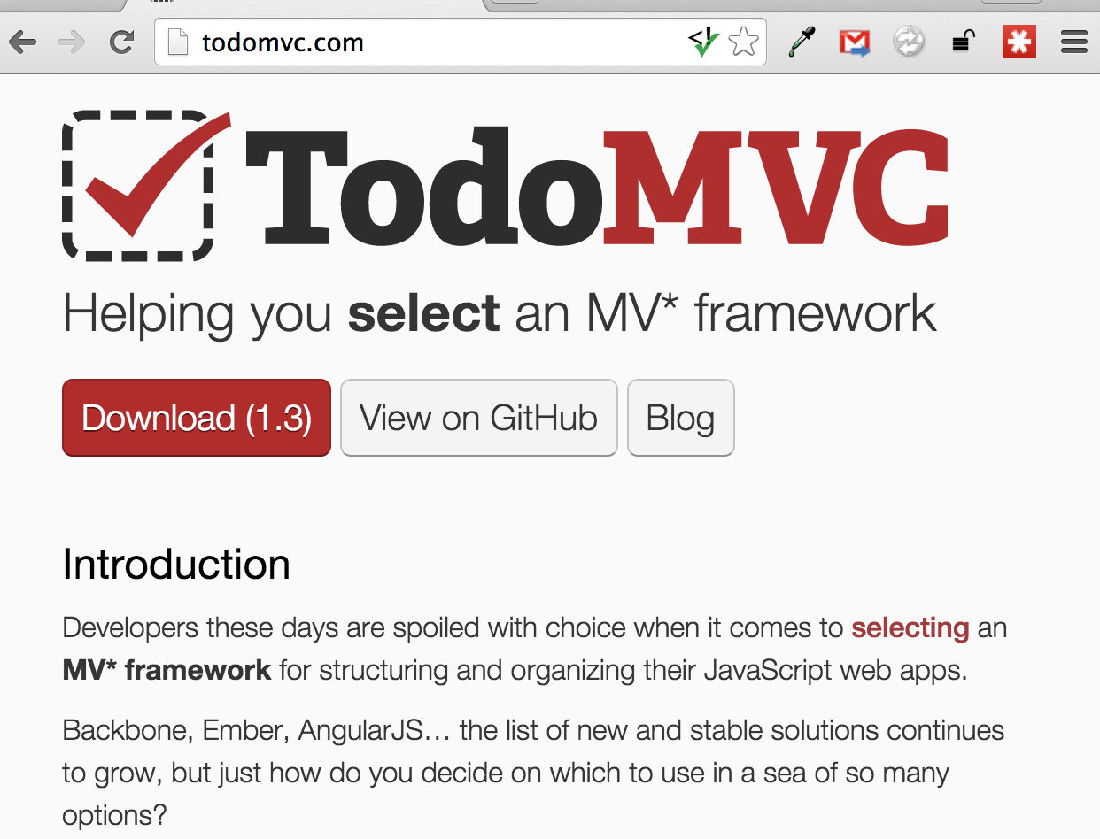
There are other ways…
Modern web development: MV* frameworks

Slide 17
There are other ways…
https://github.com/
https://nodejs.org/
https://www.npmjs.com/
https://www.google.com/#q=javascript+the+good+parts https://developer.mozilla.org/en-US/

Slide 18
Enlightenment from BC
Functional programming concepts
Declarative UI rendering (ReactJS)
Sequential immutable states (ImmutableJS)

Slide 19
Functional programming
Imperative programming with mutable state: fertile ground for bugs
Pure functions behave predictably
JS’s first-class functions support FP
http://en.wikipedia.org/wiki/Functional_programming http://en.wikipedia.org/wiki/Comparison_of_programming_paradigms

Slide 20
FP for dynamic web app?
View:
web page = F(state_{n})
Model/Controller:
state_{n+1} = G(state_{n}, event)

Slide 21
View: Imperative C…
if ((row = sqlNextRow(sr)) != NULL)
{
unsigned scafCount = sqlUnsigned(row[0]);
unsigned totalSize = sqlUnsigned(row[1]);
cgiTableRowEnd();
safef(msg1, sizeof(msg1), "contig/scaffold<BR>count:");
safef(msg2, sizeof(msg2), "total size:");
cgiSimpleTableRowStart();
cgiSimpleTableFieldStart();
puts(msg1);
cgiTableFieldEnd();
cgiSimpleTableFieldStart();
puts(msg2);
cgiTableFieldEnd();
cgiTableRowEnd();
cgiSimpleTableRowStart();
cgiSimpleTableFieldStart();
printLongWithCommas(stdout, scafCount);
cgiTableFieldEnd();
cgiSimpleTableFieldStart();
printLongWithCommas(stdout, totalSize);
cgiTableFieldEnd();
}
cgiTableRowEnd();

Slide 22
… vs. declarative HTML
if ((row = sqlNextRow(sr)) != NULL)
{
unsigned scafCount = sqlUnsigned(row[0]);
unsigned totalSize = sqlUnsigned(row[1]);
cgiTableRowEnd();
safef(msg1, sizeof(msg1), "contig/scaffold<BR>count:");
safef(msg2, sizeof(msg2), "total size:");
cgiSimpleTableRowStart();
cgiSimpleTableFieldStart();
puts(msg1);
cgiTableFieldEnd();
cgiSimpleTableFieldStart();
puts(msg2);
cgiTableFieldEnd();
cgiTableRowEnd();
cgiSimpleTableRowStart();
cgiSimpleTableFieldStart();
printLongWithCommas(stdout, scafCount);
cgiTableFieldEnd();
cgiSimpleTableFieldStart();
printLongWithCommas(stdout, totalSize);
cgiTableFieldEnd();
}
cgiTableRowEnd();
<tr>
<td>contig/scaffold<br />
count:</td>
<td>total size:</td>
</tr>
<tr>
<td>13,563</td>
<td>2,453,304,946</td>
</tr>

Slide 23
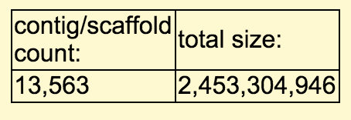
… vs. declarative HTML
if ((row = sqlNextRow(sr)) != NULL)
{
unsigned scafCount = sqlUnsigned(row[0]);
unsigned totalSize = sqlUnsigned(row[1]);
cgiTableRowEnd();
safef(msg1, sizeof(msg1), "contig/scaffold<BR>count:");
safef(msg2, sizeof(msg2), "total size:");
cgiSimpleTableRowStart();
cgiSimpleTableFieldStart();
puts(msg1);
cgiTableFieldEnd();
cgiSimpleTableFieldStart();
puts(msg2);
cgiTableFieldEnd();
cgiTableRowEnd();
cgiSimpleTableRowStart();
cgiSimpleTableFieldStart();
printLongWithCommas(stdout, scafCount);
cgiTableFieldEnd();
cgiSimpleTableFieldStart();
printLongWithCommas(stdout, totalSize);
cgiTableFieldEnd();
}
cgiTableRowEnd();
<tr>
<td>contig/scaffold<br />
count:</td>
<td>total size:</td>
</tr>
<tr>
<td>13,563</td>
<td>2,453,304,946</td>
</tr>

Slide 24
ReactJS: declarative UI done efficiently
View: web page = F(state_{n})
Rebuild entire page with JQuery DOM actions? Too slow!
ReactJS:
Rebuild a data structure of virtual DOM elements
React detects diffs, makes minimal DOM changes
http://facebook.github.io/react/ https://www.youtube.com/watch?v=DgVS-zXgMTk

Slide 25
ReactJS: declarative UI done efficiently
JSX: Javascript in which you can embed this:
<tr>
<td>contig/scaffold<br />
count:</td>
<td>total size:</td>
</tr>
<tr>
<td>{summary.scafCount}</td>
<td>{summary.totalSize}</td>
</tr>

Slide 26
ReactJS: declarative UI done efficiently
JSX: Javascript in which you can embed this:
And make your own components:
<tr>
<td>contig/scaffold<br />
count:</td>
<td>total size:</td>
</tr>
<tr>
<td>{summary.scafCount}</td>
<td>{summary.totalSize}</td>
</tr>
<TableRow valueList={[ scafCountLabel, totalSizeLabel ]} />
<TableRow valueList={[ summary.scafCount, summary.totalSize ]} />
http://jsfiddle.net/sorfx2tp/4/

Slide 27
ReactJS: declarative UI done efficiently
Make your own component
var TableRow = React.createClass({
// Transform a list of values into <tr> with <td> for each value
render: function() {
var cells = this.props.valueList.map(function(value) {
return <td>{value}</td>;
});
return (
<tr> {cells} </tr>
);
}
});
http://jsfiddle.net/sorfx2tp/4/

Slide 28
C writes JSON instead of HTML
(still pretty verbose compared to JS)
if ((row = sqlNextRow(sr)) != NULL)
{
unsigned scafCount = sqlUnsigned(row[0]);
unsigned totalSize = sqlUnsigned(row[1]);
jsonWriteObjectStart(jw, NULL);
jsonWriteListStart(jw, "summaryRow");
jsonWriteString(jw, “scafCount”, printLongWithCommas(stdout, scafCount));
jsonWriteString(jw, “totalSize”, printLongWithCommas(stdout, totalSize));
jsonWriteListEnd(jw);
jsonWriteObjectEnd();
}
{ summary: { scafCount: commify(scafCount),
totalSize: commify(totalSize)
}
}

Slide 29
What kind of Model for React View?
Model/Controller:
state_{n+1} = G(state_{n}, event)
Make a completely new copy of state every time? Inefficient!
ImmutableJS: efficient implementation of immutable data structures

Slide 30
ReactJS + immutable state
Functional programming style
Efficiency
Easy undo/redo!
https://www.youtube.com/watch?v=DMtwq3QtddY

Slide 31
New javascript code
New subdirectories of kent/src/hg/js/
external/: open source libs
react/
lib/
plugins/
hgAi/
bundle/
model/
lib/
hgAi/

Slide 32
New lib for CGI as JSON backend
hg/lib/cartJson.c
struct cartJson *cj = cartJsonNew(cart);
cartJsonRegisterHandler(cj, "getFields", getFields);
cartJsonExecute(cj);
JS sends a JSON command to CGI like this:
{ getFields: { tables: “knownGene,snp142” } }
CGI returns JSON response:
{ tableFields: { knownGene: [ ‘name’, ‘chrom’, ‘strand’, … ], snp142: …

Slide 33
New dev dependencies
node
jsx
jsxhint
uglifyjs

Slide 34
New types of bugs
Responses arriving late / out of sync
Developer forgetting to commit compiled JSX
git commit hook?

Slide 35
Thanks!
Ann, b0b, Jim
Brian Craft
Kate Rosenbloom
Jonathan Casper, Matt Speir
Genome Browser Group

