Slide 1
Data Management for
the First 1,000,000 Human Genomes
Andreas Sundquist, Ph.D.
CEO and Co-founder

Slide 2
Company origin
Founded 2009
Andreas Sundquist, PhD Stanford Computer Science
Serafim Batzoglou, PhD Stanford Professor Computer Science
Arend Sidow, PhD Stanford Professor Genetics & Pathology
Mission
Enable faster, more cost-effective, and simpler genomic data management and analysis

Slide 3
Sequencing trends
Data throughput
Throughput
1970s First DNA sequencing methods
1990 - 2003 Human Genome Project, ABI dominance 0.001 GB/day
2005 “Next-gen” Roche (454) GS20 0.1 GB/day
2006 Illumina (Solexa) GA 0.5 GB/day
2007 ABI (Agencourt) SOLiD 1.0 GB/day
2010 Illumina HiSeq 2000 25.0 GB/day
2011 Illumina HiSeq 2000 75.0 GB/day
Sequencing technology platforms
Dominant Illumina, Life Technologies ABI, Roche
Launched Complete Genomics, Pacific Biosciences, Ion Torrent Systems
Development Oxford Nanopore, NABsys, Halcyon, GnuBio, CrackerBio, IBM, …

Slide 4
Sequencing trends
Cost reduction
Analysis
Sequencing
Sequencing
Throughput 10× GB/day = 2 years
Cost 10× GB/$ = 2 years
Moore’s law
Performance 2× $/CPU = 2 years

Slide 5
2014: 1,000,000 human genomes
1 human genome
10
CPU-weeks Cloudburst (RMAP)
3 – 5
CPU-weeks Crossbow (Bowtie)
3 – 5
CPU-weeks DNAnexus
0.05 – 0.1
CPU-years
× 1,000,000
genomes
50 – 100,000
CPU-years

Slide 6
2014: 1,000,000 human genomes
3
Gbp / genome
× 30
coverage (diploid)
100
Gbp sequence data
× 10
bytes/bp (analysis)
1
Terabyte
× 1,000,000
genomes
1
Exabyte (1,000 Petabytes)

Slide 7
HiSeq 2000 run
data output =
200 GB
(soon
600 GB)

Slide 8
HiSeq 2000 run
information output =
?

Slide 9
mRNA-seq
30,000
transcripts
× 1
value (RPKM)
30,000
values ≈ 0.1 Megabytes
× 100
experiments (multiplexed)
3 million
values ≈ 10 Megabytes

Slide 10
ChIP-seq
10,000
loci
× 5
values (coords, enrich, p-value, gene)
50,000
values ≈ 0.2 Megabytes
× 100
experiments (multiplexed)
5 million
values ≈ 20 Megabytes

Slide 11
Human variation
3
million SNPs
+ 7
Megabases other variation
10
Megabases ≈ 10 Megabytes
× 2
genomes (100 GB each)
20
Megabytes

Slide 12
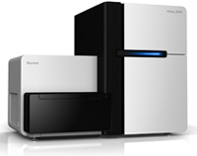
run
year
image data
32 TB
1.5 PB
sequence data
200 GB
10 TB
biology
20 MB
1 GB

Slide 13
Researchers need to be freed from working with raw sequence data

Slide 14
Web application
Web 2.0
Gmail
“Cloud Computing”
Grid computing
= ?
Cluster
Private cloud
Data center
Google
Amazon
Microsoft

Slide 15
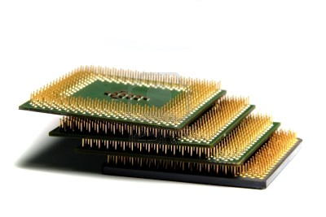
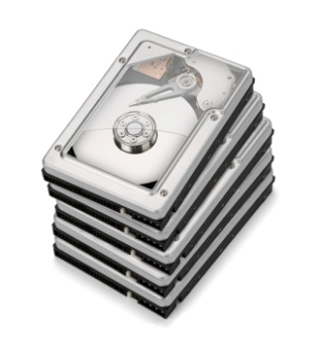
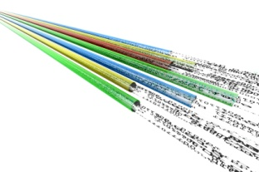
Externalizing data center operations
+
Elastic/utility compute, storage, network
“Cloud Computing”
=
⇐

Slide 16
Cloud computing
Migration challenges
Setting up cloud environment
Tools may not immediately work (Hadoop use rare)
Data persistence
Managing resource usage (turning lights on/off)
Data transfer
Security
Cloud ≠ Publicly accessible
Huge investment in physical and computing security
Employ data encryption, network firewalls, authentication, …

Slide 17
Cloud computing
biology
Data transfer
10 MB/sample
CPU
CPU
Storage
Storage
Storage
Storage
CPU
CPU
Gbps
Storage
Storage
CPU
CPU
100 Mbps
Genome center
50 HiSeq 2000
2 Mbps
HiSeq 2000

Slide 18
Cloud computing
1 genome
Elasticity
1 day
8 node server
CPU
CPU
CPU
CPU
CPU
CPU
CPU
CPU
1 day
1 day
1 day
1 day
1 day
1 day
1 day
1 day
1 day
Cloud
CPU
CPU
CPU
CPU
CPU
CPU
CPU
CPU
1 day
1 day
1 day
1 day
1 day
1 day
1 day
1 day
1 day

Slide 19
1,000 genomes
1 day
1 day
8 node server
CPU
CPU
CPU
CPU
CPU
CPU
CPU
CPU
1000 days
Cloud
CPU
1 day
1 day

Slide 20
Cloud computing
Scalability
Year | # genomes | $/genome | Raw DNA | CPUs
1990 | 0
2000 | 1 | $3,000,000,000
2010 | 1,000 | $10,000 | 100 Terabytes | 100
2014 | 1,000,000 | $100 | 100 Petabytes | 100,000

Slide 21
Cloud computing is practical today and will scale well into the future

Slide 22
Company origin
Founded 2009
Andreas Sundquist Stanford Computer Science
Serafim Batzoglou Stanford Professor Computer Science
Arend Sidow Stanford Professor Genetics & Pathology
Mission
Enable faster, more cost-effective, and simpler genomic data management and analysis
dnanexus.com
Sequencing facility: Off-load sequence data management and analysis
Researcher: Data management, analysis, visualization
Web-based (no software install)
Cloud infrastructure (no hardware purchase)
Illumina GAII/HiSeq, LifeTech SOLiD, Complete Genomics support

Slide 23
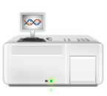
dnanexus.com
System overview
Sequencing core
Automated upload
Integrated browser
Data sharing
raw DNA
$5 / Gigabase
Data QC
Mapping
RNA-seq
ChIP-seq
SNP/indel
Exome
Tumor-normal
Analysis results
raw DNA
$20 / Gigabase
raw DNA
Server
Researcher

Slide 24
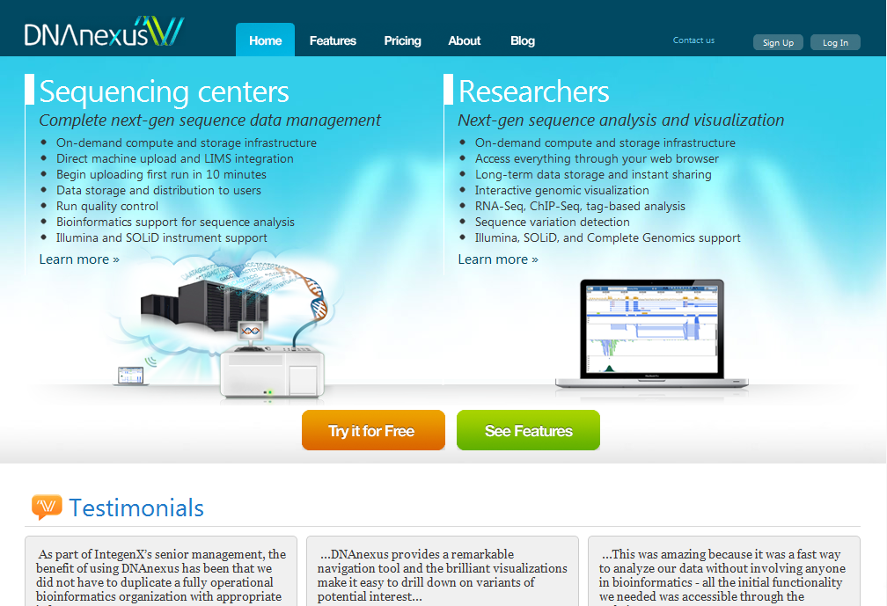
http://dnanexus.com

Slide 25
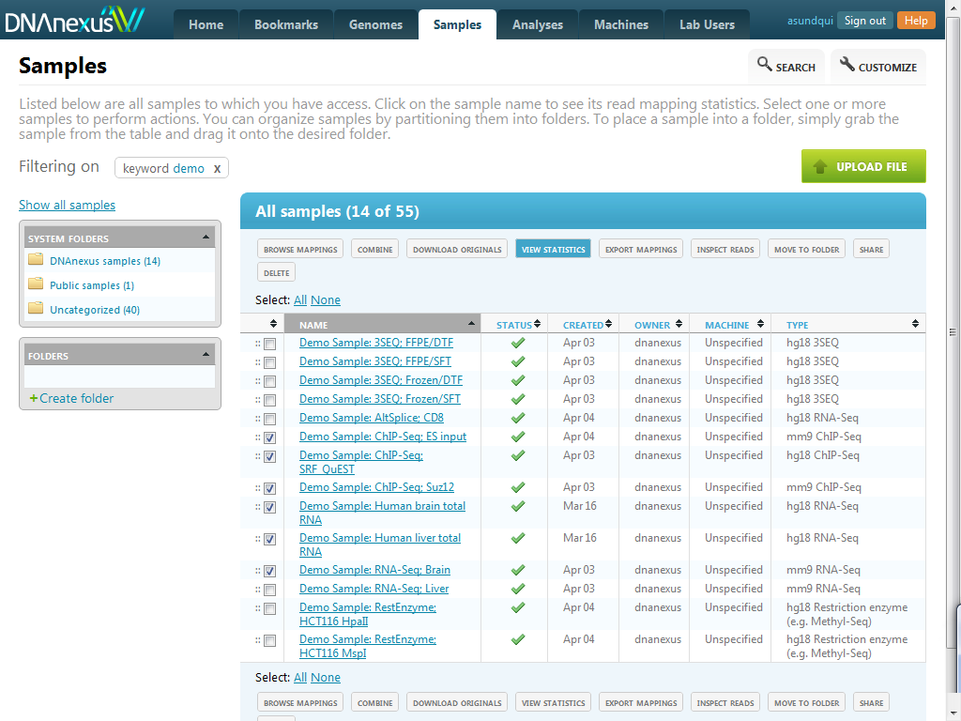

Slide 26
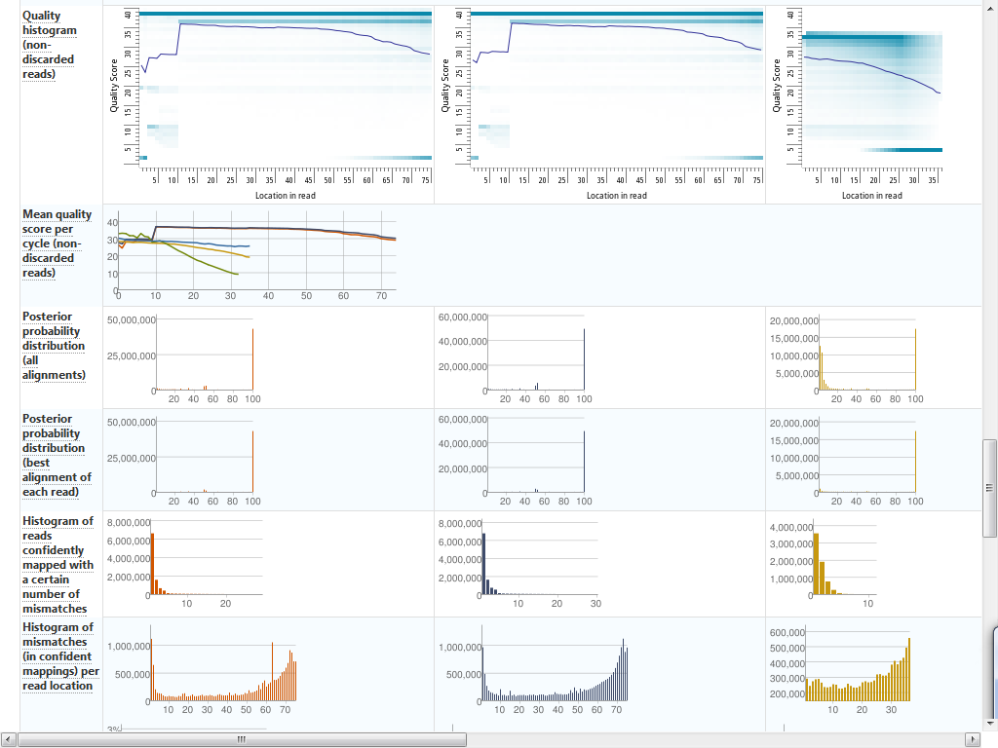

Slide 27
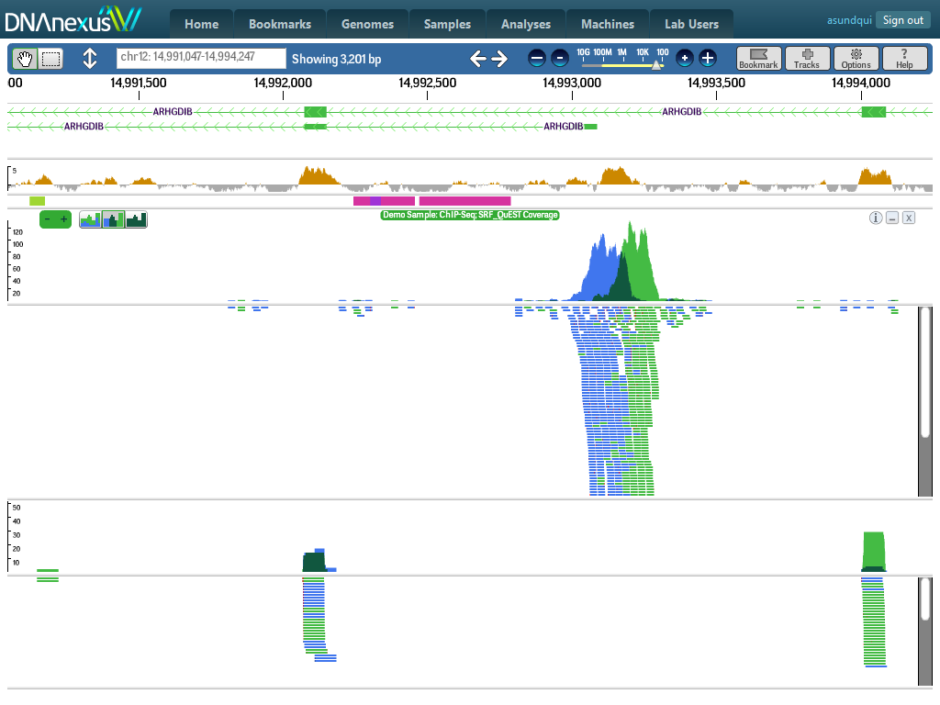

Slide 28
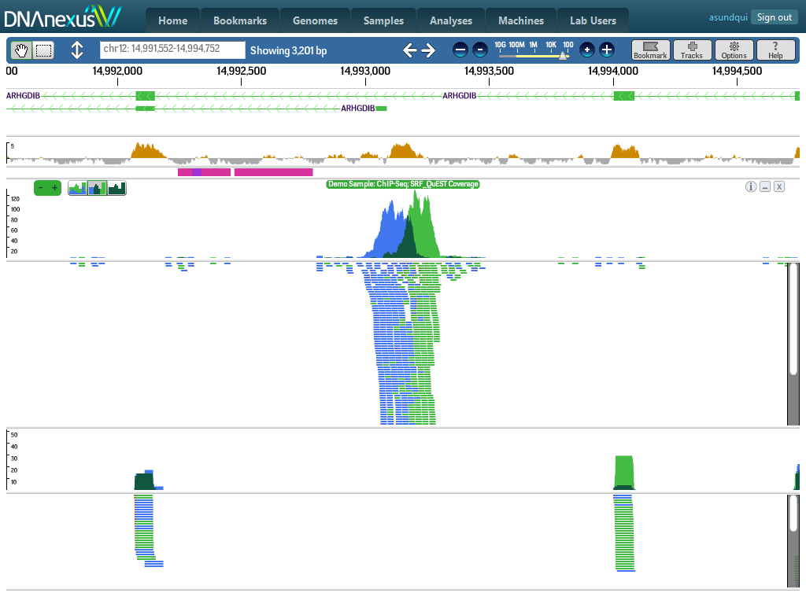

Slide 29
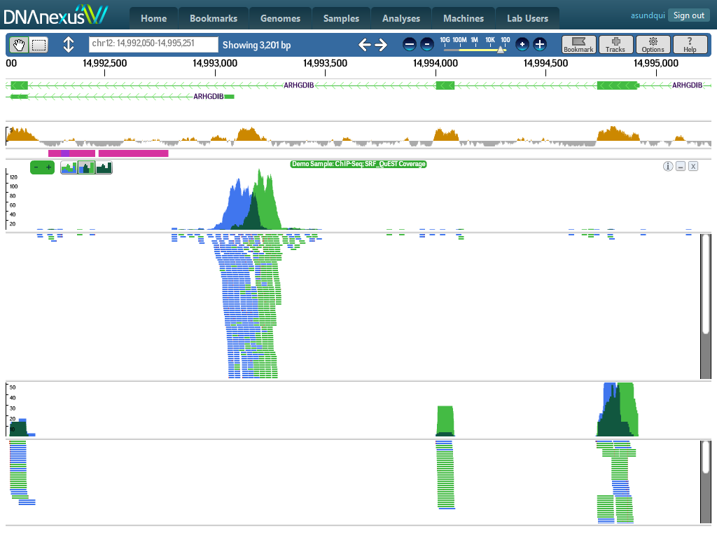

Slide 30
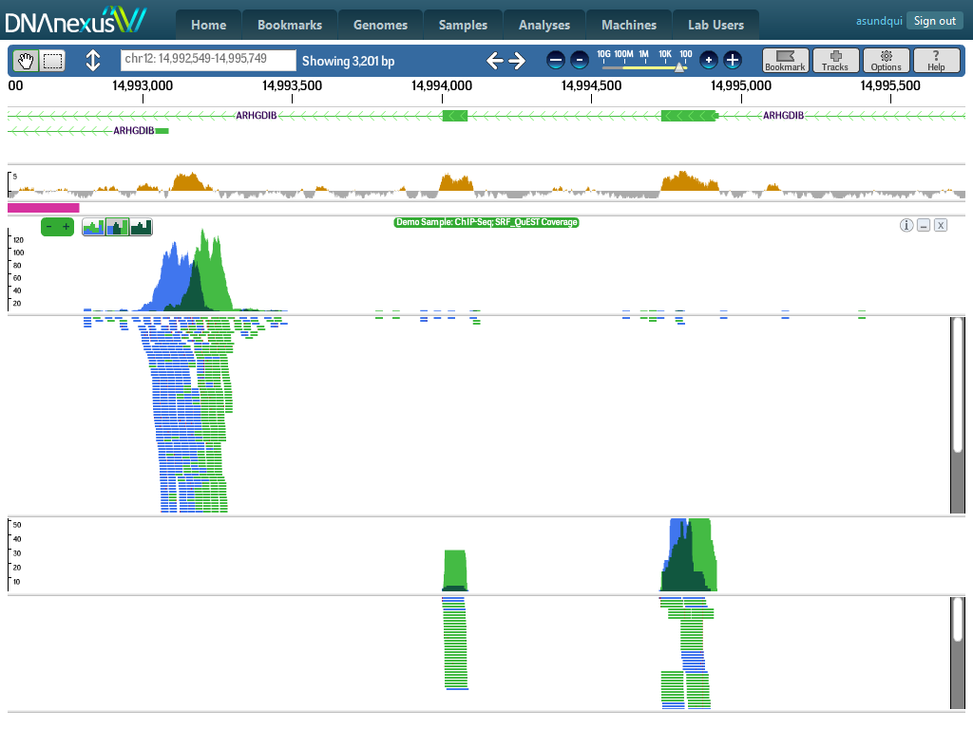

Slide 31
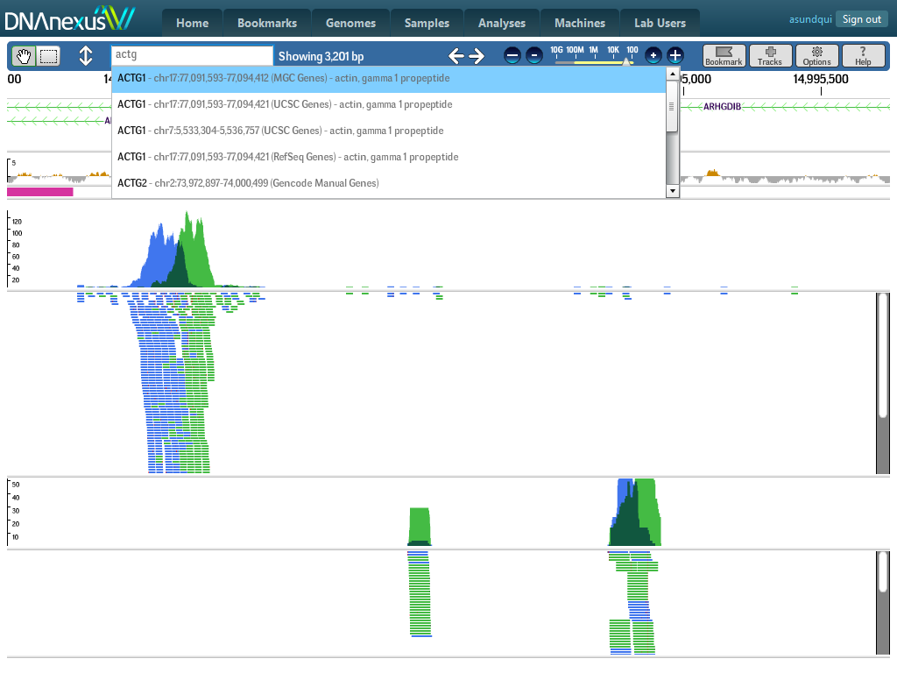

Slide 32
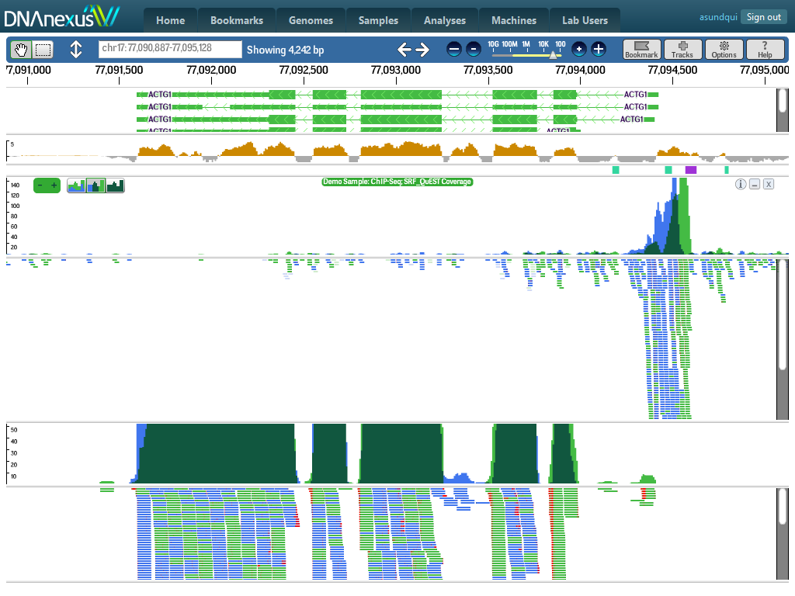

Slide 33
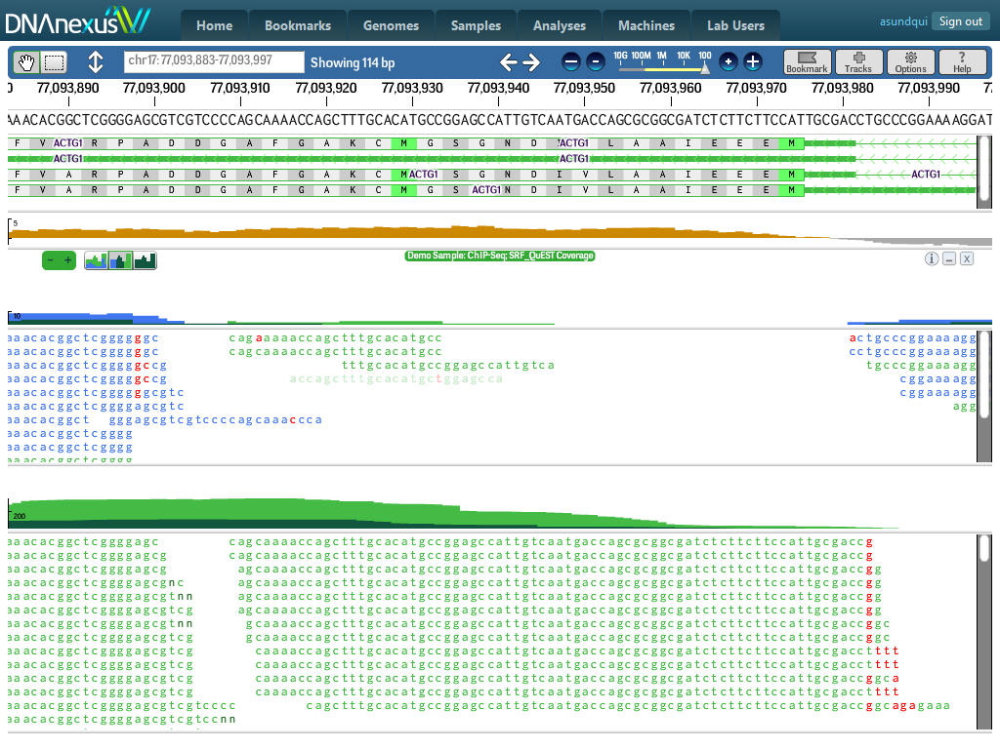

Slide 34
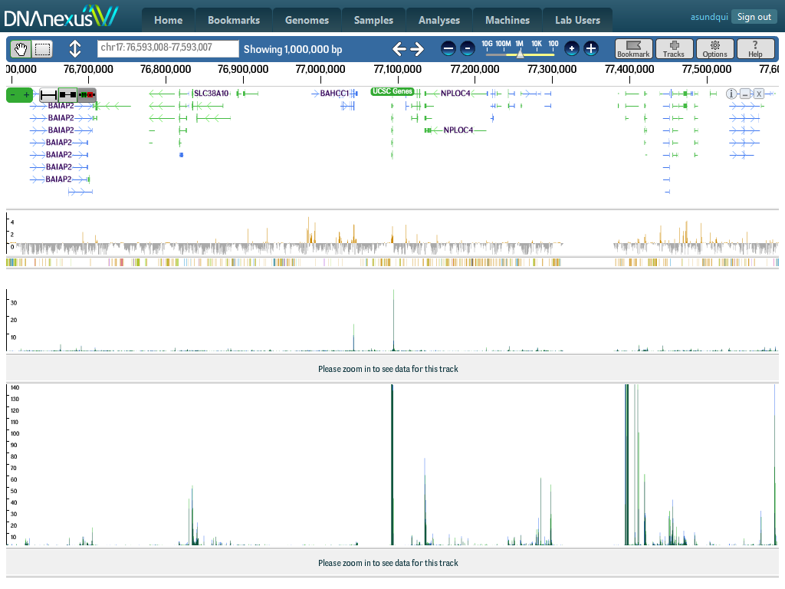

Slide 35
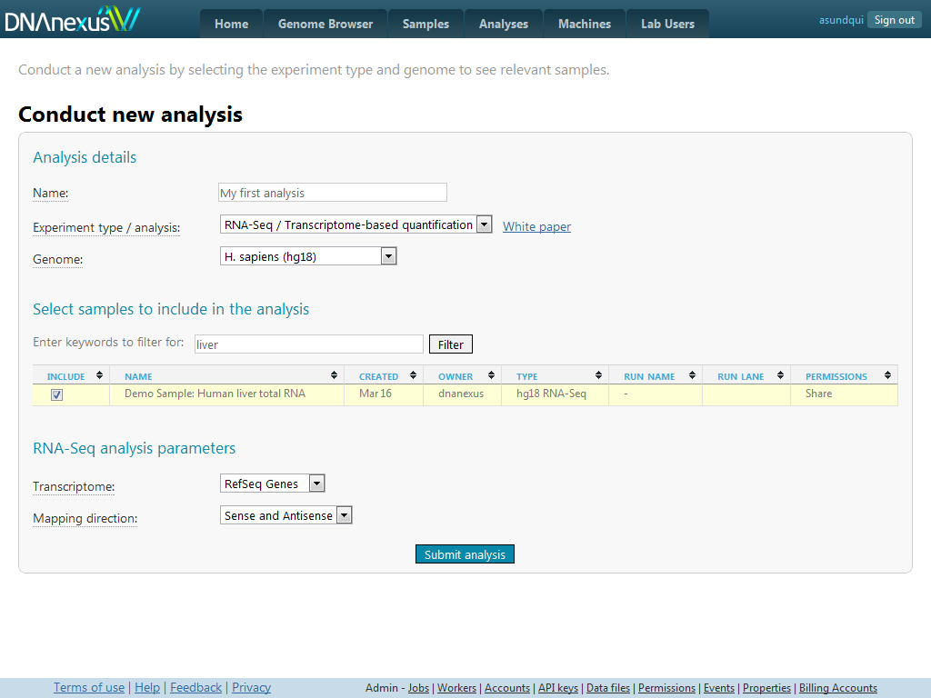

Slide 36
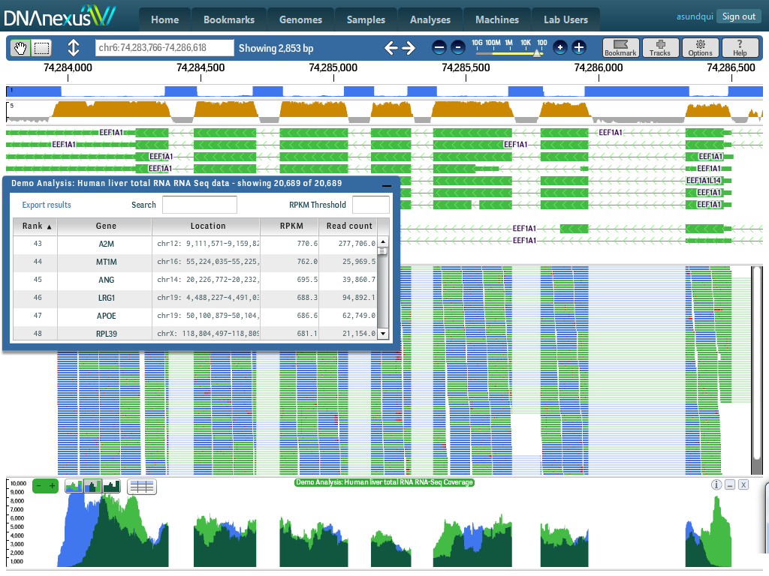

Slide 37
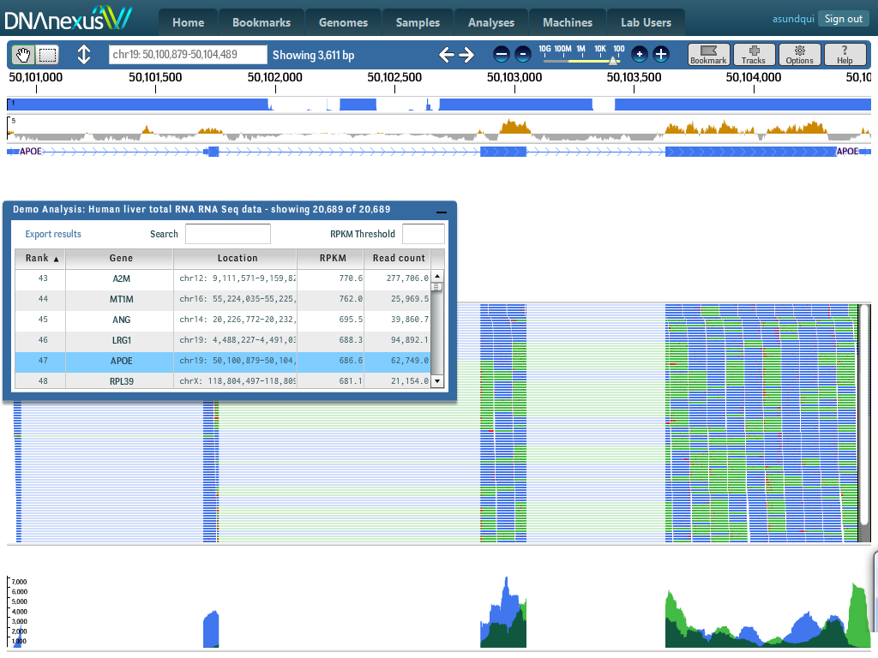

Slide 38
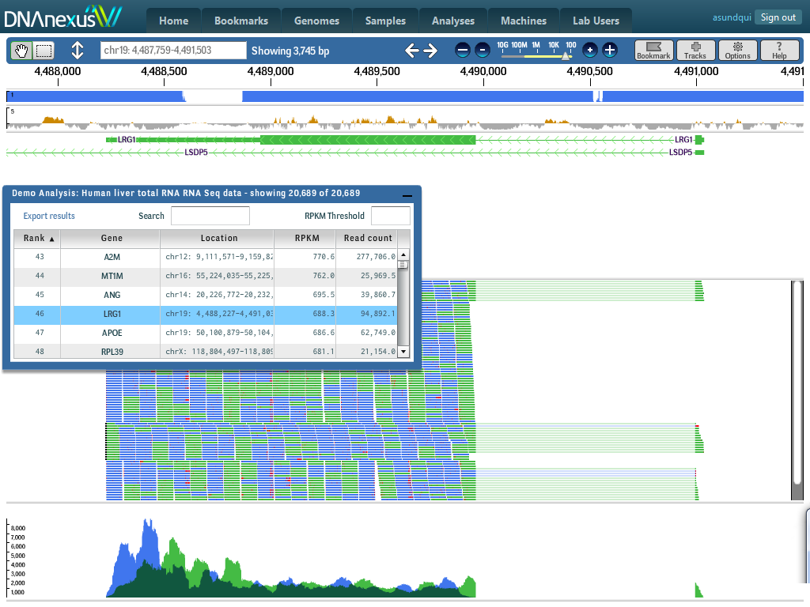

Slide 39
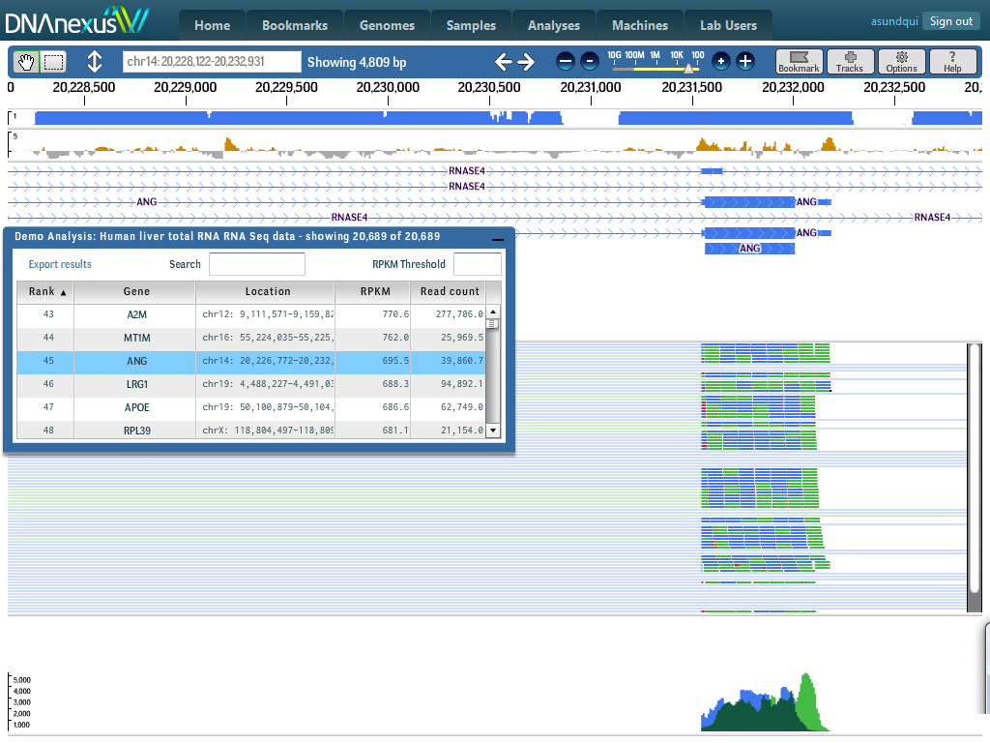

Slide 40
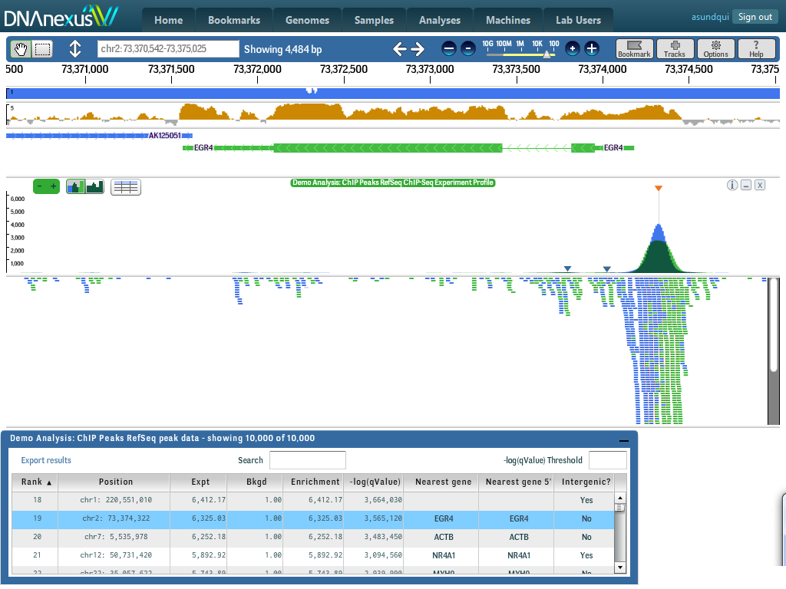

Slide 41
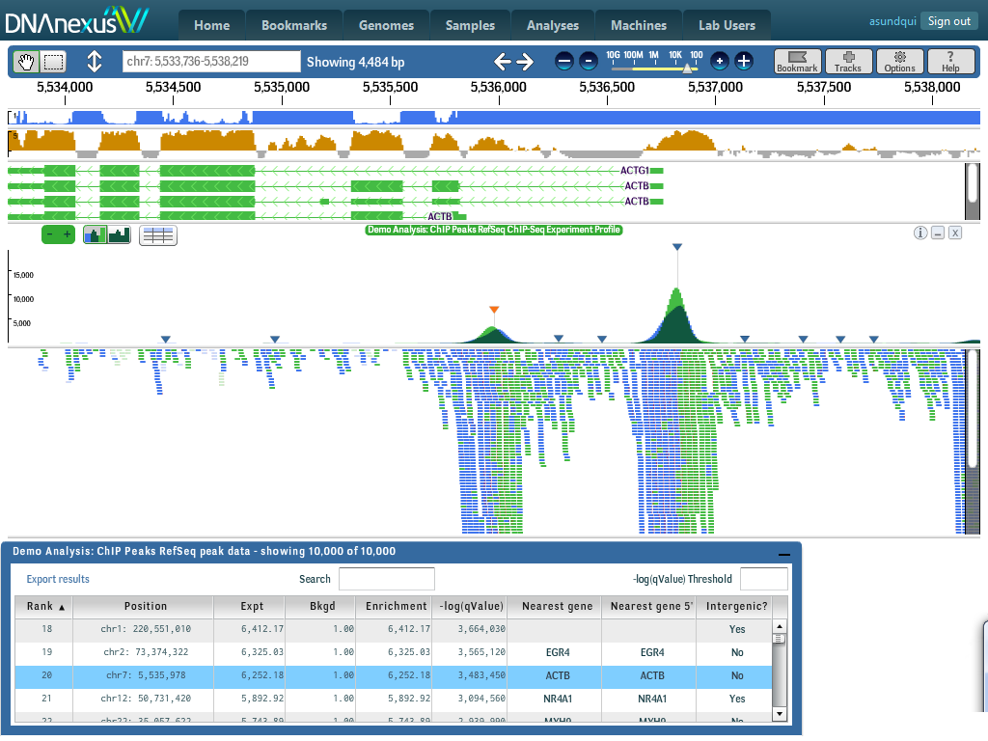

Slide 42
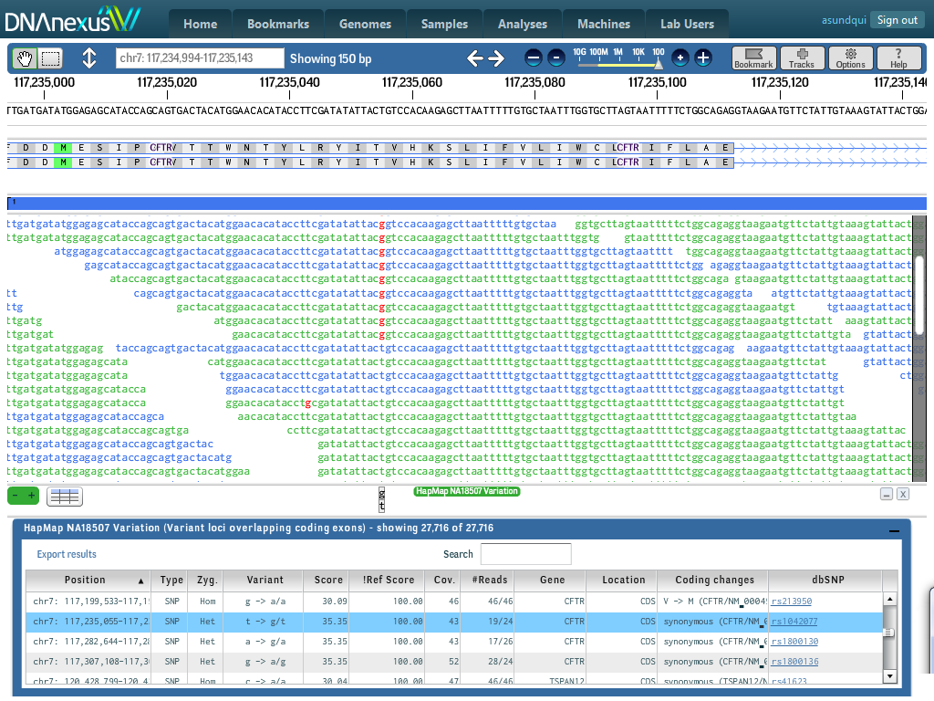

Slide 43
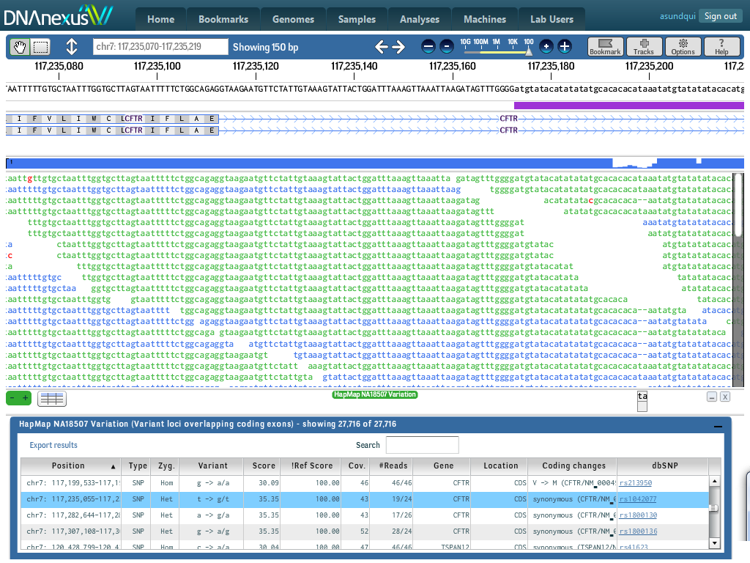

Slide 44
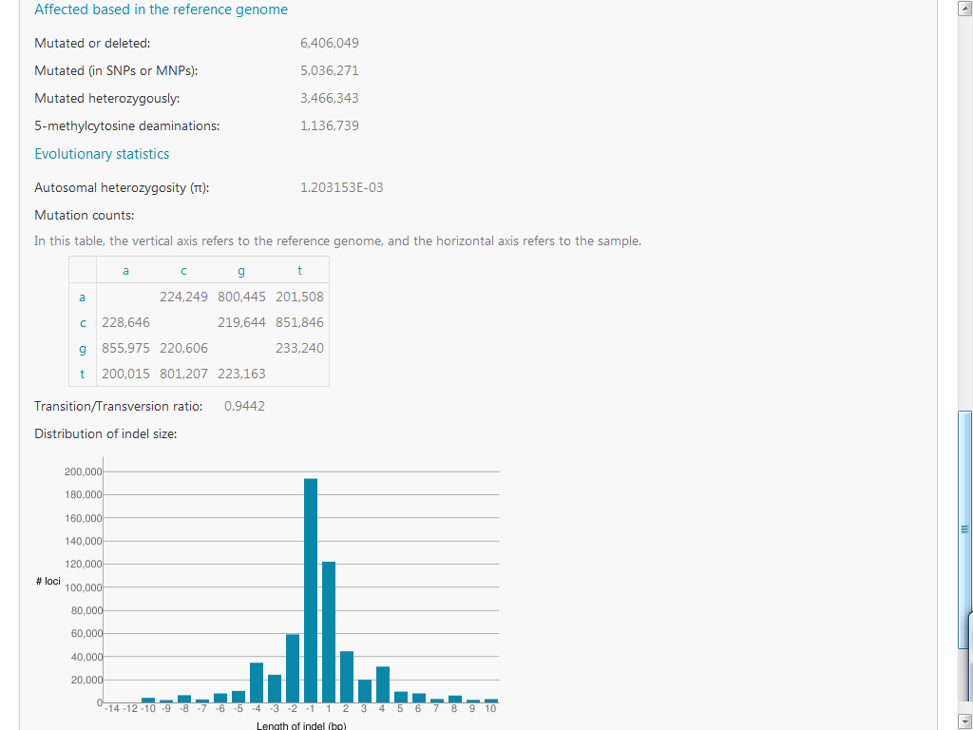

Slide 45
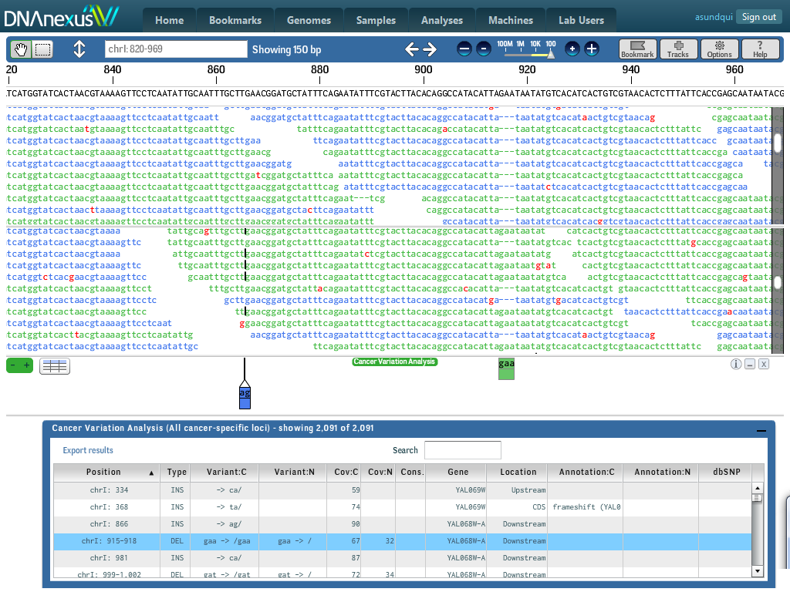

Slide 46
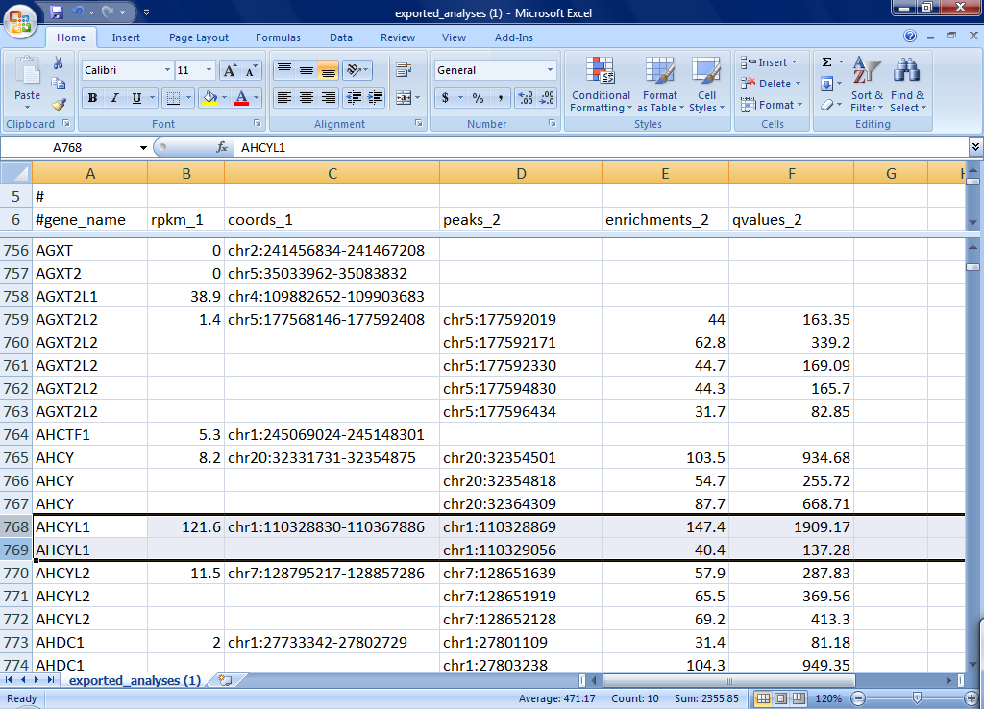

Slide 47
Future directions
Analyses
Build out analysis features
Integrate requested tools, Improve interoperability
Platform support: Pac Bio, Ion Torrent, future tech
Cost + scale
Continue reducing cost to users
Increase scale
Collaboration
Promote public data sharing and collaboration
Goals
Vibrant community of genomics users, data, + tools
First to manage + analyze 1 million human genomes

Slide 48
Recap
Researchers need to be freed from working with raw sequence data
Cloud computing is practical today and will scale well into the future
Give DNAnexus a try! Tell us how we can improve

Slide 49
Thank you
UCSC, Genome Sequencing Center, Dr. Pourmand
NIH/NHGRI grant HG005794-01
our investors
DNAnexus team
Stanford University

Slide 50
Q & A
Andreas Sundquist
andreas@dnanexus.com
http://dnanexus.com
We’re hiring!
http://dnanexus.com/careers

