Slide 1


Contributed annotation tracks to the UCSC genome browser
Hiram Clawson – U.C. Santa Cruz Genomics Institute - hclawson@ucsc.edu
PAG 2026, Monday 12 January 2026 7:30 PM
Copy of this presentation:
https://bit.ly/4pJimVB
Notes:
PAG 2026, Monday 12 January 2026 19:30 – Contributed annotation tracks to the UCSC genome browser – Hiram Clawson – U.C. Santa Cruz Genomics Institute

Slide 2
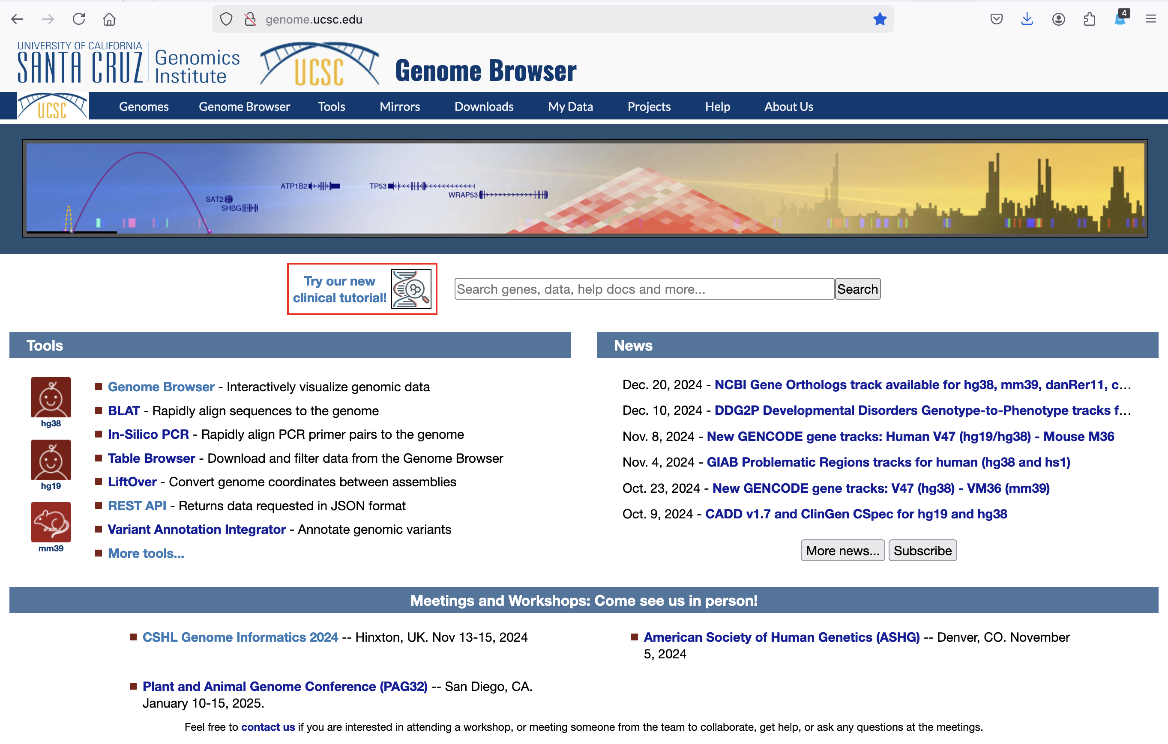
UCSC Genome Browser ‘home’ page
Use the blue
navigation bar
Click on ‘Genomes’ to get to the gateway page
https://genome.ucsc.edu/
Notes:
U.C. Santa Cruz genome browser home page: https://genome.ucsc.edu/ - best to use the blue navigation bar to move around the various tool sets. Going to ‘genomes’ will get to the ‘gateway’ page.

Slide 3
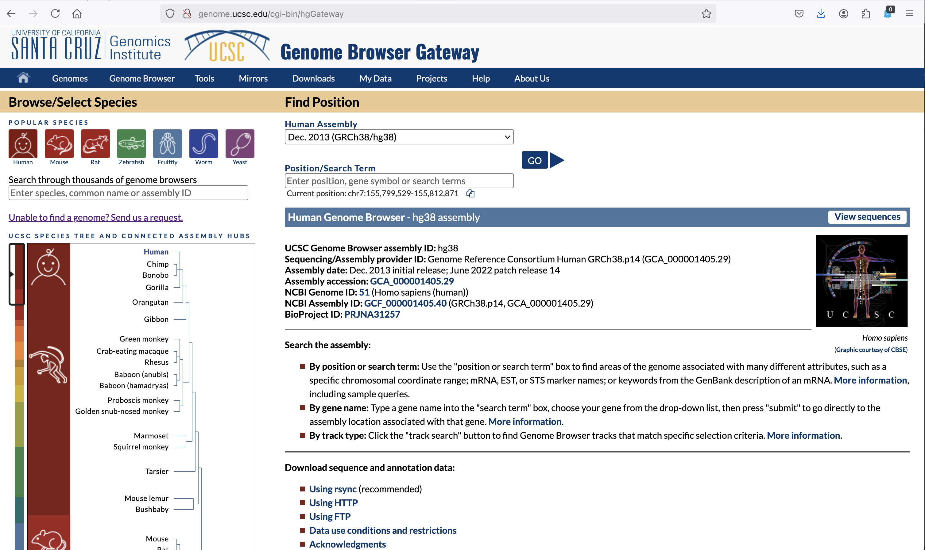
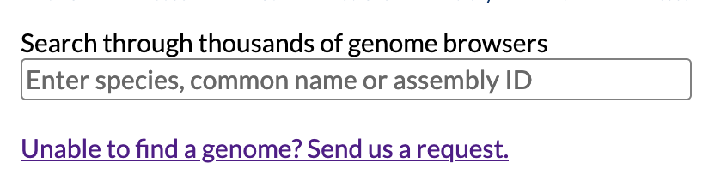
Find assemblies on the ‘gateway’ page
https://genome.ucsc.edu/cgi-bin/hgGateway
! ! !
Note the search
form entry
Text search, any
word, case
insensitive
Phylo tree selection to be phased out, does not work with so many assemblies.
Finding genomes in the browser, use the search form on the gateway page.
Notes:
On the ‘gateway’ page, note the search box prompt: “Enter species, common name or assembly ID” – it is a text search for any word. Implemented as a MySQL full text search. Use the ‘Send us a request’ to add and assembly of interest that is not yet in the UCSC browser. The phylogenetic tree diagram selector is obsolete with the large number of assemblies in the system at this time. Future revisions will have a single mechanism to find an assembly in the system.

Slide 4
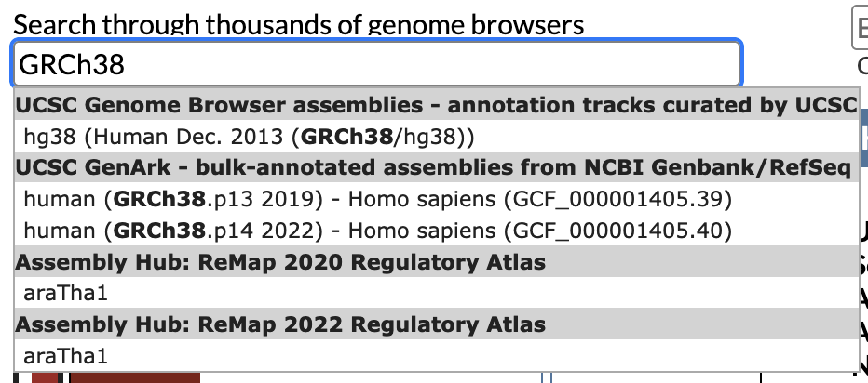
Finding genome assemblies at UCSC
Single word search:
For example, an assembly name
Click on item to display in browser
Unique words: few match results
Notes:
Single words when matched exactly

Slide 5
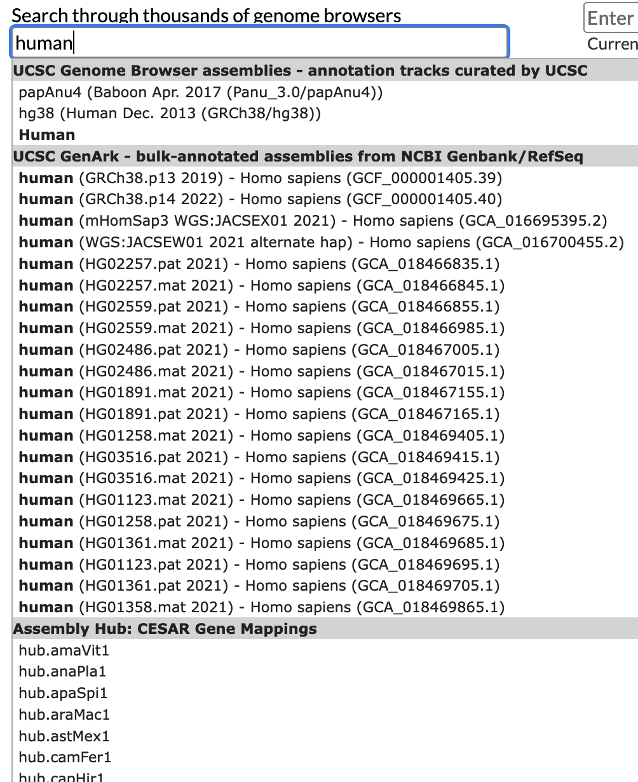
Common words, limited number results e.g.: ‘human’
Browsers with annotated tracks, curated by UCSC
Automated annotations on NCBI GenBank/RefSeq
There is an ordering to the results,
the ‘important’
assemblies should be first.
External assembly hubs from third party contributors
Notes:
Common words could have a large number of matches, the display will be a limited number from the full match set. The implicit ordering should show the more ‘important’ assemblies first.

Slide 6
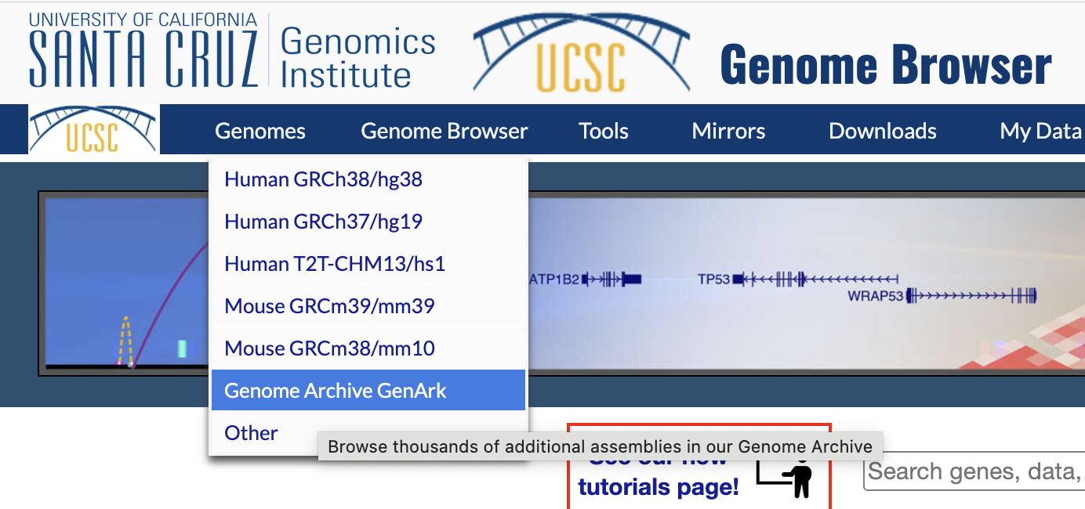
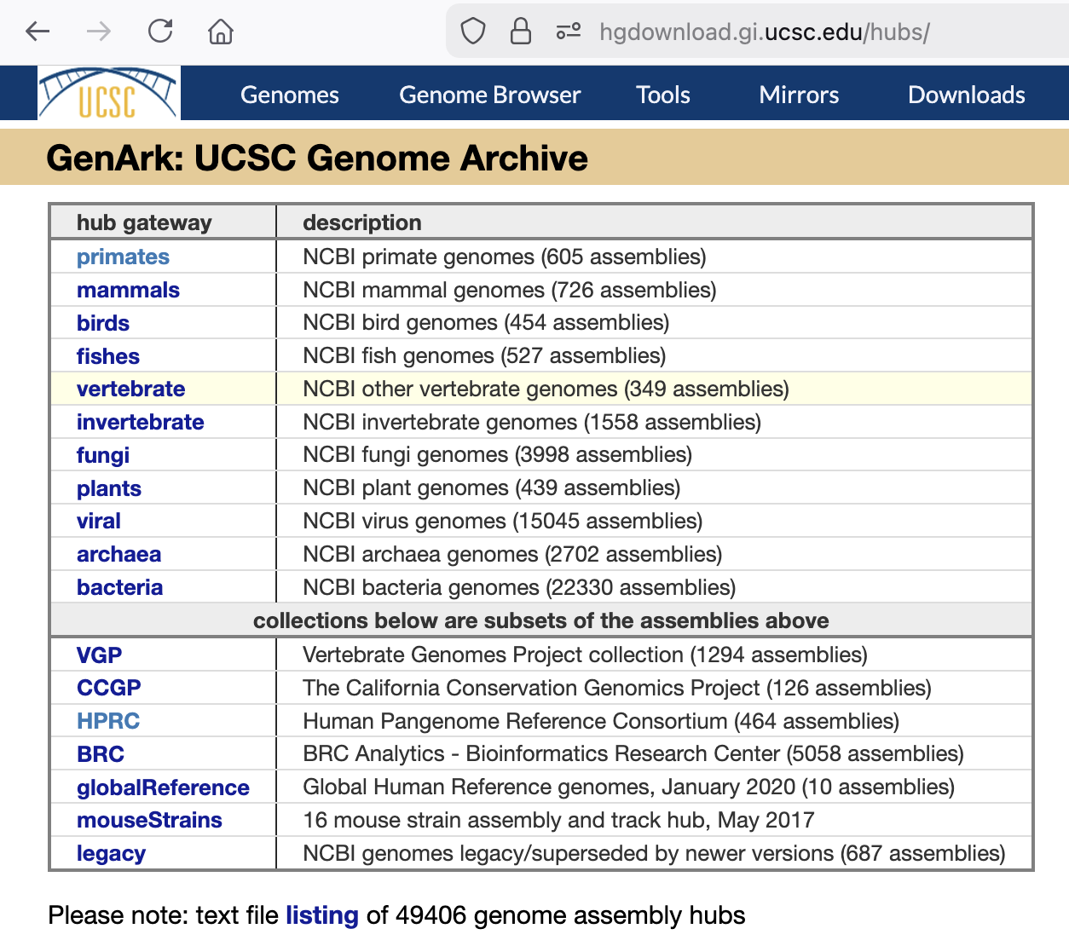

Over 49,000 assemblies in the UCSC Browser
https://hgdownload.gi.ucsc.edu/hubs/
What is GenArk: All NCBI ‘RefSeq’ assemblies classified as "reference” or “representative”, and ‘GenBank’ assemblies as requested or in specialized projects.
‘JBrowse’ and ‘IGV’ browsers can display these assemblies. And:
Notes:
GenArk are all NCBI RefSeq assemblies classified as ‘reference’ or ‘representative’, plus ‘GenBank assemblies as requested by users or are in specialized projects such as VGP – The Vertebrate Genome Project.

Slide 7
GenArk increase in assembly counts 2025 to 2026
GenArk group | 2025 | 2026 | % increase
archaea | 2 | 2,702 | 135,000
bacteria | 111 | 22,330 | 20,017
birds | 399 | 454 | 13.8
fishes | 426 | 527 | 23.7
fungi | 918 | 3,998 | 335.5
invertebrate | 1,114 | 1,558 | 39.9
mammals | 608 | 726 | 19.4
plants | 306 | 439 | 43.5
primates | 221 | 605 | 173.8
vertebrate | 280 | 349 | 24.6
viral | 288 | 15,045 | 5,124
legacy | 527 | 687 | 30.4
totals | 5,200 | 49,420 | 850.4
Notes:
2026 started to better support archaea, bacteria and viral assemblies. Fungi increased a lot with the BRC project, and the primates increase with the addition of HPRC project assemblies.

Slide 8
GenArk increase in annotation track counts 2025 to 2026
GenArk group | 2025 | 2026 | % increase
archaea | 20 | 28,786 | 143,830
bacteria | 1,146 | 237,649 | 20,637
birds | 6,627 | 7,527 | 13.6
fishes | 7,556 | 9.156 | 21.2
fungi | 15,792 | 59,273 | 275.3
invertebrate | 18,674 | 25,436 | 36.2
mammals | 11,935 | 14,014 | 17.4
plants | 5,586 | 7,548 | 35.1
primates | 4,776 | 9,258 | 93.8
vertebrate | 4,666 | 5,785 | 24.0
viral | 2,693 | 140,599 | 5,121
legacy | 9,860 | 12,928 | 31.1
totals | 89,331 | 557,959 | 524.6
Typical tracks: RepeatMasker, TRF/simpleRepeats, WindowMasker,
GC percent, NCBI RefSeq genes, CpG Islands, and soon ‘contributed’
Notes:
2026 started to better support archaea, bacteria and viral assemblies. Fungi increased a lot with the BRC project, and the primates increase with the addition of HPRC project assemblies.

Slide 9
Your custom annotations in the UCSC browser
https://hgdownload.gi.ucsc.edu/hubs/
Researchers are creating annotations for hundreds of assemblies in one process.
Or: creating a number of annotations for one assembly.
You want to submit these annotations for local hosting at UCSC.
Notes:
Statement of the issue at hand. Thousands of assemblies, annotation pipelines producing annotations for hundreds of assemblies in one process. Submitting those tracks to UCSC for inclusion in the browser. https://hgdownload.gi.ucsc.edu/hubs/

Slide 10
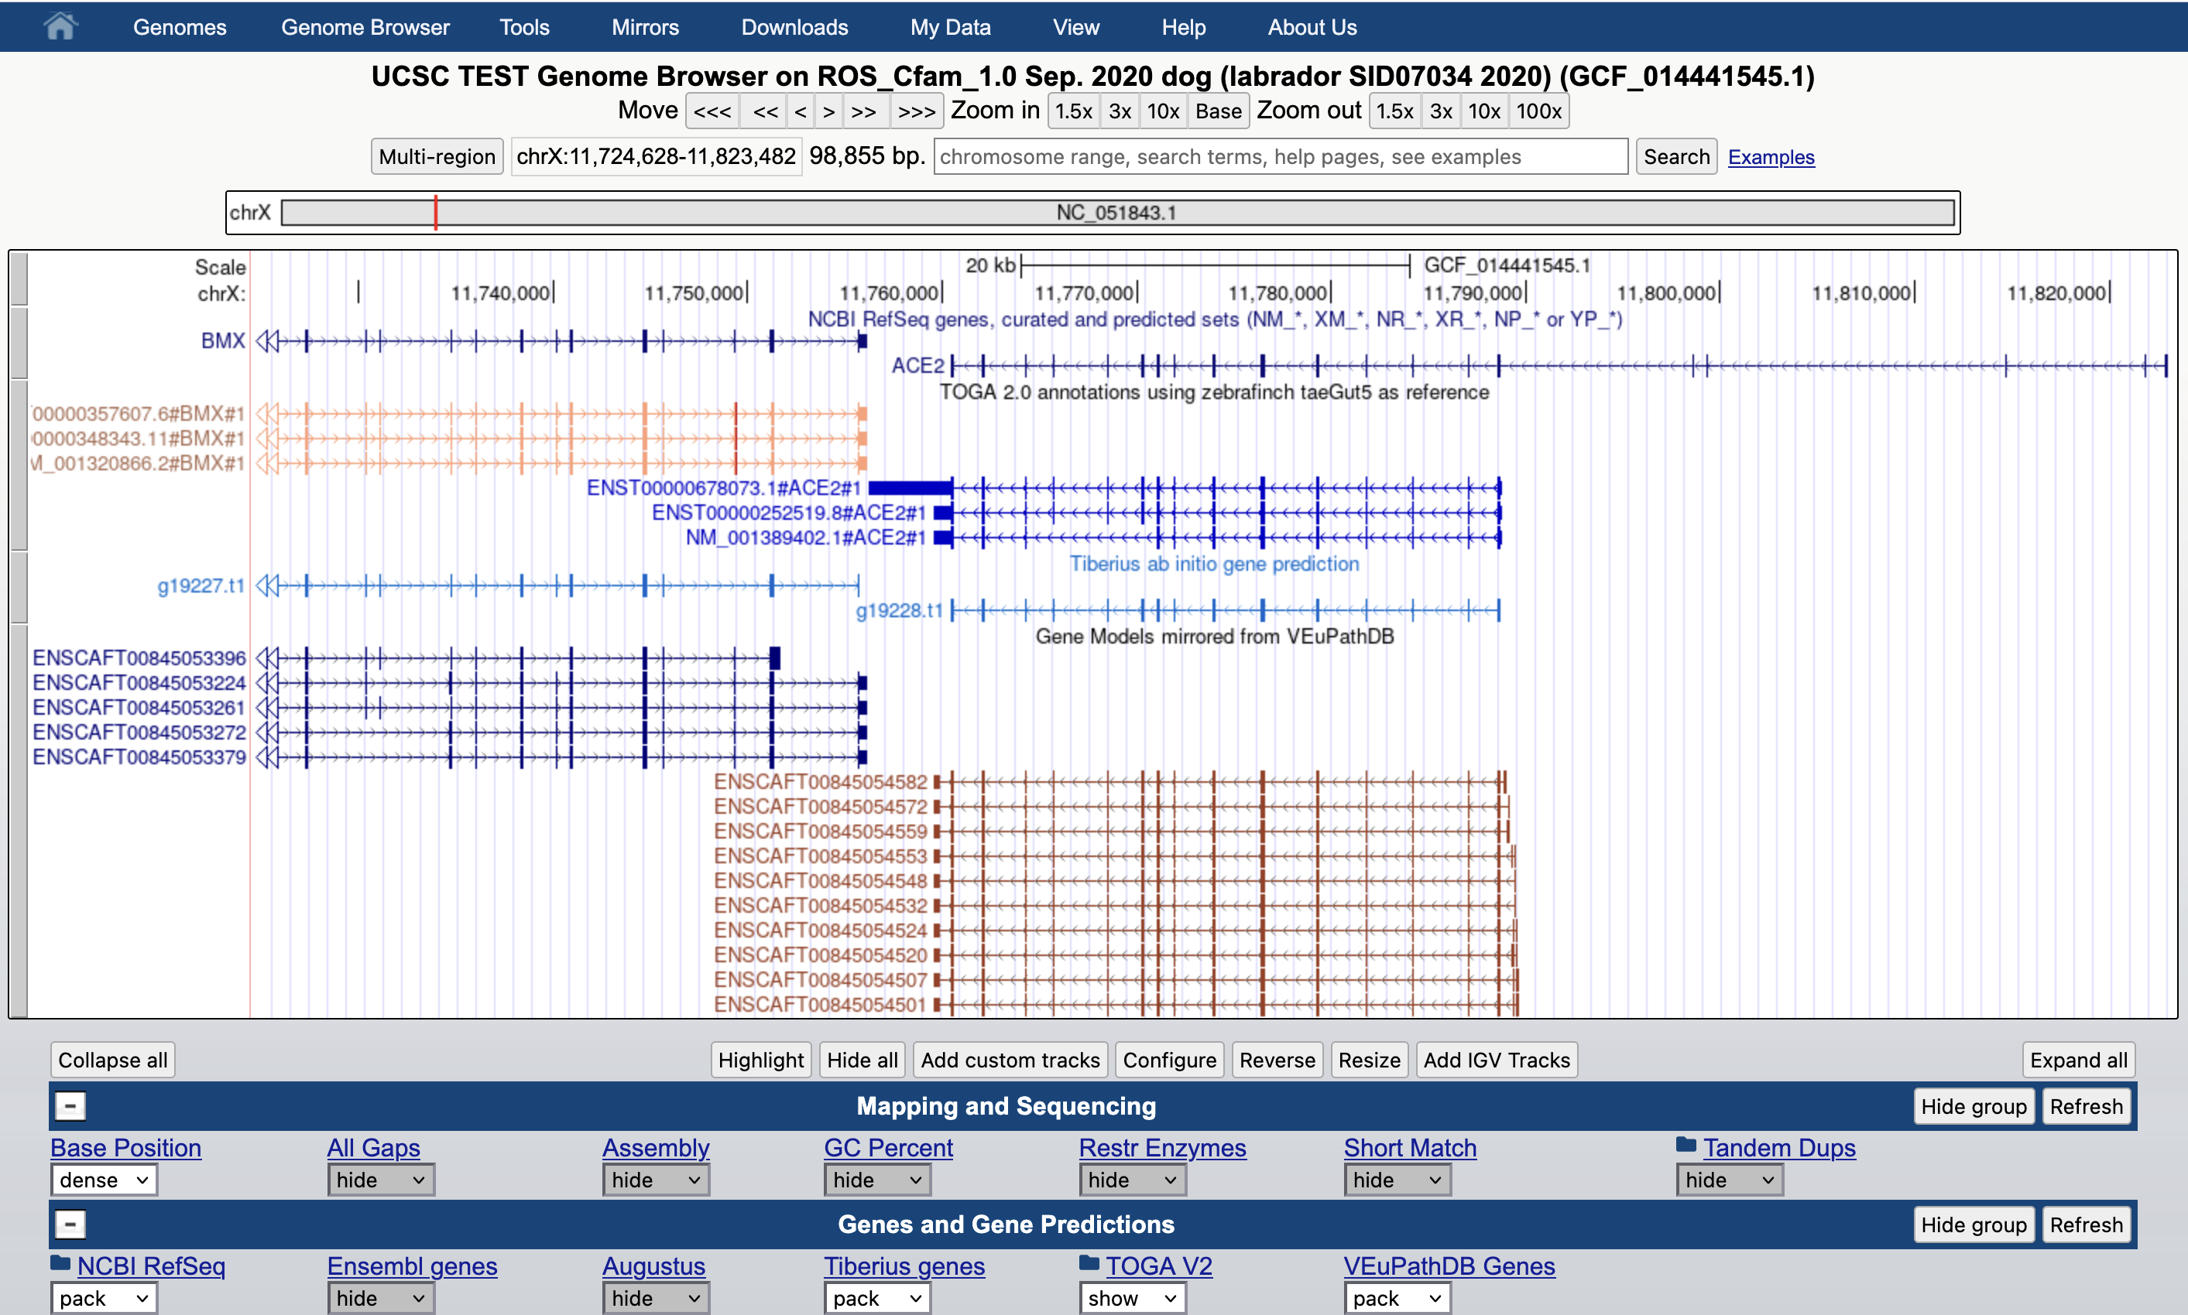
For example: TOGAv2, Tiberius, VEuPathDB annotations:
Notes:
Several example tracks developed externally from UCSC, hosted within the browser infrastructure. These same tracks are on hundreds of assemblies.

Slide 11
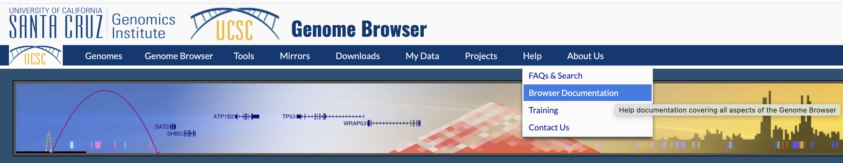
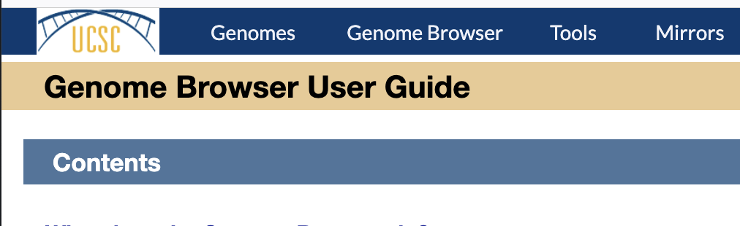
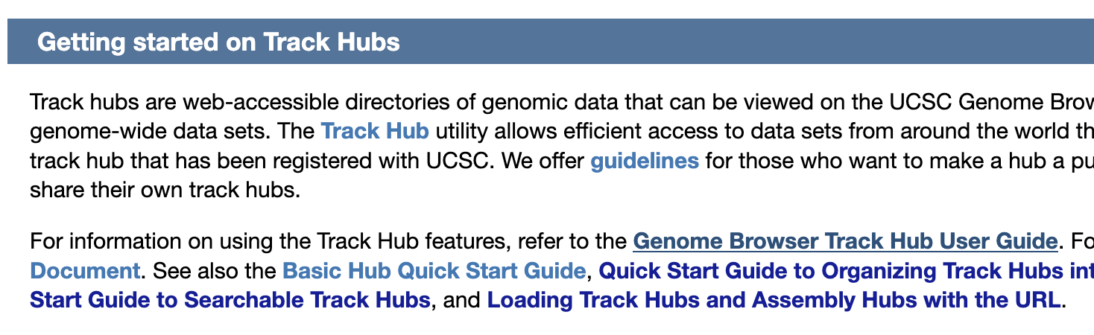

Your annotations
Develop your annotations into a ‘track hub’
Notes:
You develop your annotations and examine them in the browser with your own constructed ‘track hub’. Note the track hub documentation: https://genome.ucsc.edu/goldenPath/help/hgTrackHubHelp.html

Slide 12
Documentation for developing track hubs
There is a reference document for all track types and associated specifications.
https://genome.ucsc.edu/goldenPath/help/trackDb/trackDbHub.html
Notes:
When you see tracks in the browser of the type you would like to use for your annotations, you can find the track definition in the ‘hub.txt’ file for any GenArk assembly. Note the documentation for writing track definitions: https://genome.ucsc.edu/goldenPath/help/trackDb/trackDbHub.html

Slide 13
Specific layout for your annotation track hub
Directory structure:
For efficient import of such data, there must be a consistent and structured layout.
+-- hub.txt
+-- genomes.txt
+-- documentation.html
+-- GCA_000260495.2/
| +-- trackDb.txt
| +-- veupathGenes.bb
| +-- veupathGenes.gtf.gz
+-- GCF_014441545.1/
| +-- trackDb.txt
| +-- veupathGenes.gtf.gz
| +-- veupathGenes.bb
+-- GCF_014108235.1/
| +-- trackDb.txt
| +-- veupathGenes.gtf.gz
| +-- veupathGenes.bb
Assembly names need to be the NCBI GenBank accession names to identify the corresponding assembly. GCF_... GCA_...
All the track files can be the same names since they are all the same annotation type.
Notes:
To make importation of such external data efficient, need to follow a consistent and uniform structure of files and directory hierarchuy.

Slide 14
A specific example: start with the ‘hub.txt’ file
hub PAG_2026_GenArk_Contrib_Example
shortLabel PAG 2026 GenArk tracks
longLabel PAG 2026 example of contributed tracks to UCSC GenArk assemblies
email genome@soe.ucsc.edu
genomesFile genomes.txt
descriptionUrl documentation.html
# comments:
# load this hub with a reference to this hub.txt file:
# https://genome-test.gi.ucsc.edu/~hiram/BRC/contrib/hub.txt
# for example, to show this track hub in the genome browser::
# https://genome.ucsc.edu/cgi-bin/hgTracks?genome=GCA_000260495.2&
# hubUrl=https://genome-test.gi.ucsc.edu/~hiram/BRC/contrib/hub.txt
Specify the target assemblies
DOCUMENTATION ! ! !
You can have all your documentation in one single html file
Notes:
Showing a specific example. Starting with the ‘hub.txt’ file which is the reference to the track hub. This example is from: https://genome-test.gi.ucsc.edu/~hiram/BRC/contrib/hub.txt

Slide 15
The ‘hub.txt’ points to this ‘genomes.txt’ file
genome GCA_000260495.2
trackDb GCA_000260495.2/trackDb.txt
genome GCF_014441545.1
trackDb GCF_014441545.1/trackDb.txt
genome GCF_014108235.1
trackDb GCF_014108235.1/trackDb.txt
List each assembly for which you have calculated annotations.
The trackDb.txt file defines the tracks.
Important to use the correct GenBank accession identifier or UCSC database name, e,g. ‘GCF_016077325.2’, ‘hg38’, ‘mm39’
Full listing of all GenArk assemblies:
https://hgdownload.gi.ucsc.edu/hubs/UCSC_GI.assemblyHubList.txt
Notes:
The ‘hub.txt’ file points to the ‘genomes.txt’ file. Use the GenBank accession names: https://hgdownload.gi.ucsc.edu/hubs/UCSC_GI.assemblyHubList.txt

Slide 16
All the tracks are identical, only one trackDb.txt needed
track VEuPathDBGeneModels
shortLabel PAG 2026 contrib
longLabel PAG 2026 - demonstrating contributed tracks to UCSC GenArk assemblies
group genes
type bigBed 12 .
visibility pack
labelFields name
searchIndex name
bigDataUrl veupathGenes.bb
colorByStrand 0,0,122 157,60,32
dataVersion VEuPathDB release 68
html ../documentation
# can be multiple track definitions here for other annotations
DOCUMENTATION ! ! !
Your documentation can all be in one documentation.html page.
Copy UCSC format: Description, Methods, Credits, References
Notes:
Since all the tracks are identical types of annotations, only one copy of the same trackDb.txt can be used for all the tracks. You must have documentation to describe your data, your methods, and references to publications.

Slide 17
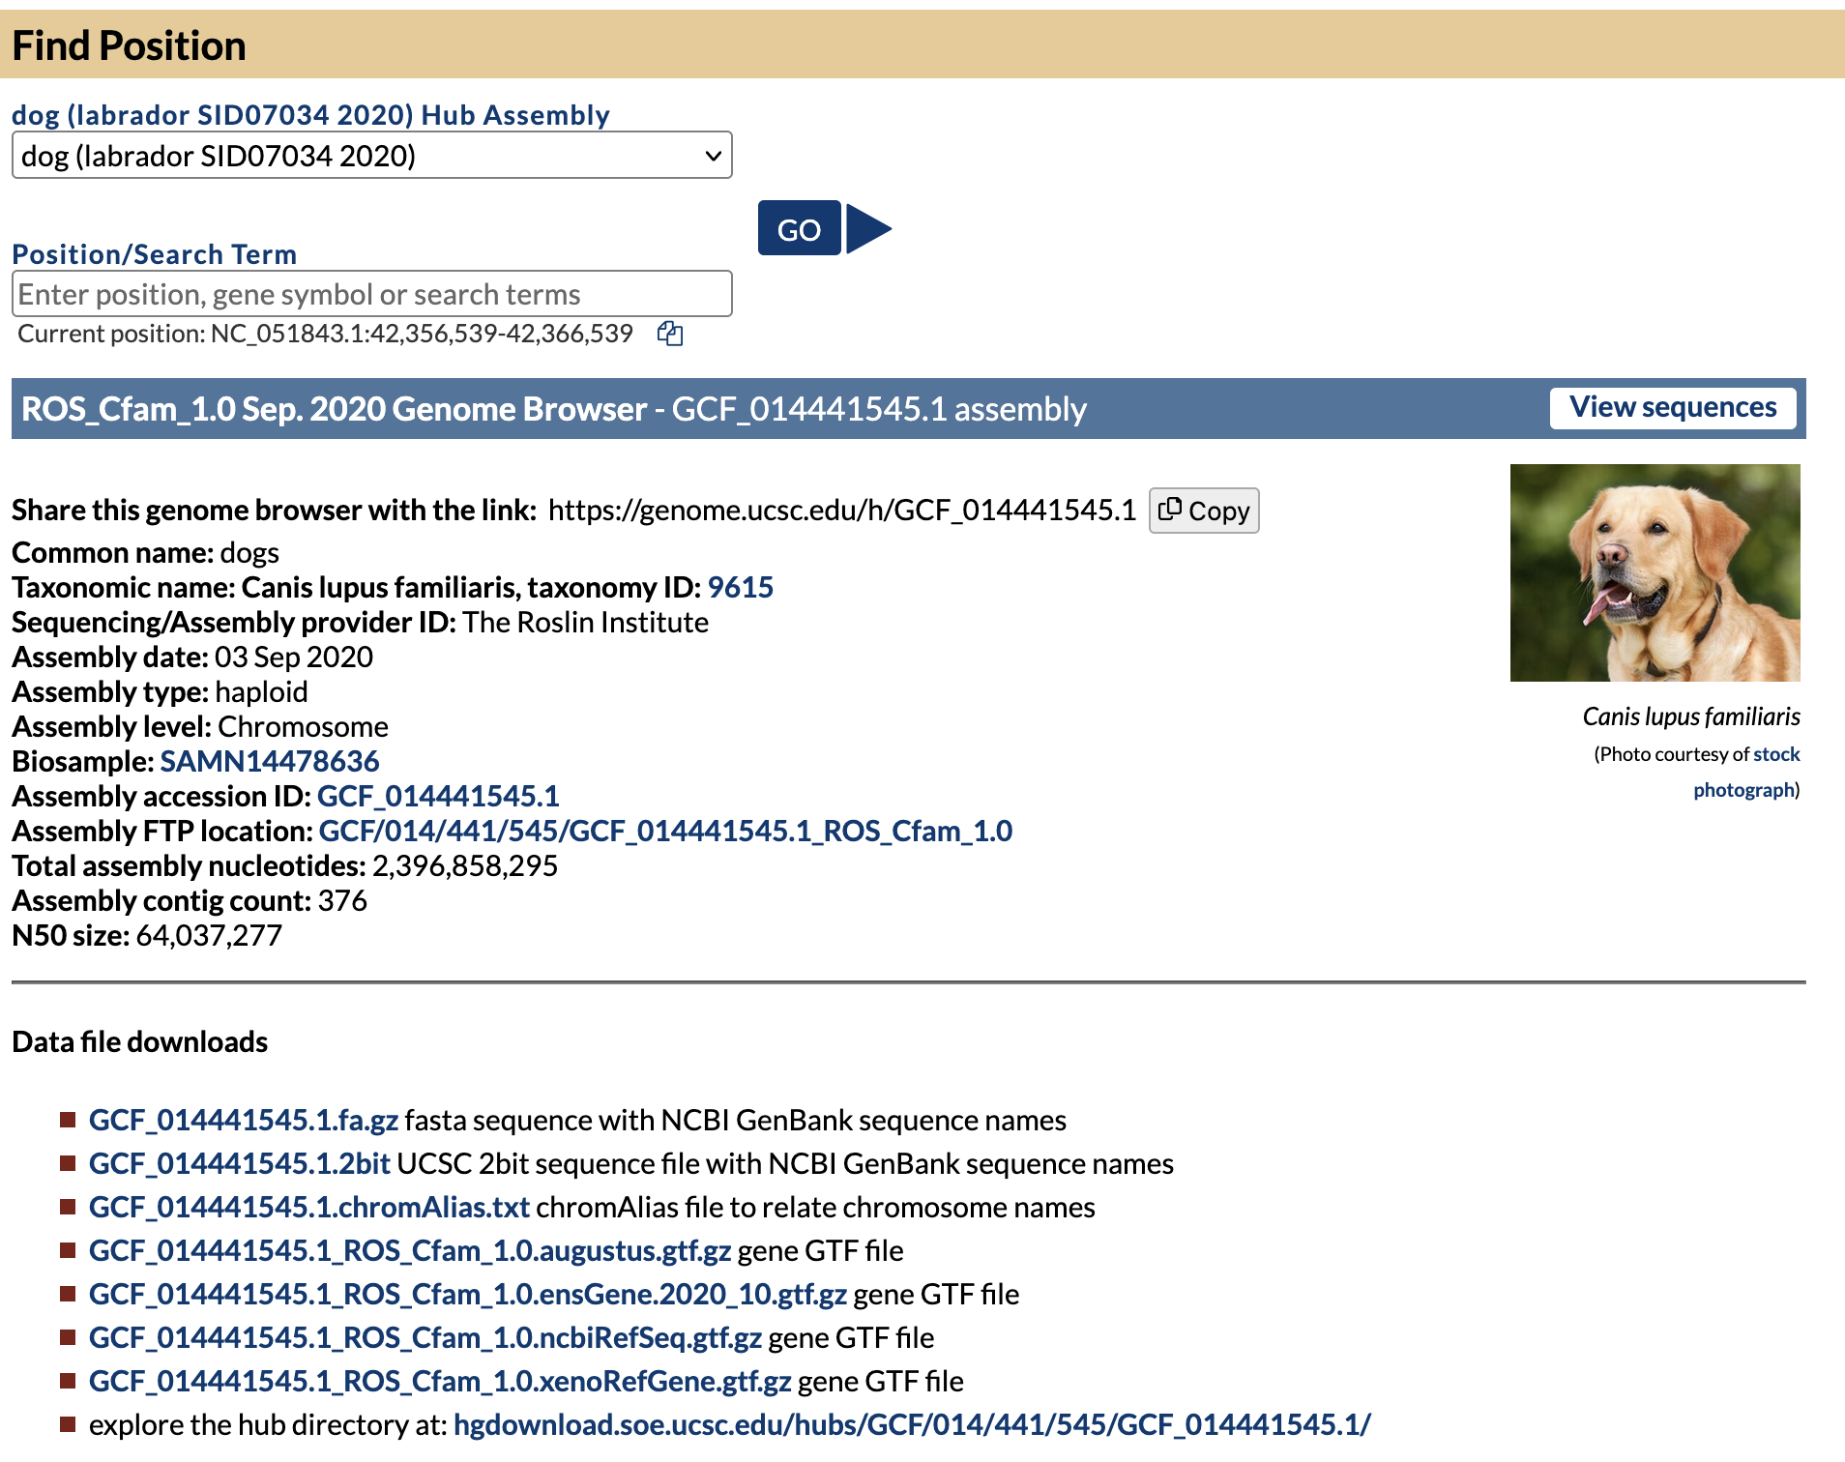
Where to find example track definitions
For any GenArk browser, on the gateway page, use the link to the hub directory.
Notes:
To find typical track definitions, use any of the GenArk browsers and to examine how they define tracks.

Slide 18
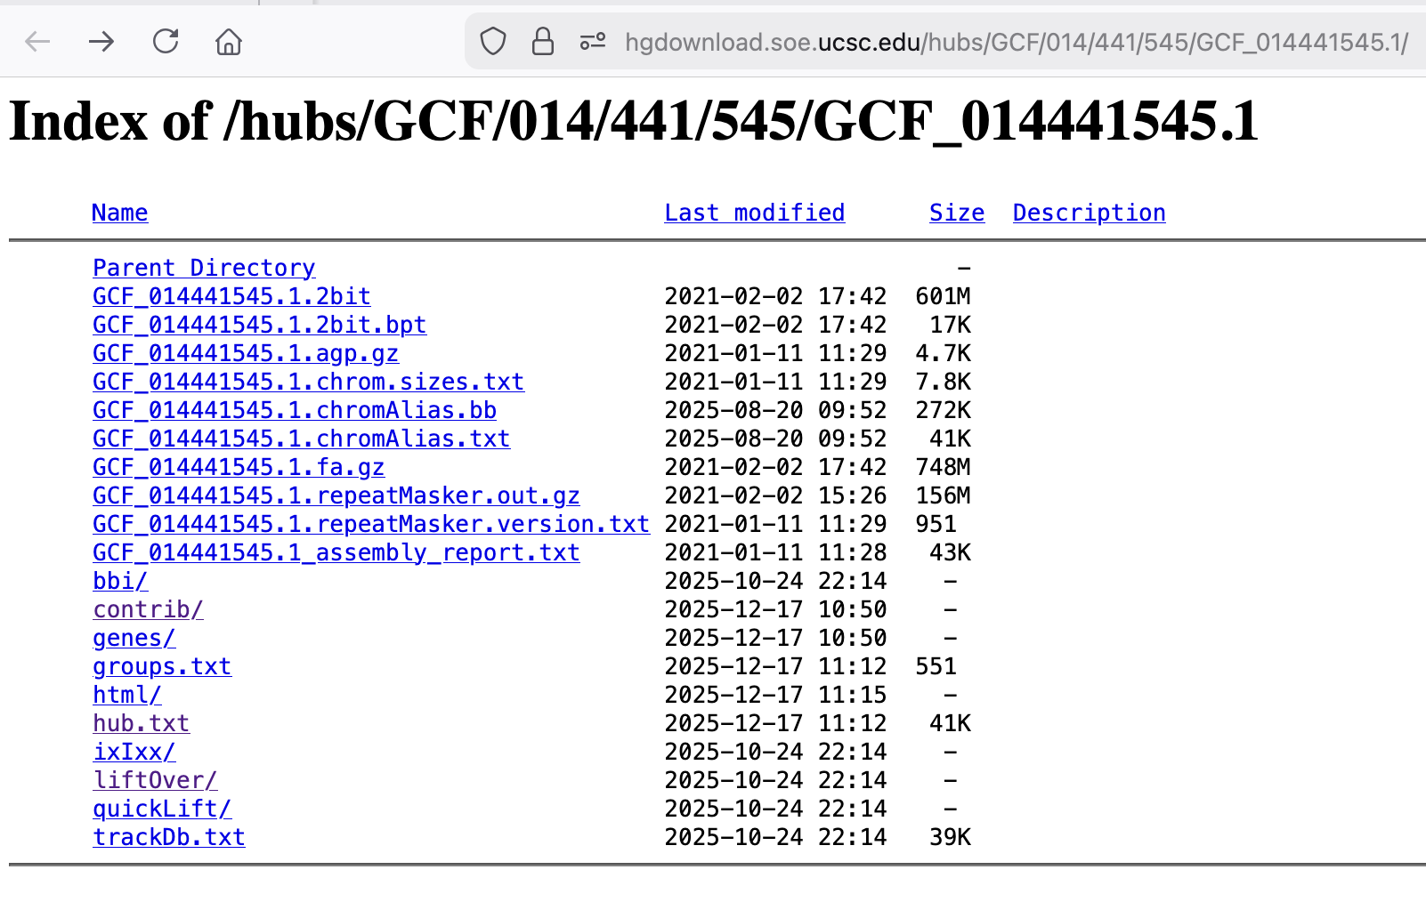
A typical GenArk assembly download directory:
Documentation examples
View the ‘hub.txt file for track definitions.
https://hgdownload.gi.ucsc.edu/hubs/GCF/014/441/545/GCF_014441545.1/
Notes:
The track definitions can be found in the ‘hub.txt’ file for this assembly hub. This example: https://hgdownload.gi.ucsc.edu/hubs/GCF/014/441/545/GCF_014441545.1/

Slide 19
Example track definitions from any GenArk assembly:
track repeatMasker
shortLabel RepeatMasker
longLabel RepeatMasker Repetitive Elements
type bigRmsk 9 +
visibility pack
group varRep
bigDataUrl bbi/GCF_014441545.1_ROS_Cfam_1.0.rmsk.bb
maxWindowToDraw 5000000
html html/GCF_014441545.1_ROS_Cfam_1.0.repeatMasker
track simpleRepeat
shortLabel Simple Repeats
longLabel Simple Tandem Repeats by TRF
group varRep
visibility dense
type bigBed 4 +
bigDataUrl bbi/GCF_014441545.1_ROS_Cfam_1.0.simpleRepeat.bb
html html/GCF_014441545.1_ROS_Cfam_1.0.simpleRepeat
track refSeqComposite
compositeTrack on
shortLabel NCBI RefSeq
longLabel RefSeq gene predictions from NCBI
group genes
visibility pack
type bigBed
dragAndDrop subTracks
allButtonPair on
dataVersion NCBI Canis lupus familiaris Annotation Release 106 (2021-01-11)
html html/GCF_014441545.1_ROS_Cfam_1.0.refSeqComposite
priority 2
Notes:
When you see tracks in the browser of the type you would like to use for your annotations, you can find the track definition in the ‘hub.txt’ file for any GenArk assembly. Note the documentation for writing track definitions: https://genome.ucsc.edu/goldenPath/help/trackDb/trackDbHub.html

Slide 20
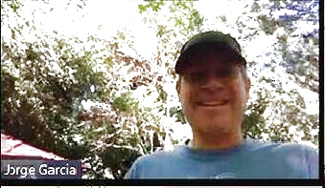

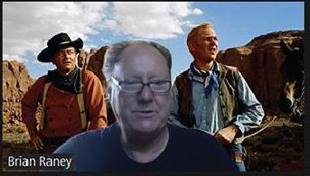
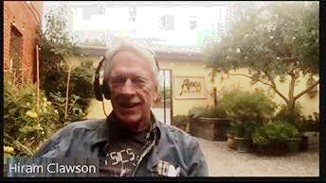
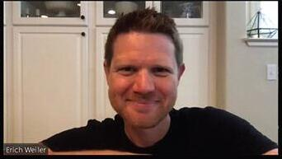
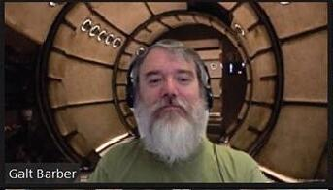
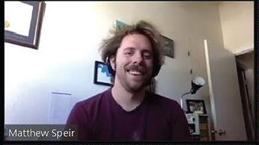

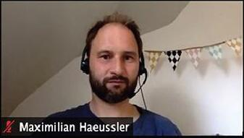
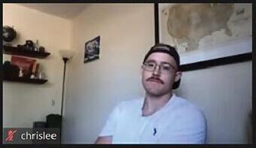

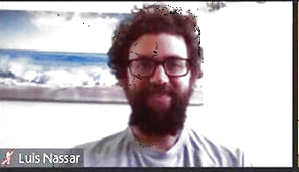


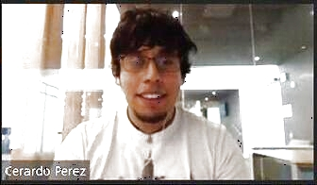
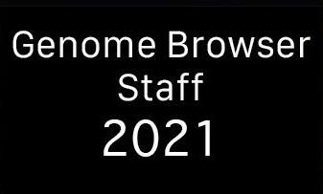
UCSC Genome Browser Staff 2026
Jorge
Angie
Brian
Hiram
Erich
Galt
Matt
Jonathan
Max
Chris
Brittney
Lou
2026
Jairo
Clay
Gerardo
2026
Notes:
The UCSC browser staff 2026.

Slide 21
Our work is supported by a number of different grants:
National Human Genome Research Institute U24HG002371
National Institute of Mental Health RF1MH132662
National Science Foundation 2419522 subcontract S006079-NSF
California’s Stem Cell Agency DISC0-14514
National Institute of Allergy and Infectious Diseases U24AI183870
subcontract S005829-DHHS
Clawson, H., Lee, B.T., Raney, B.J. et.al.
GenArk: towards a million UCSC genome browsers
Genome Biology 24, 217 (2023)
https://doi.org/10.1186/s13059-023-03057-x
https://pubmed.ncbi.nlm.nih.gov/37784172/
Notes:
PAG 2026, Monday 12 January 2026 19:30 – Contributed annotation tracks to the UCSC genome browser – Hiram Clawson – U.C. Santa Cruz Genomics Institute

