Slide 1
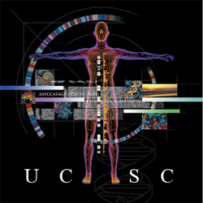
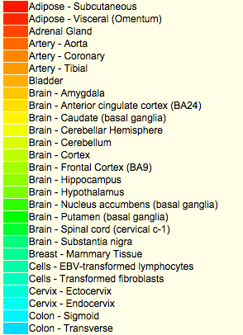
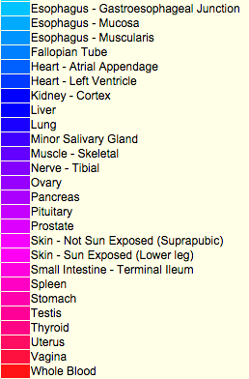
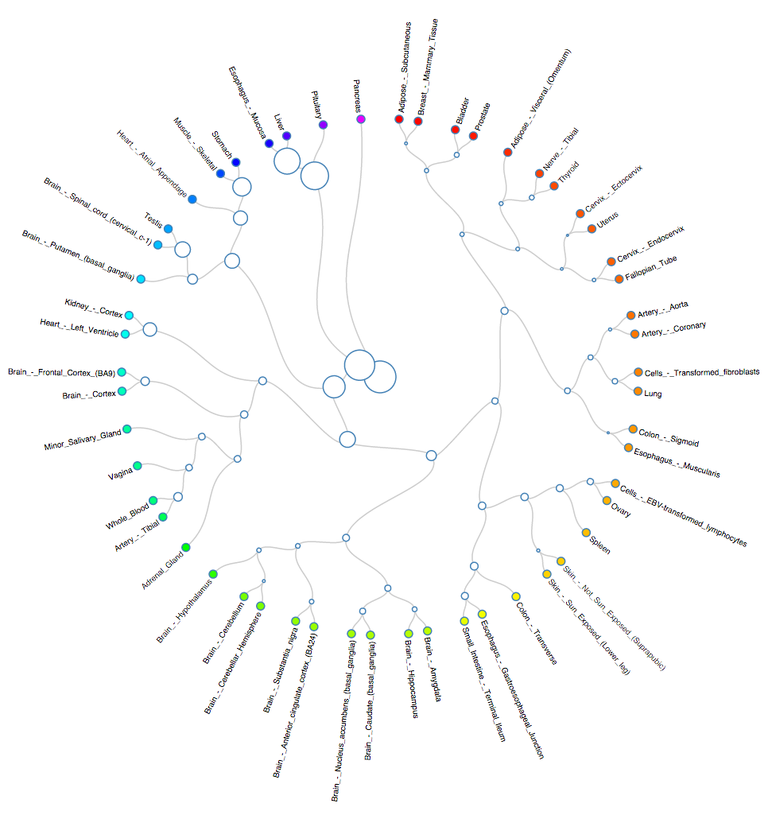
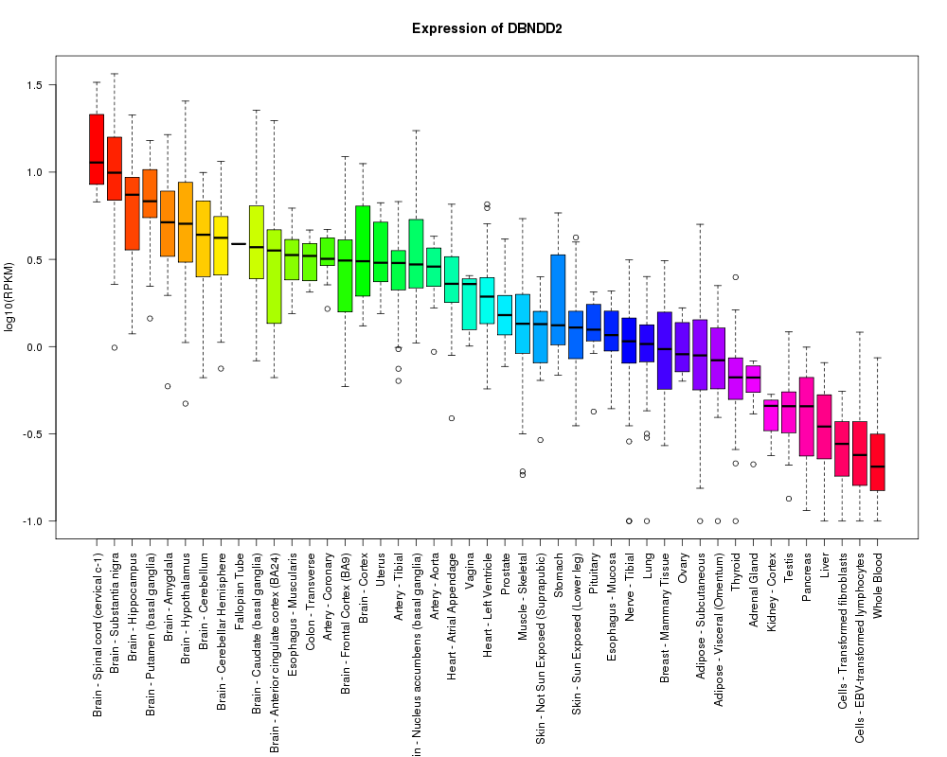
GTEx Data in the UCSC Genome Browser
KR Rosenbloom, GP Barber, J Casper, H Clawson, C Eisenhart, PA Fujita, L Guruvadoo, M Haeussler, S Heitner, AS Hinrichs, D Karolchik, K Learned, BT Lee, BJ Raney, ML Speir, AS Zweig, D Haussler, RM Kuhn, WJ Kent
UCSC Genomics Institute & HHMI at University of California Santa Cruz
Overview
We are integrating GTEx expression and sample data into the UCSC Genome Browser visualization and analysis tools with the aim of making this valuable data more broadly accessible to the research community. New display capabilities are currently being developed for browser tracks that summarize gene expression levels by tissue and allele-specific expression by SNP in a genomic context. In conjunction with this development, we welcome input on how best to display the data to maximize its usefulness in research and analysis. The expression data together with full sample metadata are hosted in the Genome Browser database to support data mining via the UCSC Table Browser, Data Integrator and other tools available at http://genome.ucsc.edu.
GTEx Gene Expression track display
Genome Browser display of GTEx gene-level expression data from the V4 Analysis in a 20 kbp genomic region shows 2 genes with different patterns of tissue specificity. The VAT1 (vesicle amine transport protein) locus is expressed across a broad set of tissues, while RND2 (Rho GTPase) shows expression in a small subset of tissues (supported by the ENCODE RNA-seq evidence shown below). The yellow-green range of the tissue color spectrum here denotes brain tissues. This display is based on median expression levels (RPKM) computed for each tissue per gene. The displayed expression graphs are fixed-width and are anchored at the genomic start of the canonical transcript.
Tissue color assignment
Genome browser display of tissue expression is condensed when viewing larger genomic regions (in this example, a 500 kbp view).
Next steps
Display full sample metadata in details pages
Provide track controls to filter or partition the display based on metadata
Bring in exon-by-exon data as tracks
Make GTEx data available from the primary browser gene track pages
Incorporate GtEx data into Gene Sorter tool
Consider including signal graphs of raw read overlaps
Additional display features are mocked-up below:
Radial dendrogram of GTEx tissues derived from hierarchical clustering of GTEx data. The size of the circles is proportional to the gene expression difference. This is one of several schemes we are exploring for color assignment.
The GTEx track details will provide fuller information about the expression pattern, including a Tukey mean-difference boxplot.
A companion GTEx eQTL SNP track will show allele frequencies and median expression graph for each SNP with significant differential expression across alleles.
Acknowledgements
Funding by NHGRI award 3U41HG002371-15S1 to the UCSC Center for Genomic Science
http://genomewiki.cse.ucsc.edu/index.php/File:GTEX2015Poster.pdf

