Slide 1

BME-18 Scientific Principals of Life
Wednesday 05 November 2025 – Thimann 1
Hiram Clawson – U.C. Santa Cruz Genomics Institute
software engineer on the genome browser project:
https://genome.ucsc.edu/
Private email to the browser staff: genome-www@soe.ucsc.edu
Public email list: genome@soe.ucsc.edu
Latest updated copy of this presentation: https://bit.ly/4ojHfqq
Notes:
Hiram Clawson – hclawson@ucsc.edu - https://www.linkedin.com/in/hiram-clawson-46448b/ - browser staff private email: genome-www@soe.ucsc.edu – public email list: genome@soe.ucsc.edu

Slide 2
Today’s topics
my definition of ”science”
The genome browser: https://genome.ucsc.edu/ brief introduction
Browser educational resources: https://genome.ucsc.edu/training/education/
interactive browser sessions demonstrating biology topics
4. Leave you with a puzzle: what is CODIS ?
Some fun links for your entertainment:
1. https://youtu.be/0fKBhvDjuy0/ - Powers of 10 (1977) Eames office
2. https://youtu.be/7Hk9jct2ozY/ - DNA animation (2002-2014) by Drew Berry and Etsuko Uno
3. https://youtu.be/ydqReeTV_vk/ - Evo Devo (biology) – Acapella Science
4. https://youtu.be/f8FAJXPBdOg/ - The Molecular Shape of You (quantum atomic theory) – Acapella Science
5. https://youtu.be/SKhcan8pk2w/ - Homochirality (all natural sugar is ‘right’ handed) – Steve Mould
6. https://youtu.be/b34al8YmQSA/ - All coal is the same age (really ?) – Steve Mould
Notes:
Overview of presentation. 1. My definition of “science” 2. The UCSC Genome Browser 3. Educational resources in the Genome Browser. Fun links: 1. https://youtu.be/0fKBhvDjuy0 2. https://youtu.be/7Hk9jct2ozY 3, https://youtu.be/ydqReeTV_vk 4. https://youtu.be/f8FAJXPBdOg 5. https://youtu.be/SKhcan8pk2w 6. https://youtu.be/b34al8YmQSA

Slide 3
‘Science’ is what we do to understand how the natural world
works by looking at physical evidence.
'what we do' - it is an activity performed by people
'to understand' - answering questions, endless numbers of questions
'natural world' - the only one we can know by direct evidence
'how ... works' - 'how' are natural processes functioning, not necessarily 'why'
'looking at' - making observations, recording evidence
'physical evidence' - objective real stuff, no hand waving allowed
Notes:
The ‘Philosophy of Science’ can be a contentious subject. https://en.wikipedia.org/wiki/Philosophy_of_science

Slide 4
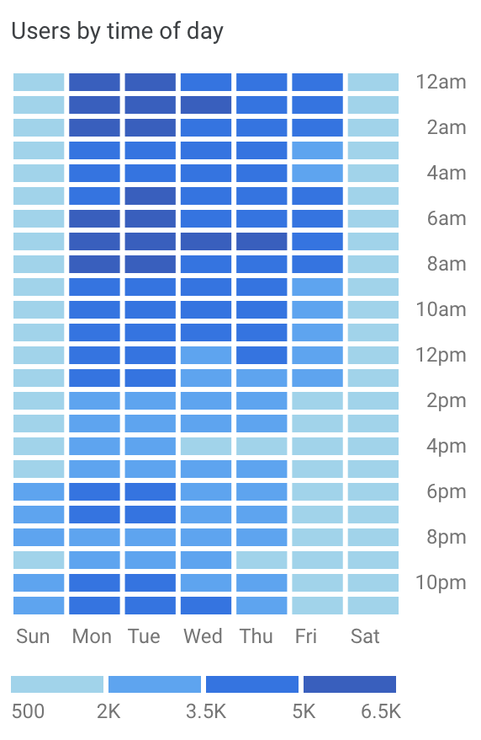
The UCSC Genome Browser
2002 - https://pubmed.ncbi.nlm.nih.gov/19957273/
Providing a web browser view of the human genome since 2001, added mouse genome in 2002, today serving up a view of over 48,000 genome assemblies for over 41,000 species
15,000 users per day, web site 300,000+ data files == 23 Tb of data, 59,000+ MySQL tables == 7 Tb of data, 90 Tb data available for download (over 2 Tb per day is sent out)
Live demonstration: https://genome.ucsc.edu/
Notes:
Original paper describing the genome browser: https://pubmed.ncbi.nlm.nih.giv/19957273/

Slide 5
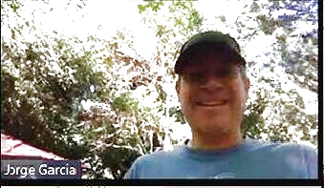
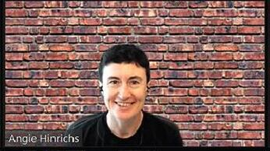
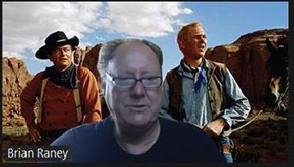
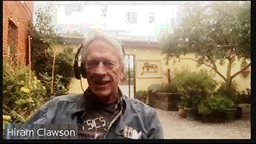
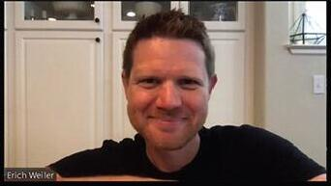
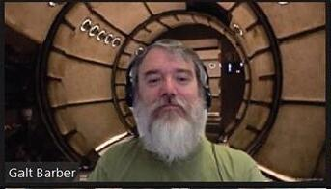
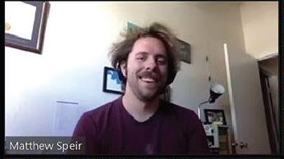
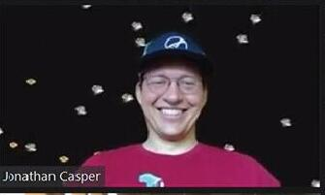
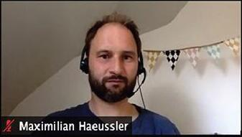
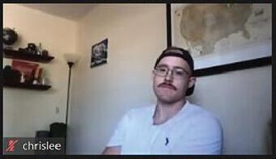
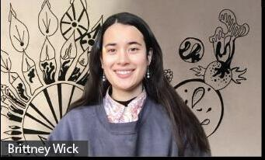
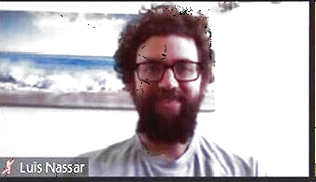
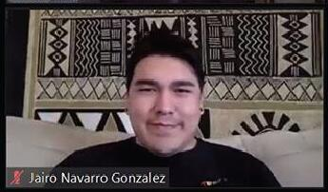
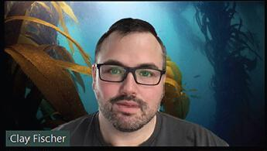
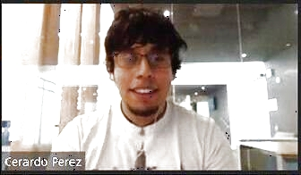
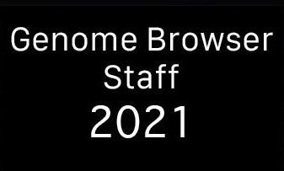
UCSC Genome Browser Staff 2025
Jorge
Angie
Brian
Hiram
Erich
Galt
Matt
Jonathan
Max
Chris
Brittney
Lou
Jairo
Clay
Gerardo
2025
Notes:
The UCSC browser staff 2025.

Slide 6
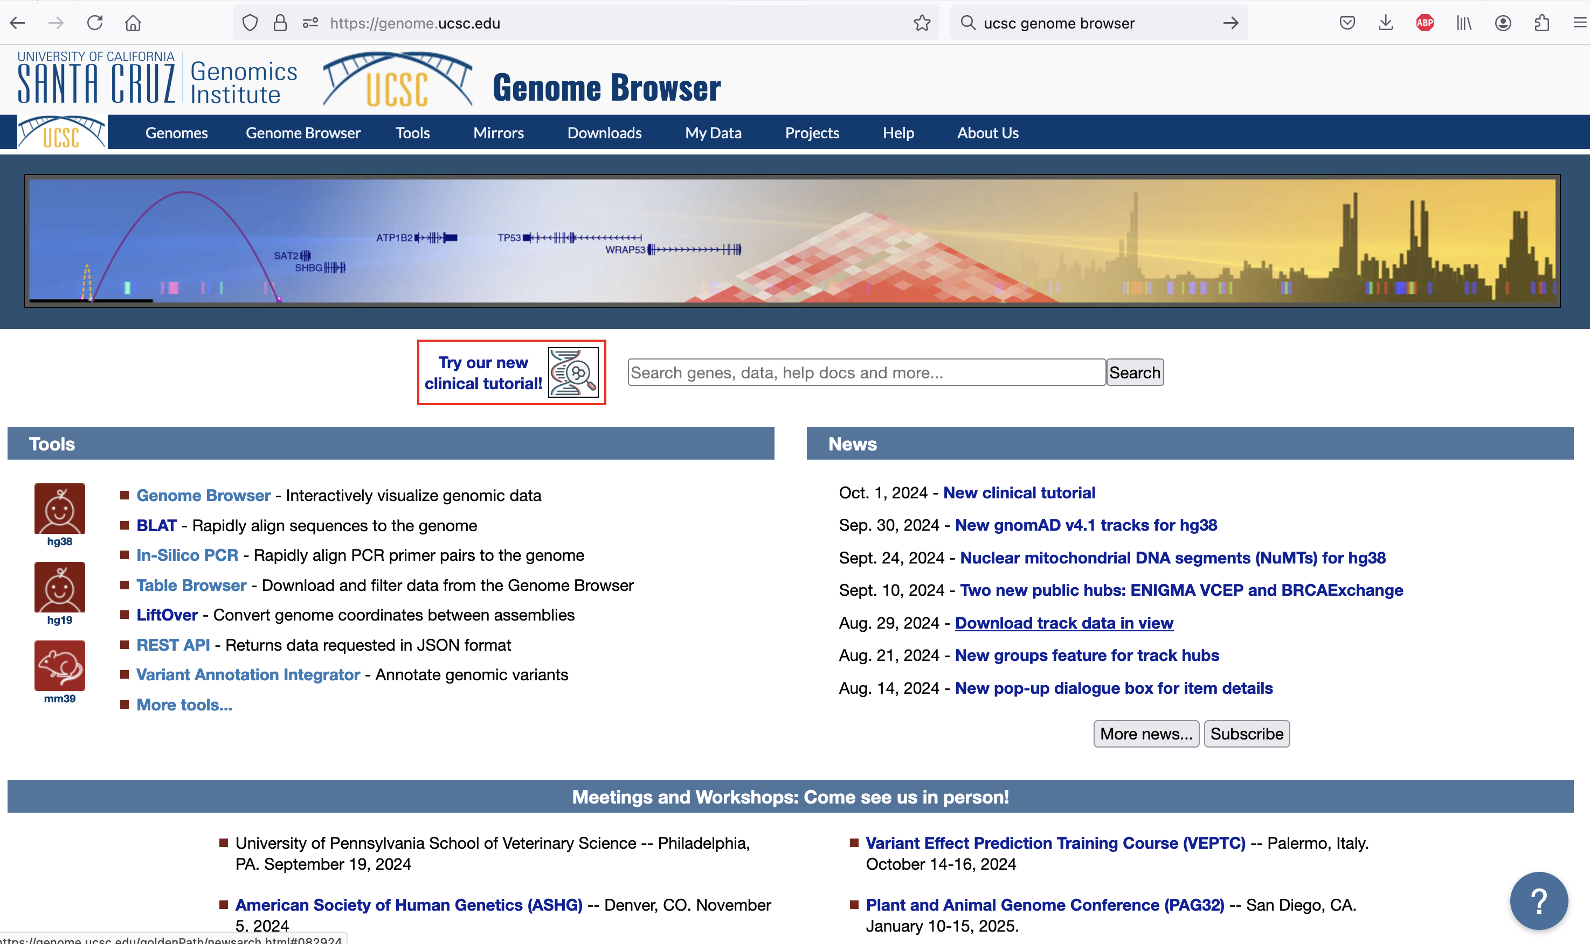
https://genome.ucsc.edu/ browser ‘home’ page
Notes:
The Genome Browser ‘home’ page – https://genome.ucsc.edu/ - primarily a landing spot for google indexing to find.

Slide 7
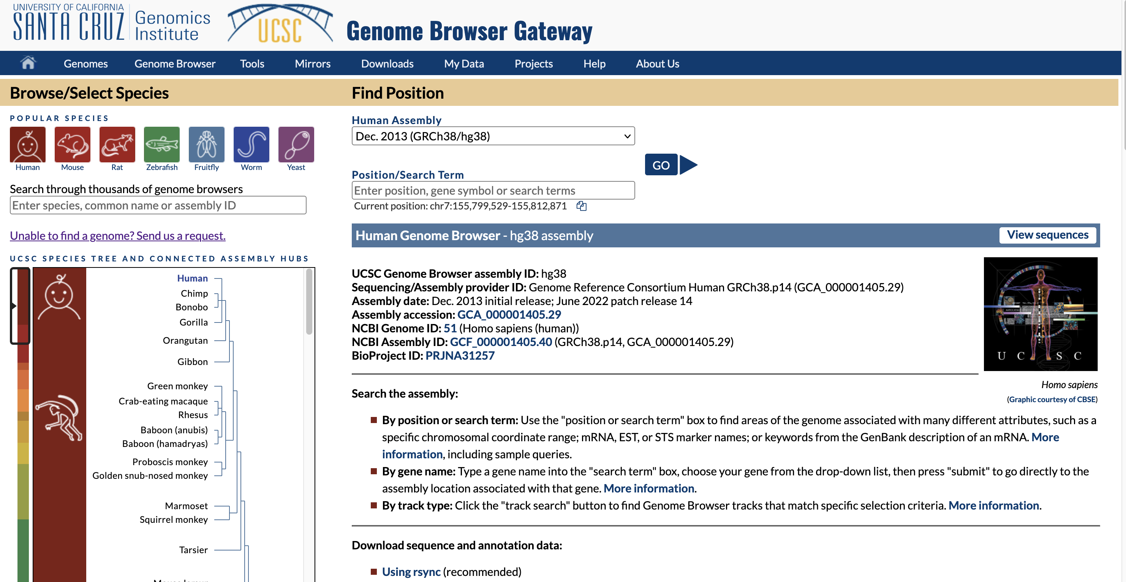
FIND ASSEMBLY
genome.ucsc.edu/cgi-bin/hgGateway
browser ‘gateway’ page
Notes:
The ‘gateway’ page is where you can find and select an assembly for display. https://genome.ucsc.edu/cgi-bin/hgGateway

Slide 8
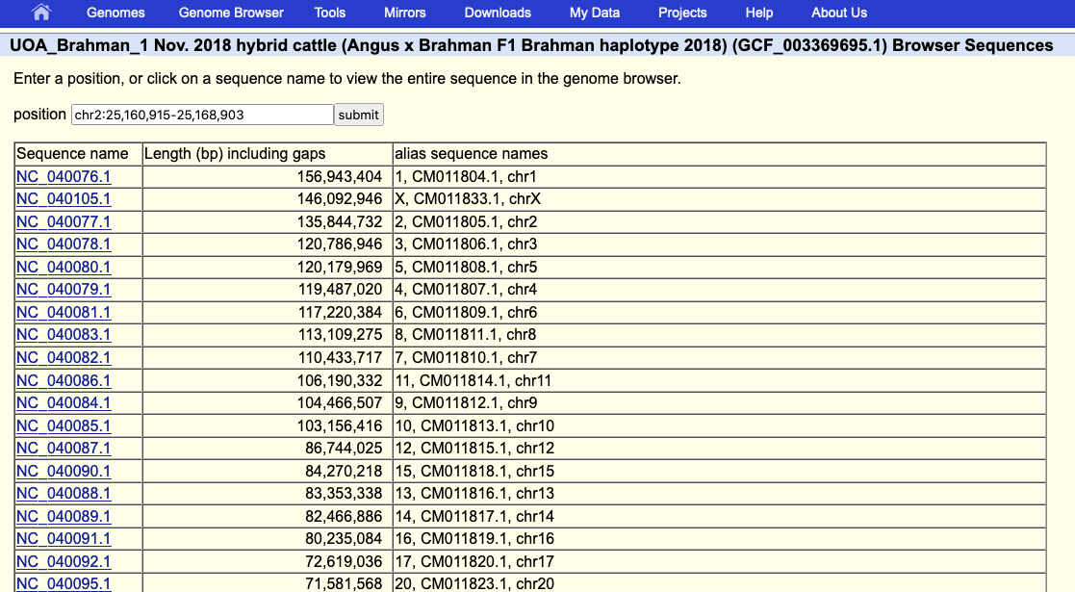
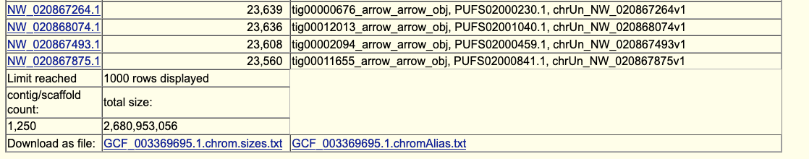
view sequences show names and aliases
Notes:
The ‘view sequences’ shows the names of the sequences in the assembly and the alternative ‘alias’ names that can be used for custom track data display on this assembly.

Slide 9
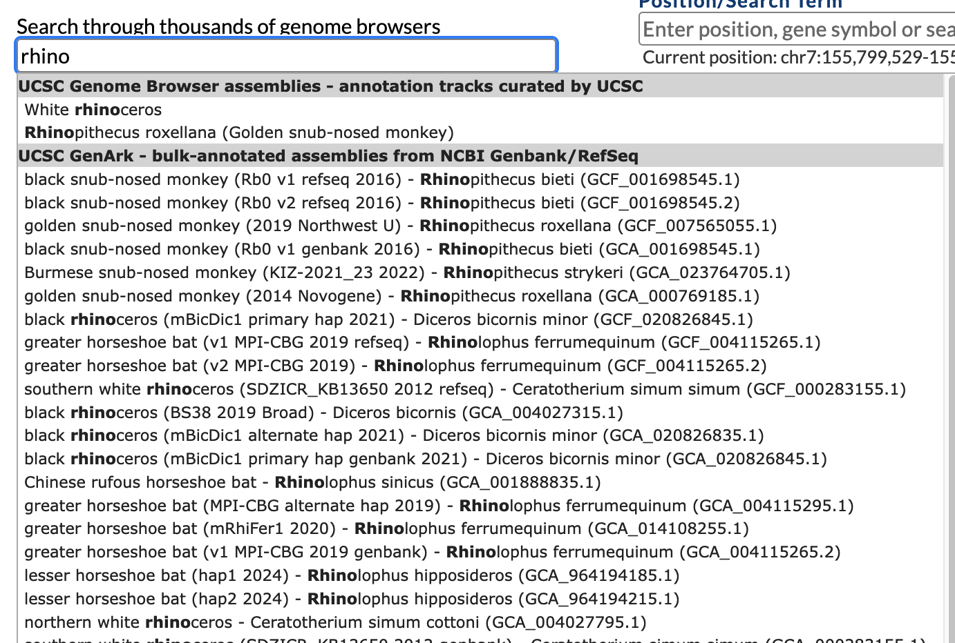
single word search can be prefix search:
Notes:
This search procedure has recently been improved. Enter search word(s) in the gateway page search form. Single words that do not have a match will be matched as a prefix.

Slide 10
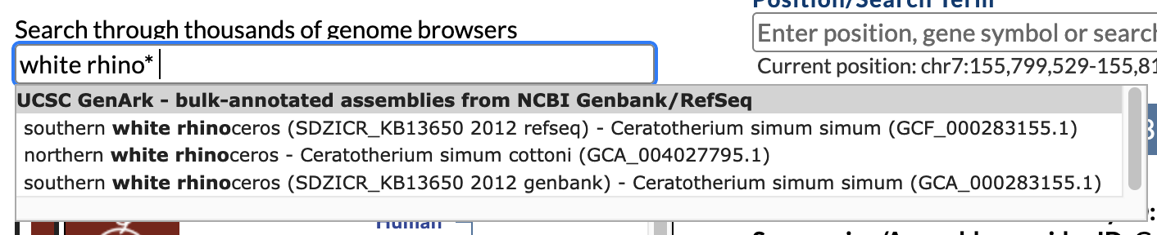
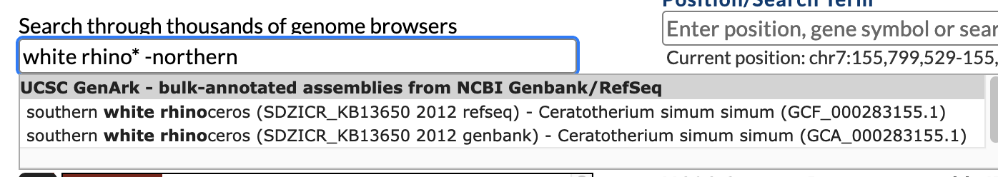
multiple word searches can be revealing:
Notes:
Multiple word searches have a variety of hidden options, we have not yet documented this new feature. A word with star* suffix will be a prefix search, a word preceded with –minus sign means to *not* include such matches in the result.

Slide 11
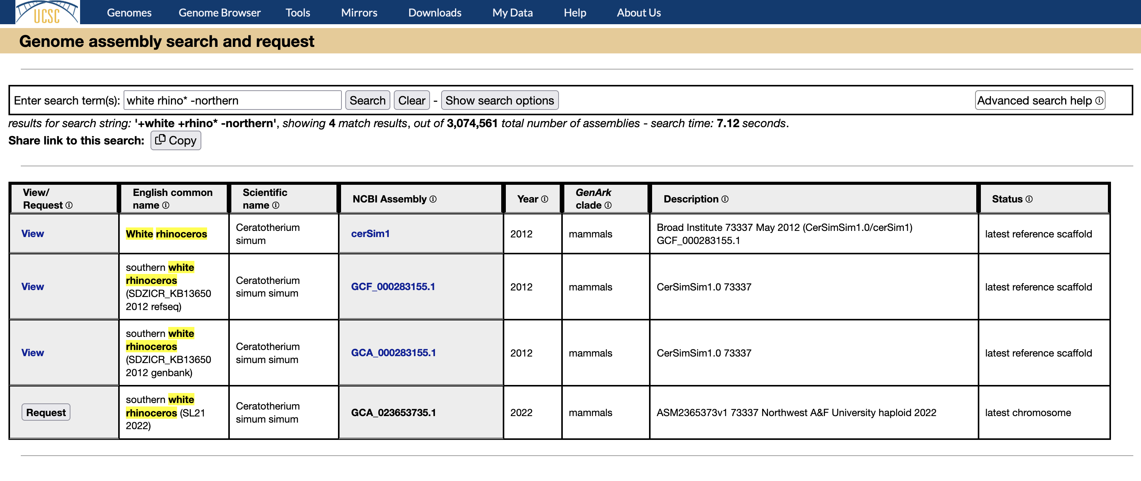
Find any assembly, in browser or not: https://genome.ucsc.edu/assemblySearch.html
Notes:
TNote the extra search options and information about how to use the advanced search string features. https://genome.ucsc.edu/assemblySearch.html

Slide 12
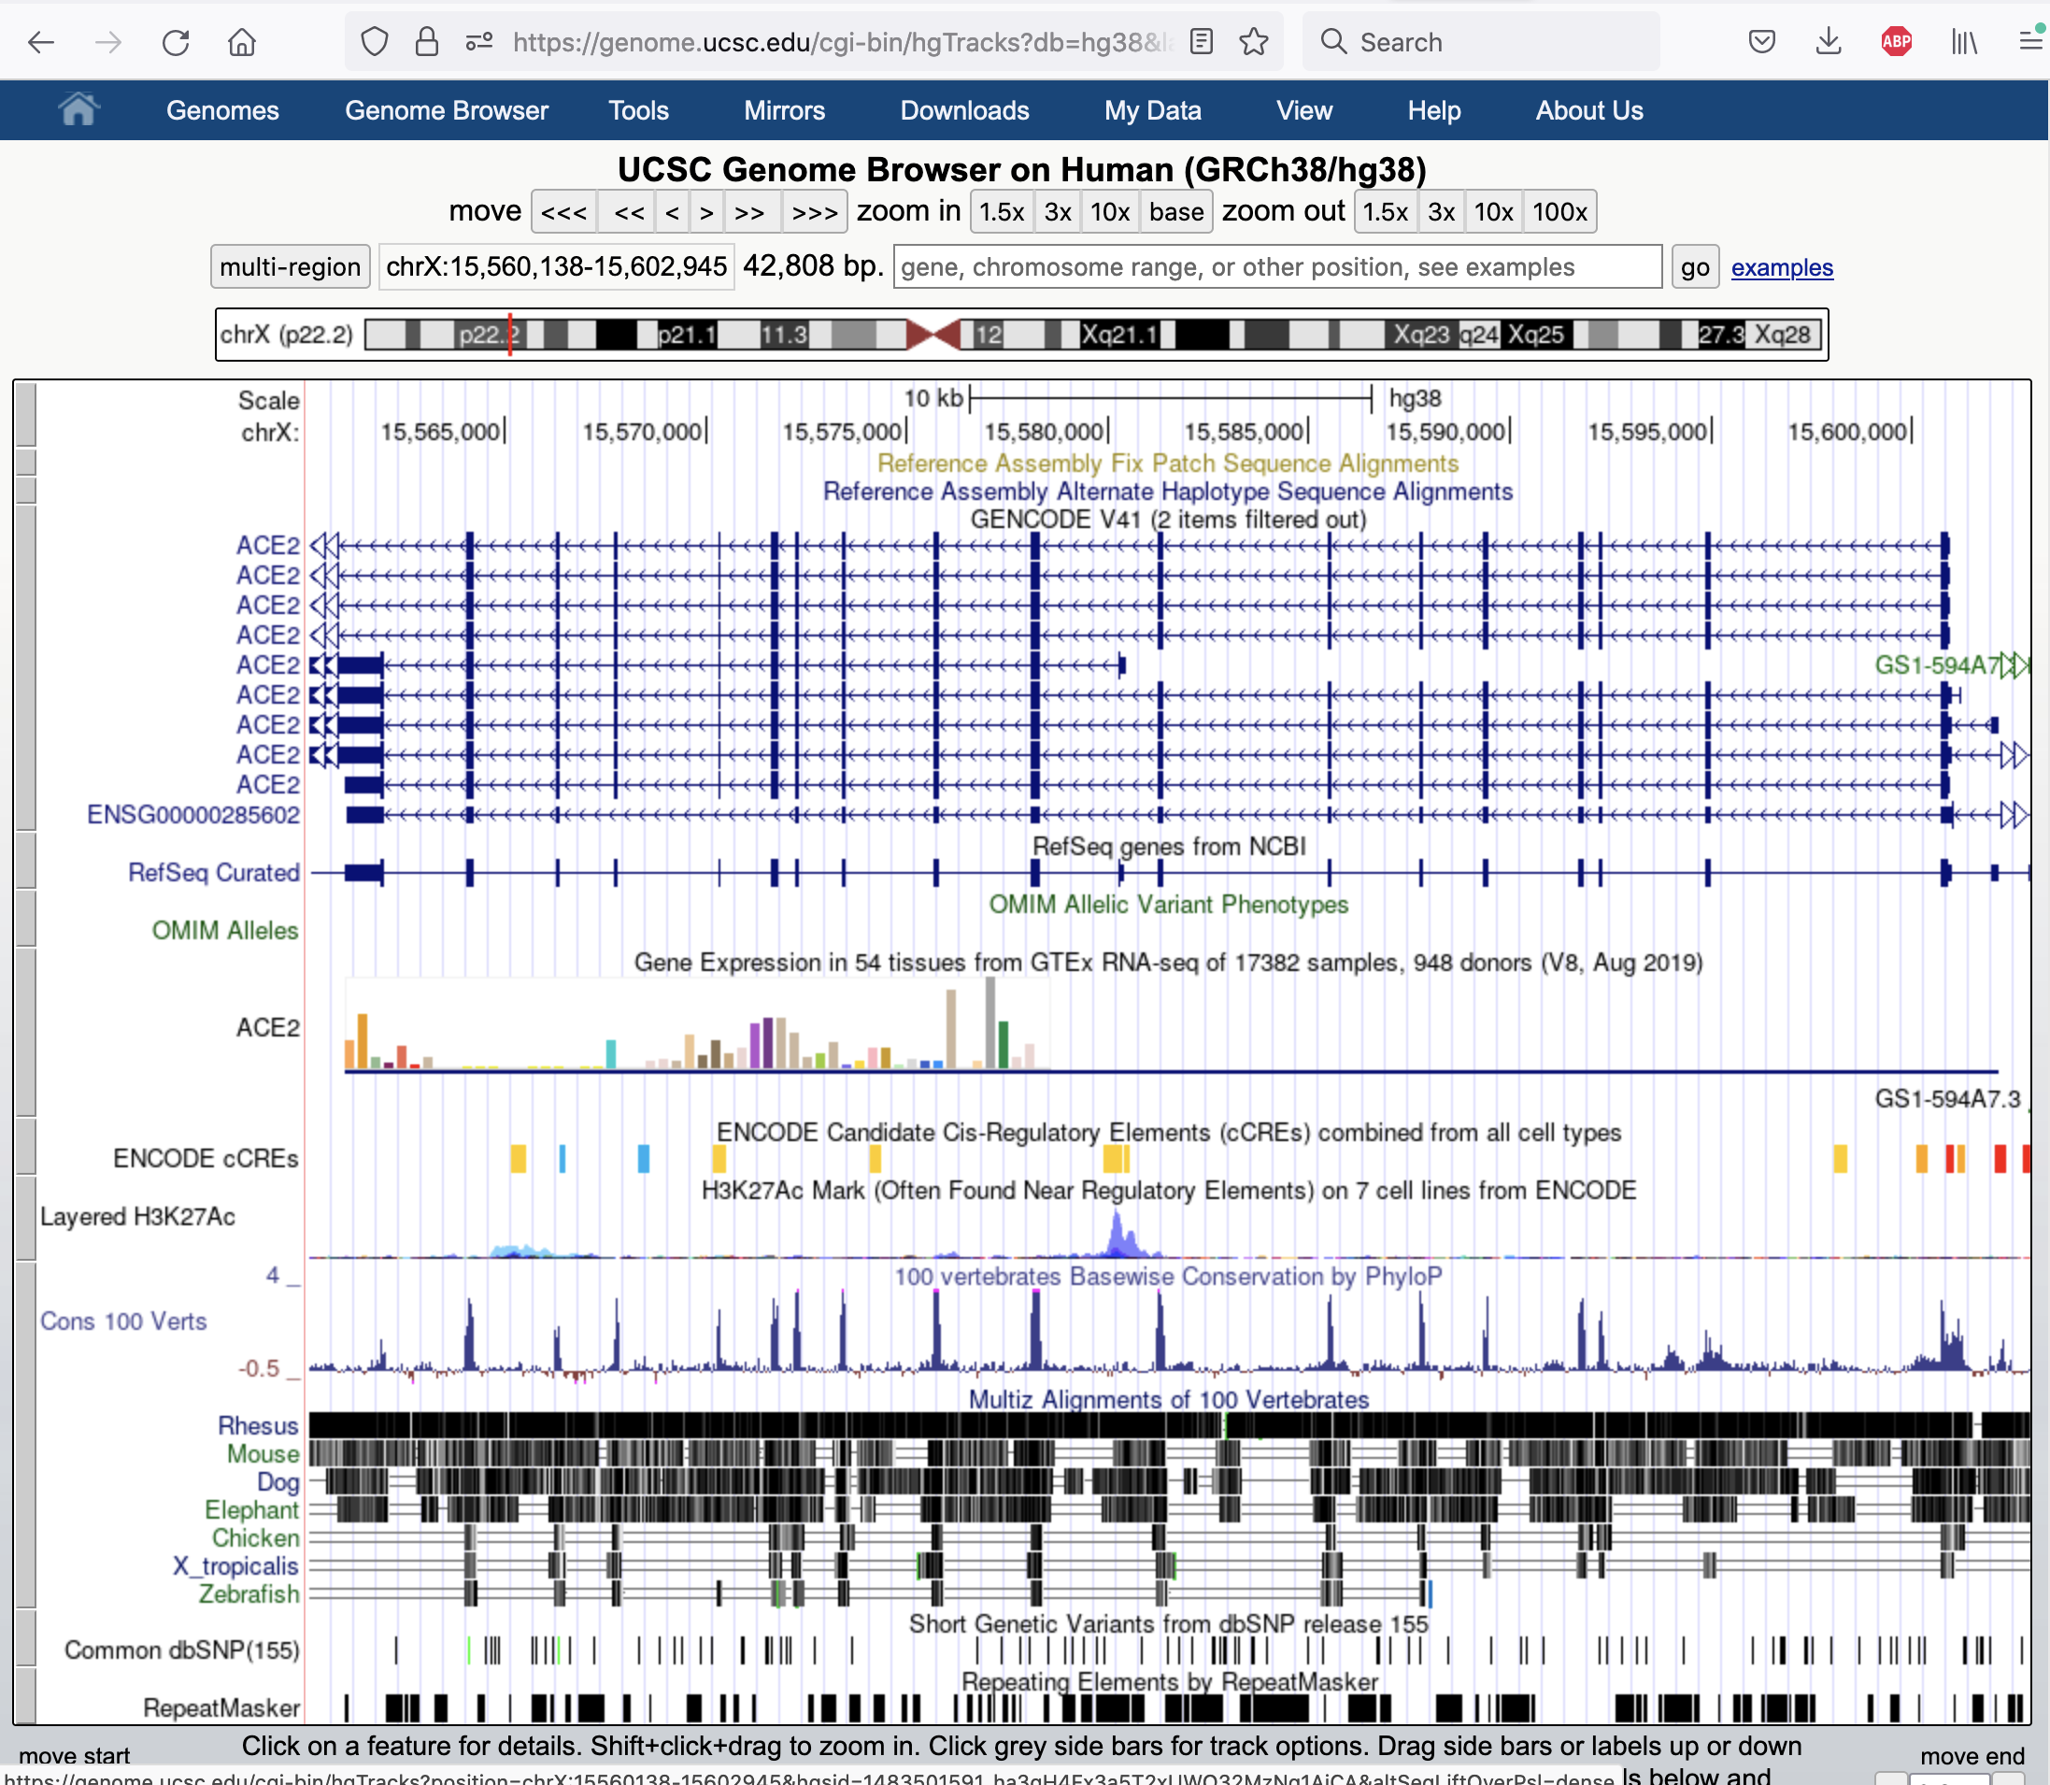
cgi-bin/hgTracks
default view
Notes:
The default view of a genome assembly and the annotations on that genome

Slide 13
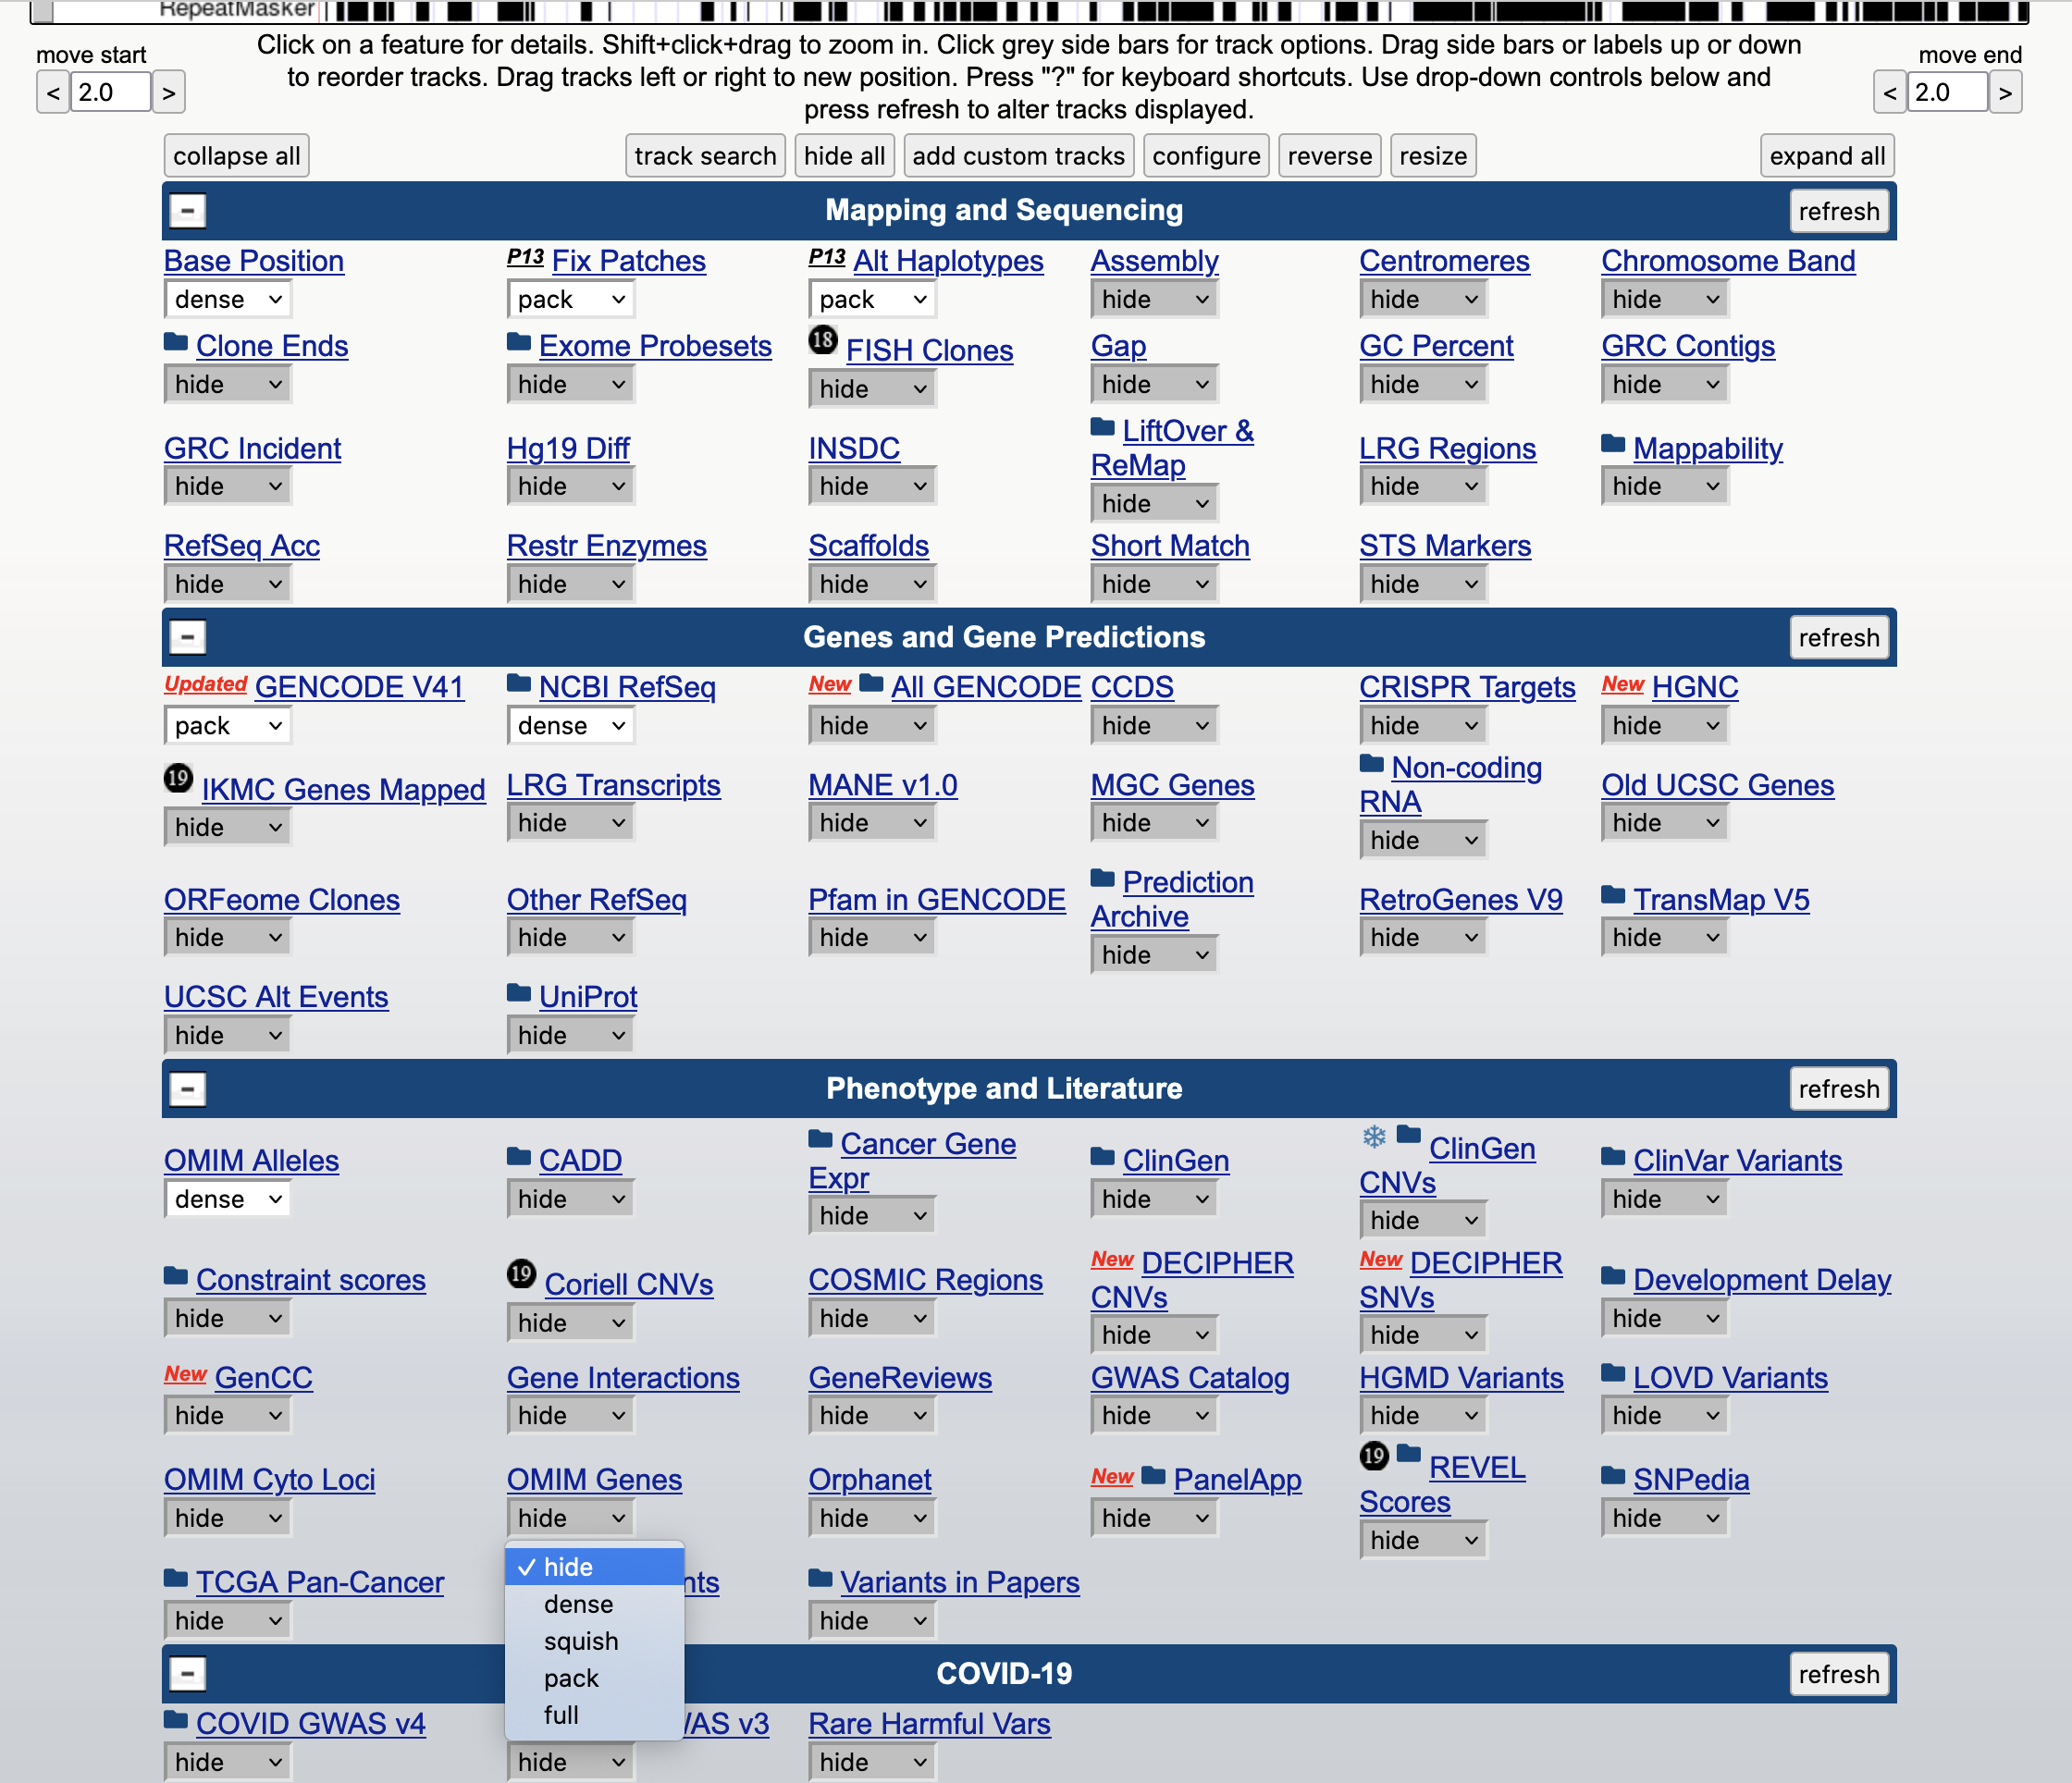
‘track’ controls
Notes:
The track controls below the main graphic image determine what is shown in the genome browser. There are thousands of annotations that can be shown.

Slide 14
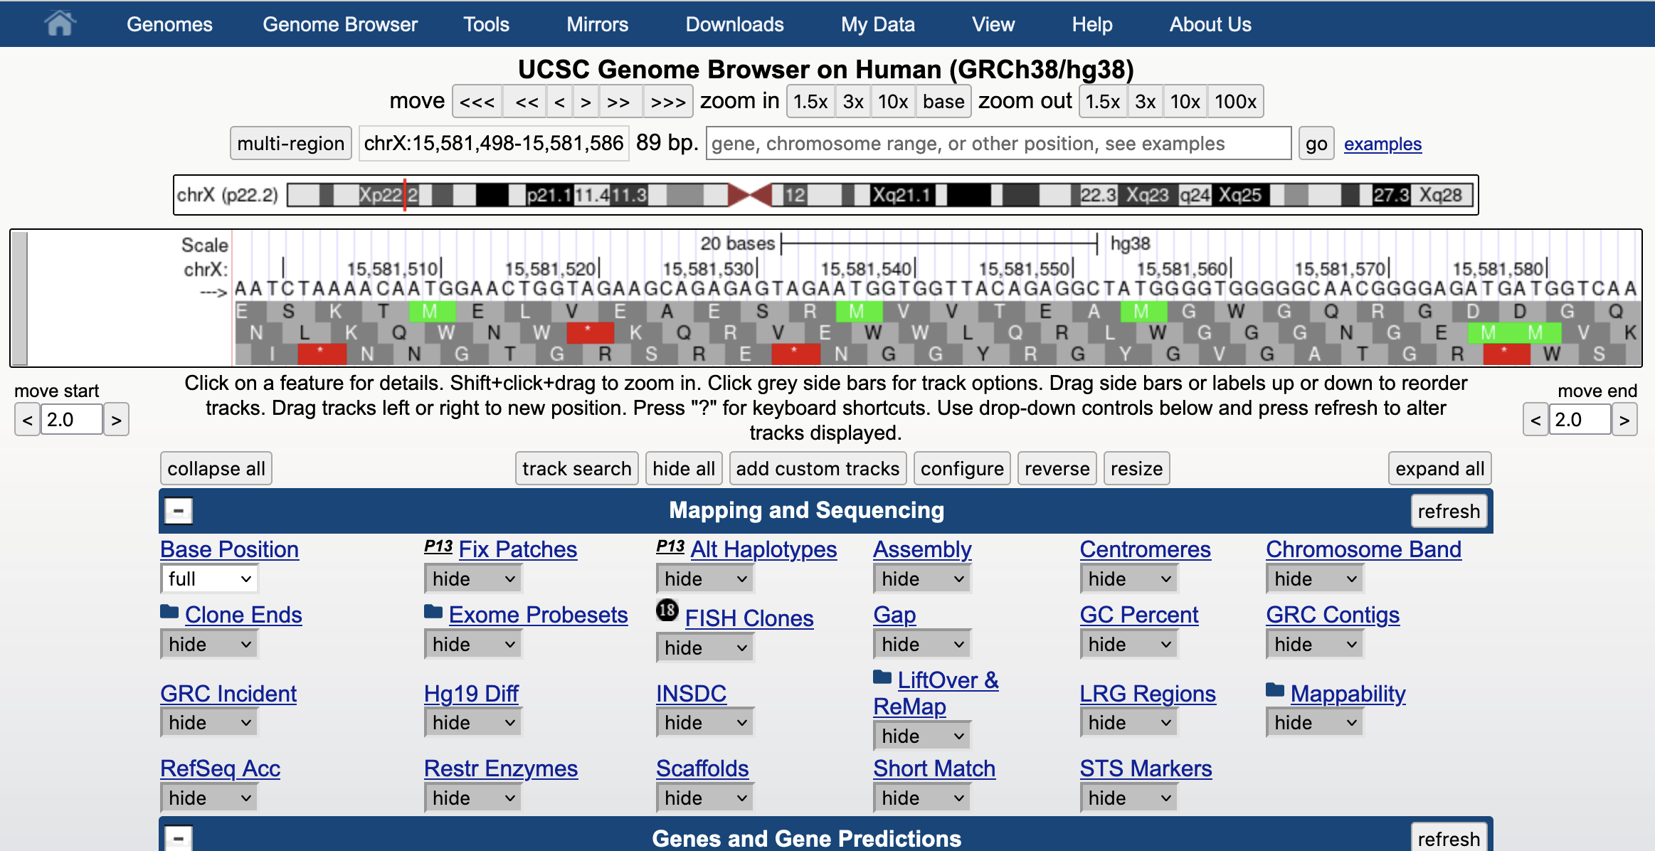
all tracks set to ‘hide’, ‘base’ track set to ‘full’, zoom in to ‘base’
Notes:
All tracks set to ‘hide’. The ‘base’ track set to ‘full’. ‘zoom in’ to ‘base’ view to see the actual nucleotides of the genome sequence.

Slide 15
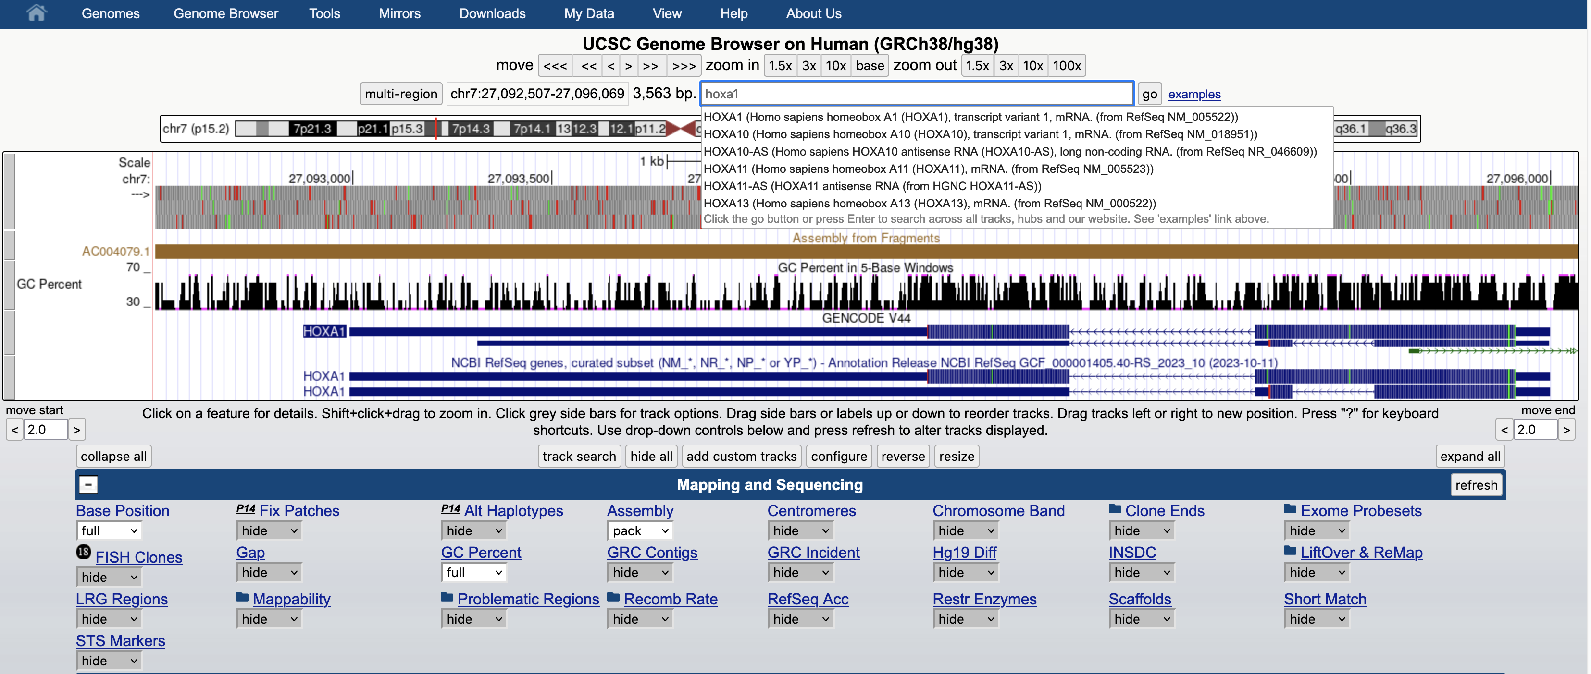
Use the search form to find items by name, e.g. gene HOXA1
Notes:
All tracks set to ‘hide’. The ‘base’ track set to ‘full’. ‘zoom in’ to ‘base’ view to see the actual nucleotides of the genome sequence.

Slide 16
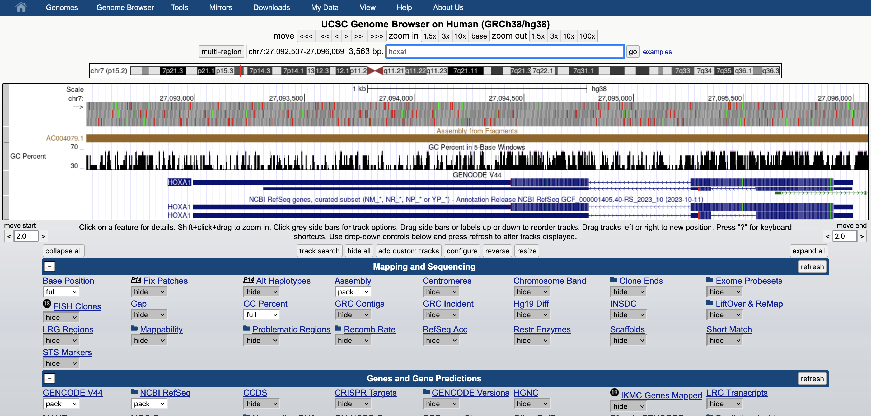
gene structure display in the browser
UTR- Untranslated region
Exon coding region
Intron non-coding region
Notes:
Gene display – UTR untranslated region – thin line, Exon coding region – thick line, Intron non-coding region – chevron arrows indicating direction of transcription
https://www.khanacademy.org/science/ap-biology/gene-expression-and-regulation/transcription-and-rna-processing/a/overview-of-transcription

Slide 17
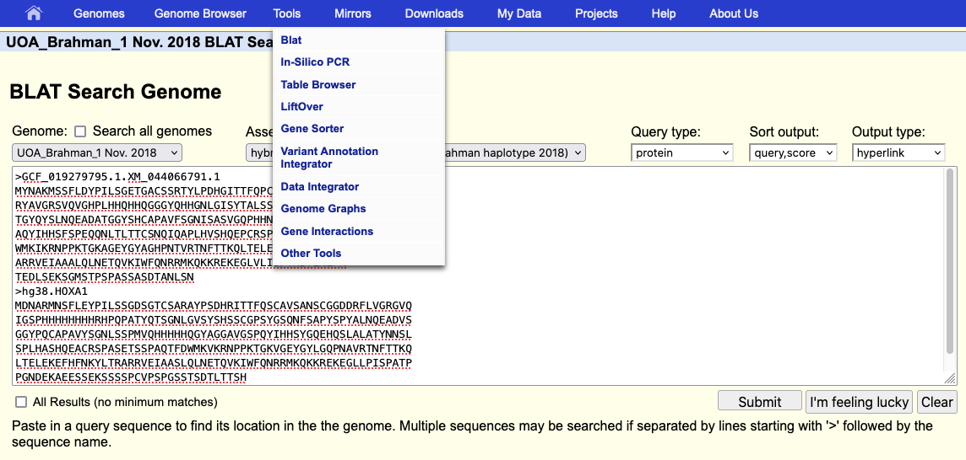
blat service now available on all assemblies
Notes:
The blat service was recently upgraded to handle very large genome assemblies. Previous limitation was a genome size of 4 Gbases.

Slide 18
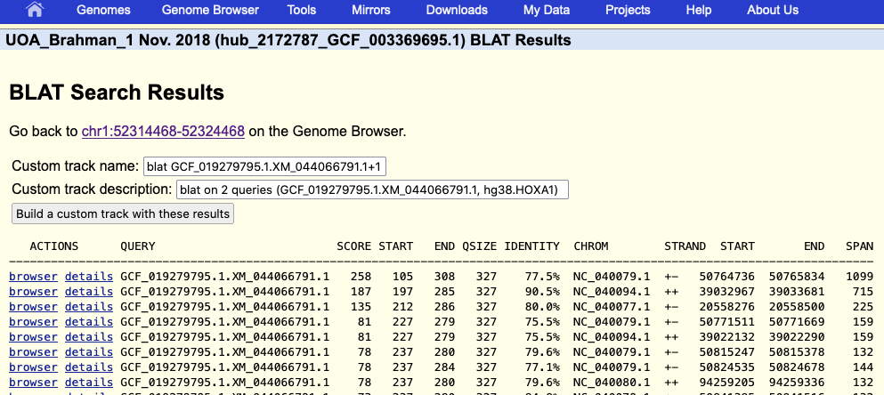
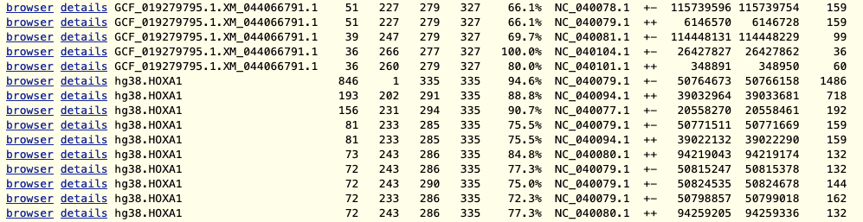
blat results
Notes:
From the blat results page, you can view the individual results, or build a custom track with all the results.

Slide 19
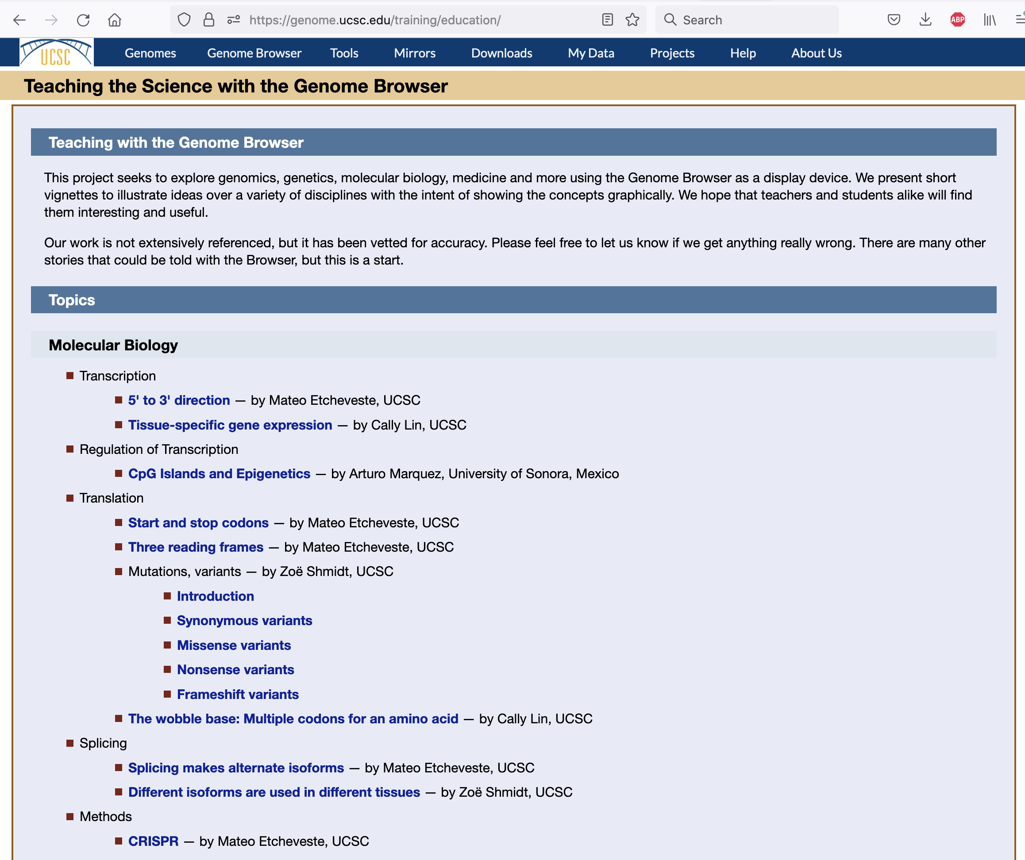
https://genome.ucsc.edu/training/education/
Notes:
Useful scenarios demonstrating biology topics using the genome browser. Leads to sessions in the browser where the demonstration can be use interactively.

Slide 20
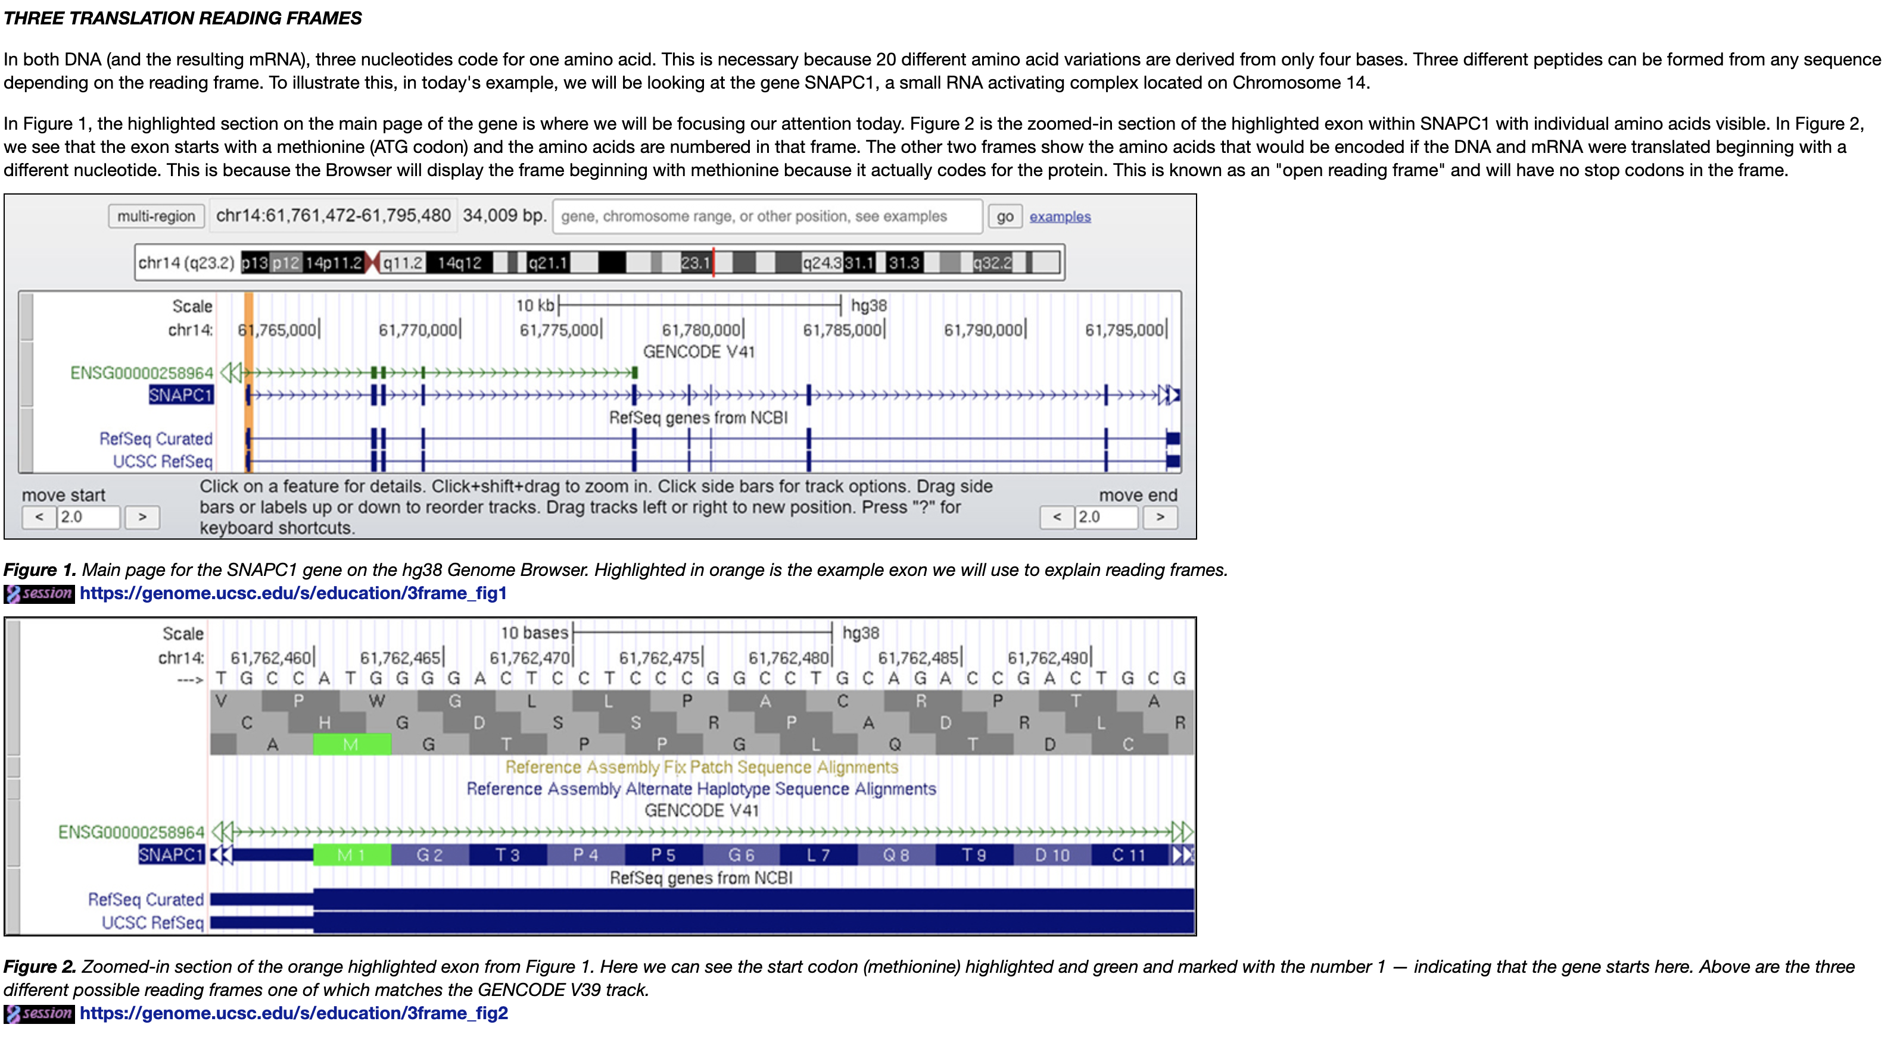
Three ‘Reading’ frames
Notes:
Sample lesson, what are ‘reading’ frames, why are there three. What about the ‘other’ three ?

Slide 21
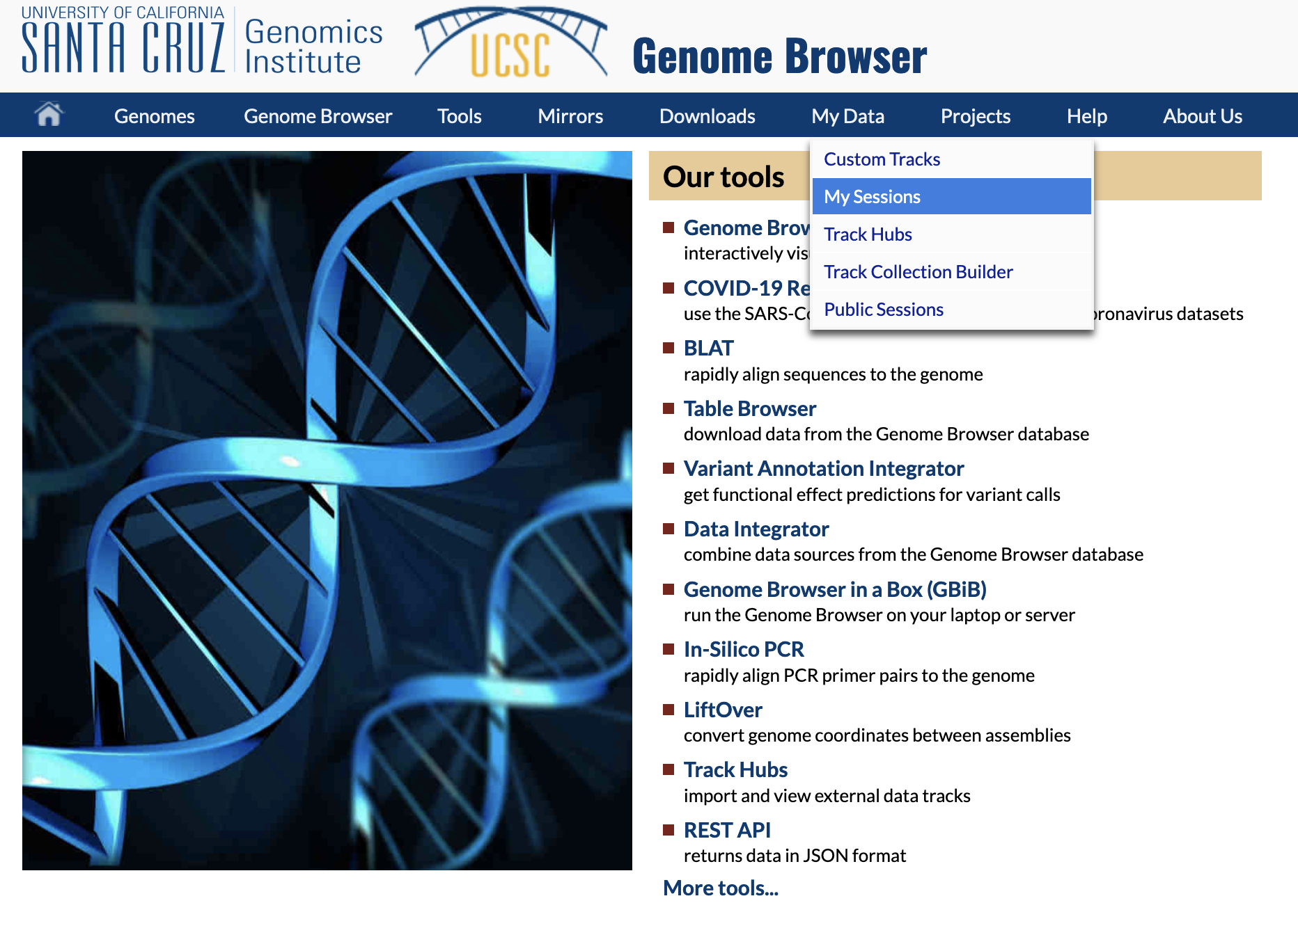
Create your own ‘sessions’ – views in the browser
See also: http://genome.ucsc.edu/goldenPath/help/sessions.html
Notes:
You can establish a login ‘account’ with the genome browser. With that account you can save ‘sessions’ – specific views of the genome browser configured to demonstrate something of interest. You can place your session in the ‘public’ list of sessions, or write to us private email at: genome-www@soe.ucsc.edu to suggest your session be used in the educational resources page.

Slide 22
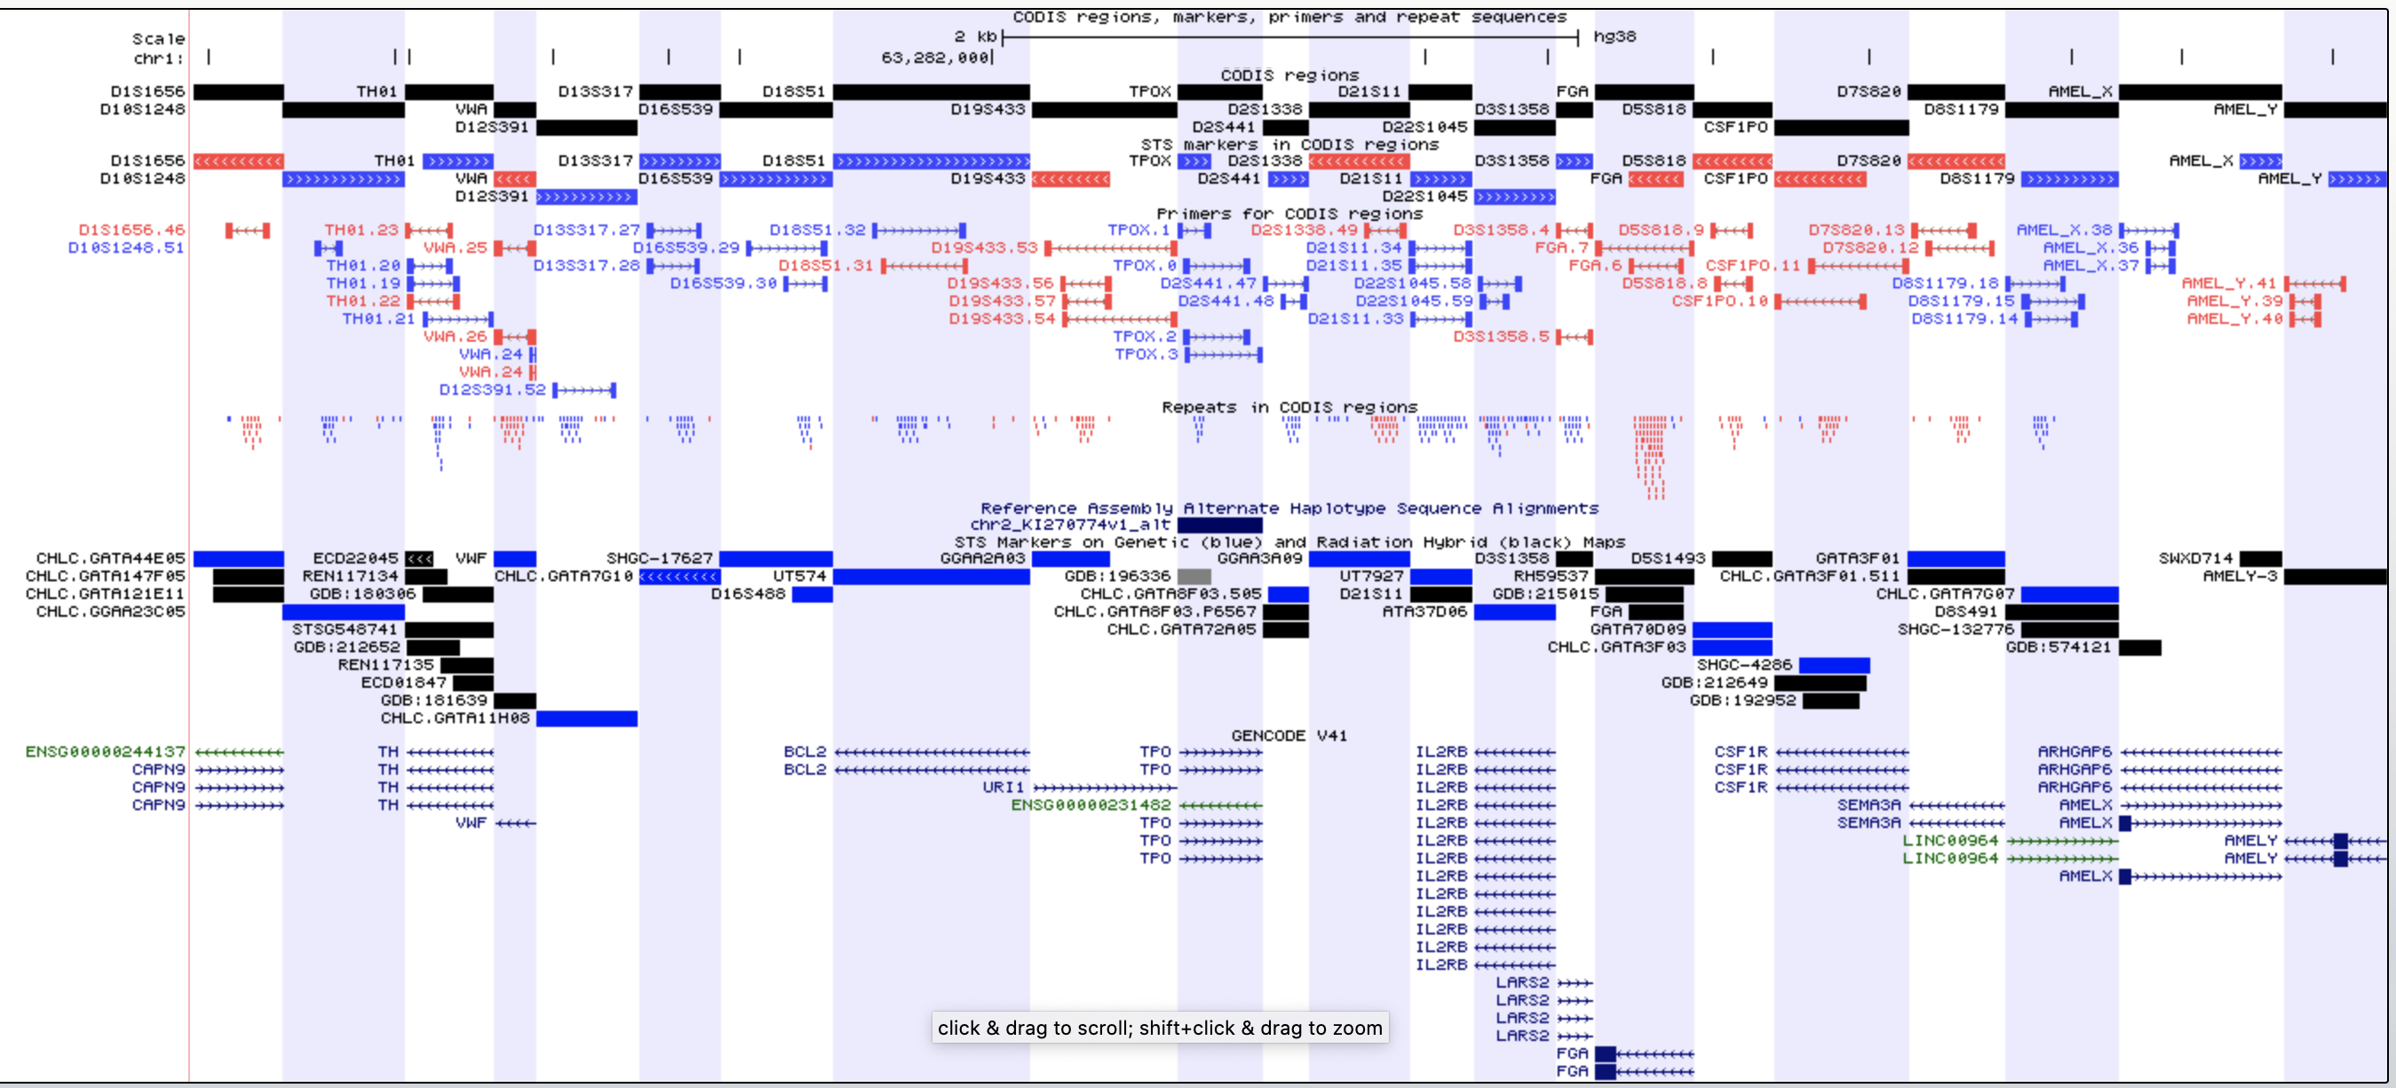
Leave you with a puzzle: how does DNA forensic identification work ?
https://genome.ucsc.edu/s/Hiram/hg38.codis
Notes:
What is CODIS ? What are DNA short tandem repeats ? What are the ethical considerations in such identification schemes ? https://genome.ucsc.edu/s/Hiram/hg38.codis

