Slide 1
The QA Release Process
what gets pushed, and when

Slide 2
Overview
This is not about how we should release things
This is about our current release processes:
CGIs
Tracks, trackDb, and how to update existing tracks
Static docs
Table descriptions
Slides include several links and will be up on genomewiki

Slide 3
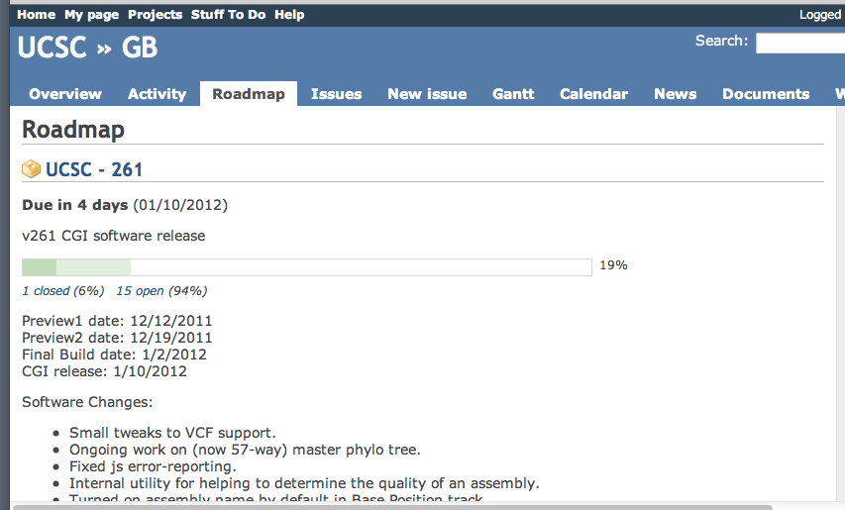
Most changes
Most code changes to the kent source tree go out with the CGI release every 3 weeks
The release schedule has an iCalendar:
http://www.google.com/calendar/ical/soe.ucsc.edu_r3m0u3g5o4glfer53i9vbe596s%40group.calendar.google.com/public/basic.ics
You can also find the scheduled release dates in Redmine: click on Roadmap

Slide 4
New features and big code changes
The best time to commit changes:
Self-contained new module: the week of the “final build” (so that it gets the most visibility on hgwdev)
Changes to many places in the code: immediately after a successful CGI release (to keep from interfering with build patches)
If changes need more testing time, use a demo sandbox:
http://genomewiki.ucsc.edu/index.php/Demo_sandbox
Please be available on push day if you have changes going out

Slide 5
CGIs: what is tested?
hgTracks and hgTables are the only CGIs that are tested every release cycle
Other CGIs tested only if they have changed
If you change something, let us know!
add the appropriate QA person as a watcher to the Redmine ticket (the sooner the better):
http://genomewiki.ucsc.edu/genecats/index.php/CGI_testing_responsibilities
fill out the CGI field in Redmine
add a target version in Redmine (this makes it show up on the Roadmap page, where QA sees it)

Slide 6
CGIs: what is pushed?
We ask for a specific subset of CGIs and files to be pushed:
http://genomewiki.ucsc.edu/genecats/index.php/CGI_Build_Process#Push_to_hgw0_only
If you add a new file or CGI, TELL US!
Many files, such as images, are only pushed once – alert the CGI push shepherd to get them pushed

Slide 7
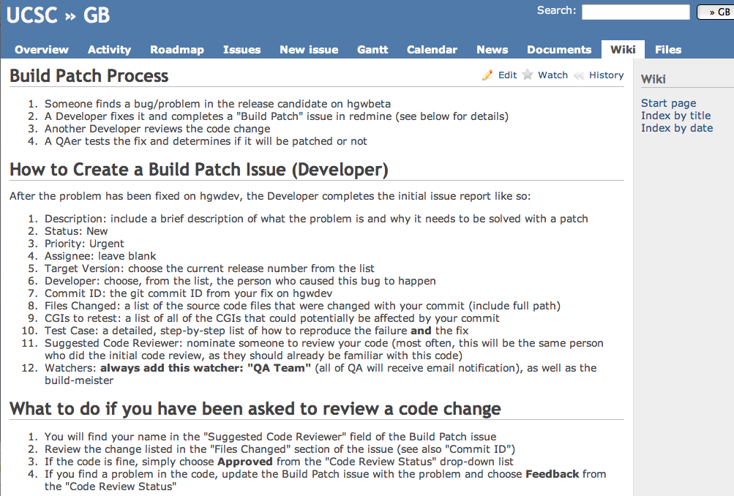
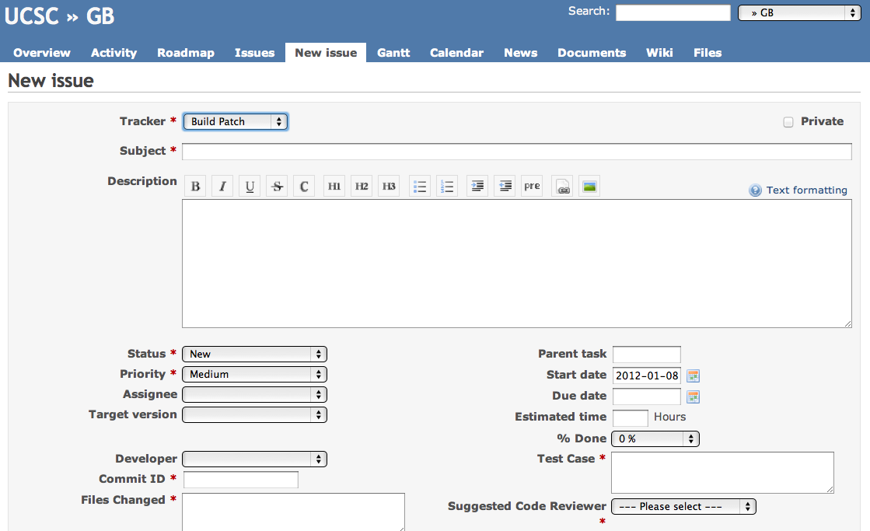
Build Patches
QAers test CGIs on hgwbeta during the week of the final build
To get a fix into the release candidate build, fill out a Build Patch ticket
http://redmine.soe.ucsc.edu/projects/genomebrowser/wiki/Build_Patch

Slide 8
Some things don’t follow the 3 week release cycle . . .

Slide 9
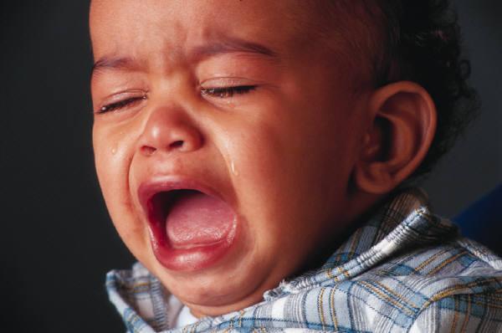
Changes here can go out at ANY time:
trackDb and friends:
kent/src/hg/makeDb/trackDb/*
Static docs:
kent/src/hg/htdocs/*, htdocsExtras/*, hgdownload/*
Table descriptions:
mostly in kent/src/hg/lib/*.as

Slide 10
Tracks
Track pushes are mostly decoupled from the CGI pushes, but if your track depends on a specific CGI version, note it in Redmine
Make Redmine tickets and push queue entries as complete as possible:
give background info
suggest tracks to compare to
mention use of release tags
include ALL tables and files (extFile and seq tables are often forgotten, for example)
Instructions: http://genomewiki.ucsc.edu/genecats/index.php/Dev_to_QA_Handoff
Redmine will replace push queue in the future

Slide 11
trackDb pushes: what
It’s actually “trackDb and friends”:
http://genomewiki.ucsc.edu/genecats/index.php/Pushing_trackDb
The changes in kent/src/hg/makeDb/trackDb/* get to the RR via 3 tables:
trackDb
hgFindSpec
metaDb
and 3 files: trackDb.ix, trackDb.ixx, cv.ra
All except trackDb and hgFindSpec tables support ENCODE and Track Search

Slide 12
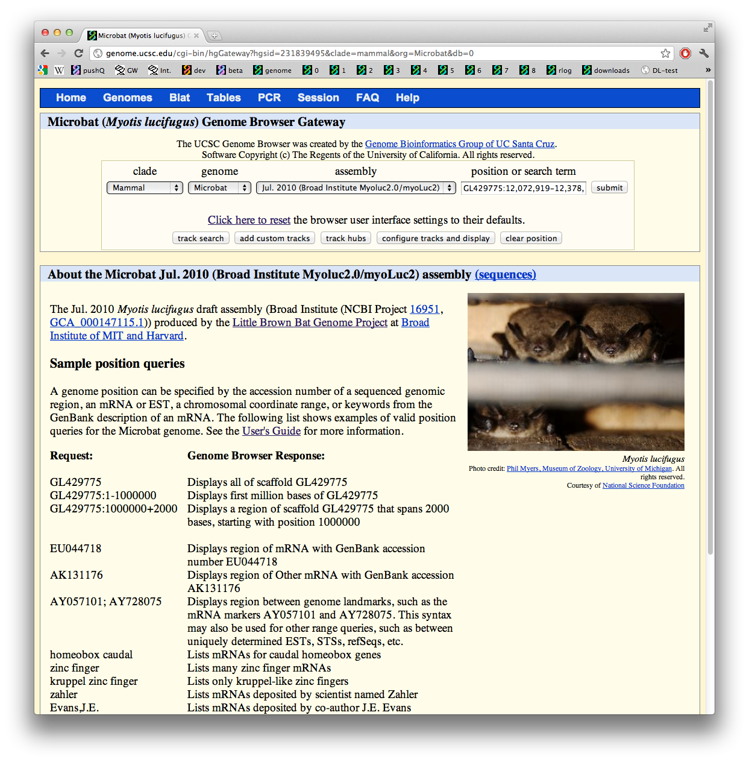
A trackDb exception: description.html
Though description.html files reside in kent/src/hg/makeDb/trackDb/, they never get pushed after an initial release unless specifically requested
Example: trackDb/microbat/myoLuc2/description.html
(These get pushed from /gbdb on hgwdev to /gbdb on hgnfs1, which serves hgwbeta and the RR.)

Slide 13
trackDb pushes: when
Usually pushed when a track is released or settings adjusted
hg19, hg18, and mm9 go out all the time
Others may not go out unless requested:
Email browser-qa if you need something minor pushed (e.g., you fixed a typo or link)
Make a Redmine ticket and email browser-qa if it needs more review
We also periodically check for changes and push them

Slide 14
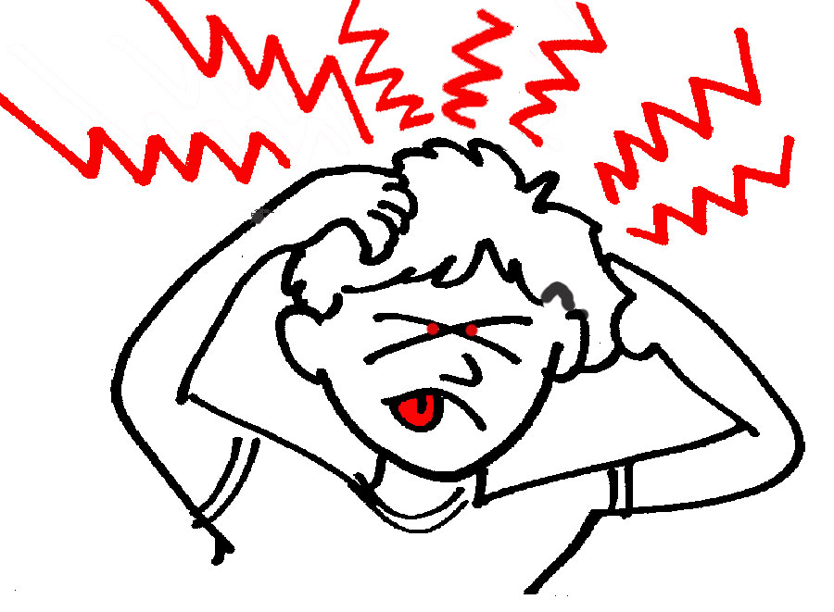
Updating existing tracks

Slide 15
Updating existing tracks: trackDb
If your changes to trackDb.ra files get pushed to the RR but the matching tables are not there, no problem
If you are changing an existing track, you probably need to use trackDb “release tags”:
http://genomewiki.ucsc.edu/index.php/ThreeStateTrackDb
(also documented in kent/src/hg/makeDb/trackDb/README)

Slide 16
Updating existing tracks: trackDb
A release tag determines whether a version of a track will be included in the trackDb table on a particular machine during a make (from genomewiki page):
make alpha run on hgwdev loads all tracks with release alpha into trackDb and hgFindSpec regardless of the table existing
make beta run on hgwbeta loads all tracks with release beta into trackDb and hgFindSpec only if the table exists
make public run on hgwbeta loads all tracks with release public into trackDb_public and hgFindSpec_public only if the table exists
Having no release tag is equivalent to having all 3 release tags present.
(trackDb_public is pushed to the RR and renamed trackDb)

Slide 17
Release tag example
track someRnas
shortLabel Mediocre RNAs
visibility hide
track someRnas
release alpha
shortLabel Great RNAs
visibility pack
html someRnasNew.html
track someRnas
release beta,public
shortLabel Mediocre RNAs
visibility hide
track someRnas
shortLabel Great RNAs
visibility pack
Developer adds:
Start:
QA eventually changes to:

Slide 18
Updating existing tracks: CGI changes
Never, never, never make code changes such that your track will only work with a new version of tables
. . . But if you do, coordinate with QA to get tables pushed at the same time as a CGI release
Allow ample time for QA!

Slide 19
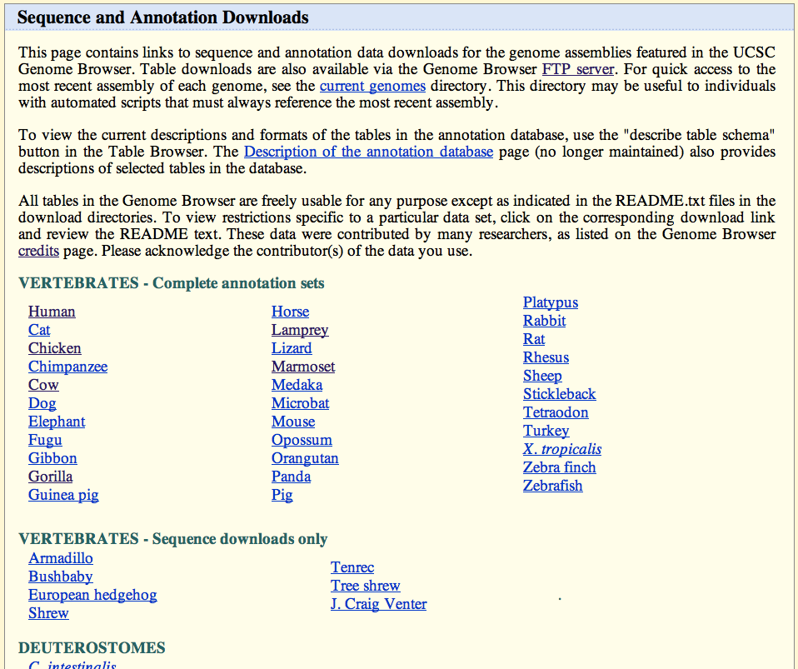
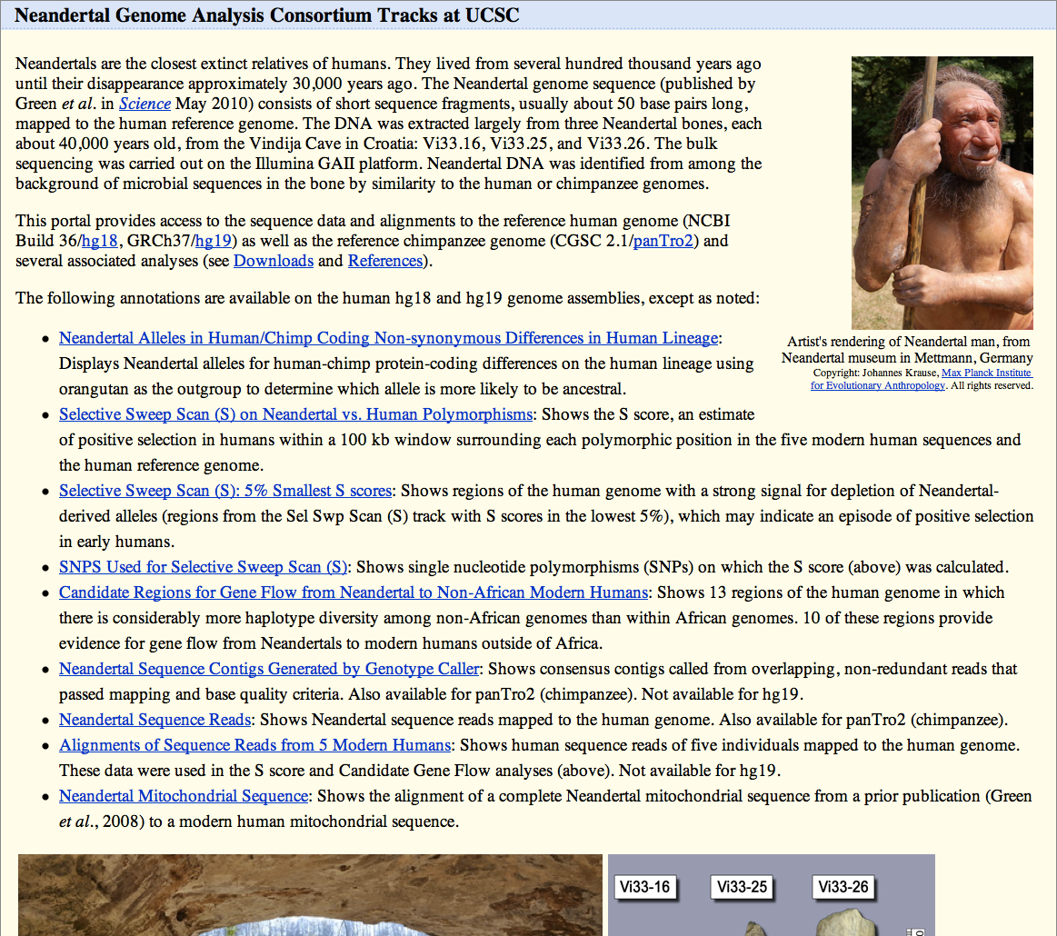
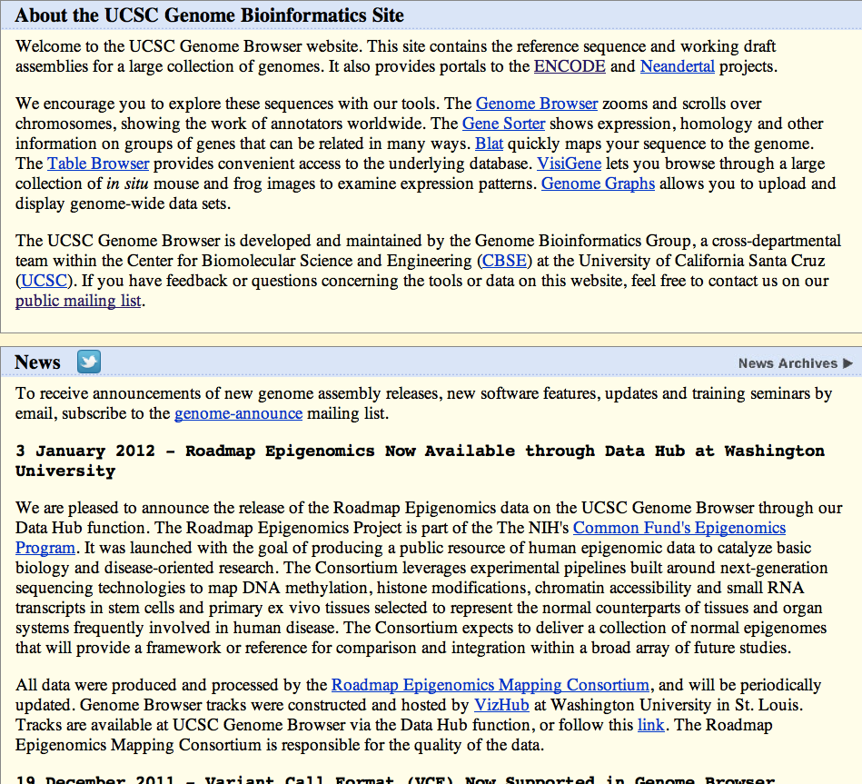
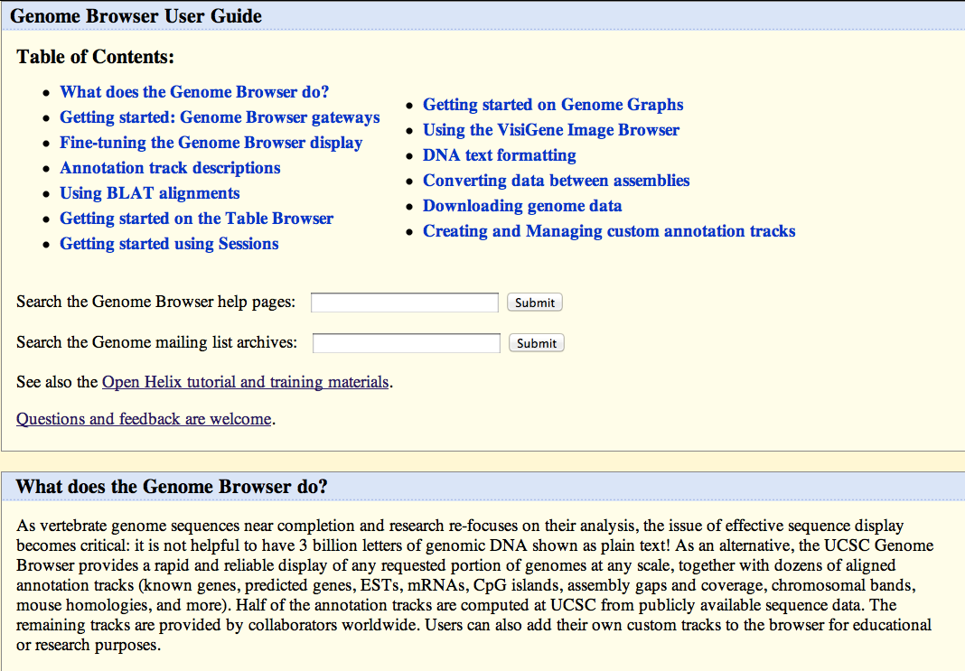
Static docs: what
Static docs are mostly in kent/src/hg/htdocs/*, but there are two other source trees: htdocsExtras and hgdownload
They all wind up in /usr/local/apache/htdocs/*

Slide 20
Static docs: when
Static docs can be pushed at any time, but
Static docs are not ever pushed automatically (so if QA doesn’t know about a change, it might not be pushed for a long time)
It is safe to add changes as comments until QA can look at them
NOTE: this comment style messes up the syntax highlighting in some text editors:
<!-- ------------ comment goes here ------------ -->
These are fine:
<!-- ======== comment goes here ======== --> <!-- *----------- comment goes here -----------* --> <!-- /----------- comment goes here ------------/ -->
<!-- ________ comment goes here ________ -->

Slide 21
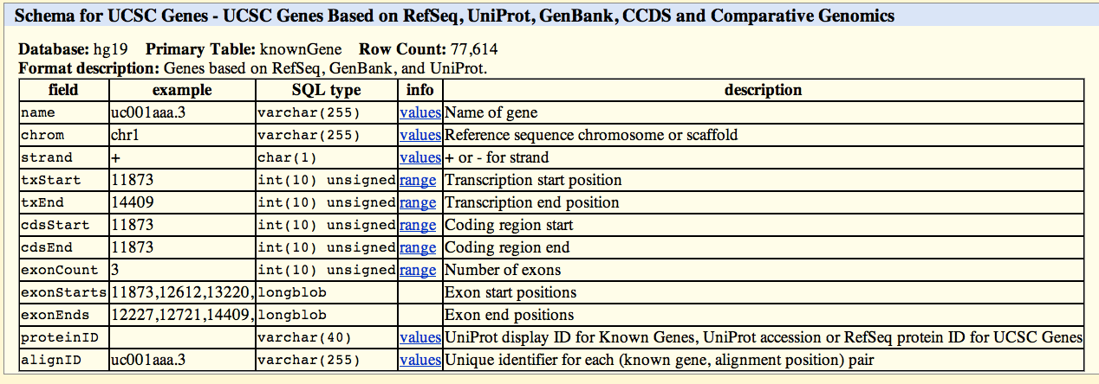
Table Descriptions
these
tableDescriptions tables for assembly databases are built nightly on hgwdev and mysqlbeta
http://genomewiki.ucsc.edu/index.php/TableDescriptions
The tableDescriptions tables are currently pushed from mysqlbeta to mysqlrr once a week, on Fridays
If you change an existing .as file, make sure it applies to all of the current tables on the RR

Slide 22
In summary
The current processes are not perfect, but they are what we have right now
If you have ever had your changes go out at an unexpected time, you are not alone
QA accepts apology chocolate, cookies, cake, lunch, etc.
QA also accepts suggestions for improvement ;-)

Slide 23
Thank you!
Questions?
Reach all QAers at browser-qa@soe.ucsc.edu

Slide 24
Links from previous slides
http://www.google.com/calendar/ical/soe.ucsc.edu_r3m0u3g5o4glfer53i9vbe596s%40group.calendar.google.com/public/basic.ics
http://genomewiki.ucsc.edu/index.php/Demo_sandbox
http://genomewiki.ucsc.edu/genecats/index.php/CGI_testing_responsibilities
http://genomewiki.ucsc.edu/genecats/index.php/CGI_Build_Process#Push_to_hgw0_only
http://redmine.soe.ucsc.edu/projects/genomebrowser/wiki/Build_Patch
http://genomewiki.ucsc.edu/genecats/index.php/Dev_to_QA_Handoff
http://genomewiki.ucsc.edu/genecats/index.php/Pushing_trackDb
http://genomewiki.ucsc.edu/index.php/ThreeStateTrackDb
http://genomewiki.ucsc.edu/index.php/TableDescriptions

