Slide 1
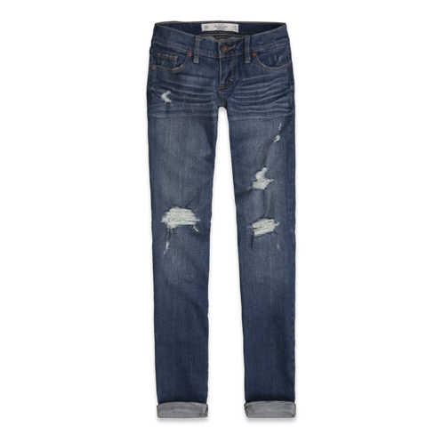
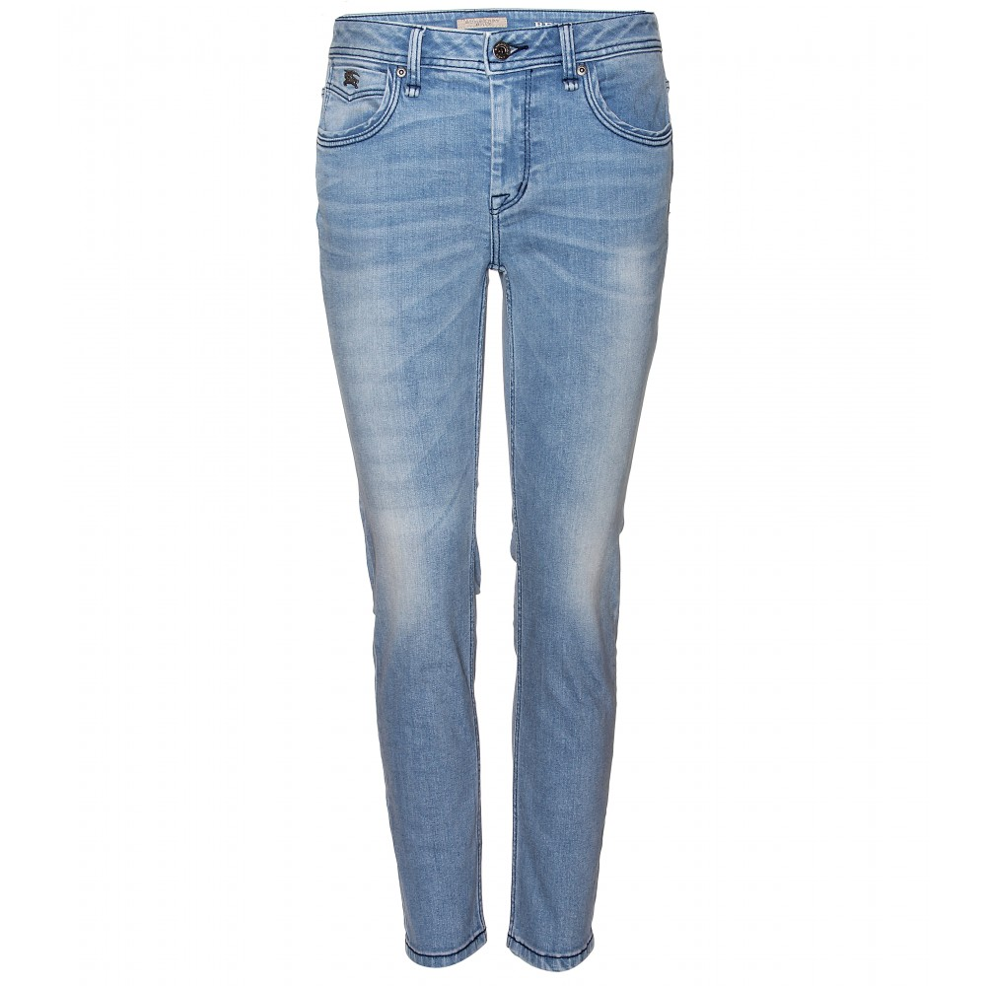
UCSC Genes
Genecats 3/20/13
Brian Raney

Slide 2
Talk Overview
What is UCSC genes?
Where do the gene models come from?
How does it all plug into the Genome Browser?
Interactive Q&A

Slide 3
UCSC Genes Overview
Semi-conservative set of gene models
Stable id’s with version numbers
Built on latest mouse and human every six months(?)
~25 supporting tables (kg*, known*)
Gene models based on several lines of evidence
RefSeq, mRNA, EST, Rfam, CCDS, MAFs, exoniphy
Extensive link out resources
Questionable Future
Two supporting databases
proteome, uniProt

Slide 4
Method Sketch
Build uniProt database
Build proteome database
Build gene models
Build link-out tables

Slide 5
uniProt Database
comprehensive, high-quality and freely accessible resource of protein sequence and functional information.
ftp://ftp.expasy.org/databases/uniprot/current_release/knowledgebase/complete/
uniprot_sprot.dat.gz
uniprot_trembl.dat.gz
uniprot_sprot_varsplic.fasta.gz
37 tables
Doc in kent/src/hg/makeDb/doc/uniProt

Slide 6
Proteome Database
Local mish-mash of remote sourced data and cross-reference tables.
HGNC (HUGO Gene Nomenclature Committee)
Reactome (biological pathways)
Interpro (protein familes)
Pfam (protein domains)
Doc in kent/src/hg/makeDb/doc/proteins
Probably should be retired.

Slide 7
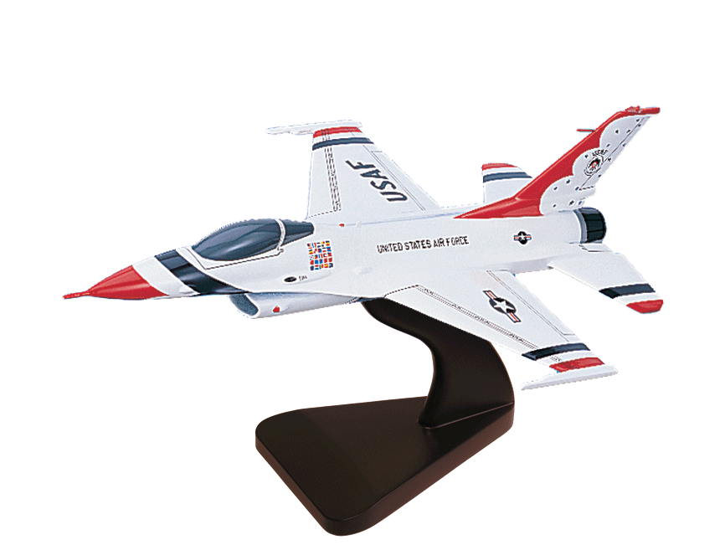
Build Gene Models
Grab Input data
Genbank alignments
CCDS (genbank)
tRNA (Lowe lab)
Rfam (rna families, Sanger)
Exoniphy (Siepel, deprecated)

Slide 8
Build Gene Models (2)
Separate out antibody regions
Build splicing graphs for mRNA and ESTs
Establish evidence weights
refSeq 100
ccds 50
mrna 2
txOrtho 1
exoniphy 1
est 1
Create EST evidence when 2 native ESTs support it

Slide 9
Build Gene Models(3)
Map xDb mRNAs to our species for txOrtho
Do the txWalk!
Tools in kent/src/hg/txGraph
Doc in kent/src/hg/makeDb
/doc/ucscGenes
More detail on trackUi page
http://genome.ucsc.edu/cgi-bin/hgTrackUi?g=knownGene

Slide 11
Tables
knownGene
The central genepred format table.
kgColor
RGB colors for knownGene display in hgTracks

Slide 12
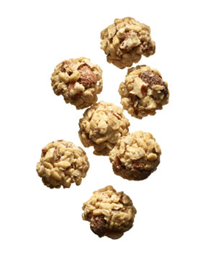
Gene Clusters
knownCanonical
Clustered knownGene to (mostly) have one gene per locus
knownIsoforms
Mapping of canonical cluster id’s to knownGene id’s
Used in gene suggest (?)

Slide 13
UCSC Gene Sequence Tables
knownGeneMrna
Sequence of mRNA associated with every gene model.
knownGenePep
Protein sequence from the CDS of translated sequence in knownGeneMrna
knownGeneTxMrna
The mRNA sequence if it had been transcribed from the reference genome
knownGeneTxPep
Protein sequence from from the CDS of translated sequence in knownGeneMTxrna

Slide 14
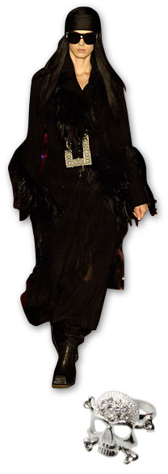
knownAlt
Alt splicings, output from txgAnalyze, (91,222)
altThreePrime, bleedingExon, retainedIntron, cassetteExon, altFivePrime, altPromoter, altFinish, strangeSplice, atacIntron,
Bed6
chr1 12594 12612 altThreePrime 0 +
chr1 1440 16606 bleedingExon 0 -
Used?

Slide 15
Blast Tables
Built by doHgNearBlastp.pl
Sum of all in knownBlastTab (updated?)
Other species
Mouse knownGene mmBlastTab
Rat rgdGene rnBlastTab
Worm sangerGene ceBlastTab
Zebrafish Ensembl drBlastTab
Human knownGene hgBlastTab
Fly flyBaseGene dmBlastTab

Slide 16
BlastTab Schema
+-----------+------------------+------+-----+---------+-------+
| Field | Type | Null | Key | Default | Extra |
+-----------+------------------+------+-----+---------+-------+
| query | varchar(255) | NO | MUL | NULL | |
| target | varchar(255) | NO | | NULL | |
| identity | float | NO | | NULL | |
| aliLength | int(10) unsigned | NO | | NULL | |
| mismatch | int(10) unsigned | NO | | NULL | |
| gapOpen | int(10) unsigned | NO | | NULL | |
| qStart | int(10) unsigned | NO | | NULL | |
| qEnd | int(10) unsigned | NO | | NULL | |
| tStart | int(10) unsigned | NO | | NULL | |
| tEnd | int(10) unsigned | NO | | NULL | | g
| eValue | double | NO | | NULL | |
| bitScore | double | NO | | NULL | |
+-----------+------------------+------+-----+---------+-------+

Slide 17
Mappings from previous set
If previous set on different assembly built with pslMap
Names like kg5ToKg6
Status from: exact, compatible, overlap, none
+------------+----------+----------+--------+------------+--------+------+
| oldId | oldChrom | oldStart | oldEnd | newId | status | note |
+------------+----------+----------+--------+------------+--------+------+
| uc001aaa.3 | chr1 | 11873 | 14409 | uc001aaa.3 | exact | |
| uc010nxq.1 | chr1 | 11873 | 14409 | uc010nxq.1 | exact | |
| uc010nxr.1 | chr1 | 11873 | 14409 | uc010nxr.1 | exact | |
+------------+----------+----------+--------+------------+--------+------+

Slide 18
kgXref
+-------------+--------------+------+-----+---------+-------+
| Field | Type | Null | Key | Default | Extra |
+-------------+--------------+------+-----+---------+-------+
| kgID | varchar(255) | NO | MUL | NULL | |
| mRNA | varchar(255) | NO | MUL | NULL | |
| spID | varchar(255) | NO | MUL | NULL | |
| spDisplayID | varchar(255) | NO | MUL | NULL | |
| geneSymbol | varchar(255) | NO | MUL | NULL | |
| refseq | varchar(255) | NO | MUL | NULL | |
| protAcc | varchar(255) | NO | MUL | NULL | |
| description | longblob | NO | | NULL | |
| rfamAcc | varchar(255) | NO | MUL | NULL | |
| tRnaName | varchar(255) | NO | MUL | NULL | |
+-------------+--------------+------+-----+---------+-------+

Slide 19
Misc Tables
kgAlias
Aliases for knownGene from uniProt
kgProtAlias
Mapping of knownGene to uniProt displayId and name
kgSpAlias
Mapping of knownGene ids to uniProt
kgProtMap2
CDS exons in PSL format
kgTargetAli
PSL mapping of knownGeneTxMrna sequence to reference genome

Slide 20
Overlap Tables
knownToAllenBrain
Mapping of Allen Brain Atlas id’s to knownGene id’s
knownToDecipher
Built by DECIPHER build process, overlaps of knownGene with DECIPHER table
knownCanonToDecipher
Built by DECIPHER load process, maps overlap of knownCanonical table and Decipher table
knownToEnsembl
Overlap of Ensembl and knownGene. Built by knownGene and Ensembl? process

Slide 21
Overlap Tables (2)
knownToGnfAtlas2
knownToHInv
knownToHprd
knownToKeggEntrez
knownToLocusLink
knownToPfam
knownToRefSeq
knownToSuper
knownToTreefam
knownToU133
knownToVisiGene

Slide 23
hgGeneData
kent/src/hg/hgGene/hgGeneData (cgi-bin/hgGeneData)
C_elegans
D_melanogaster
Human
Mouse
Rat
S_cerevisiae
Zebrafish
Assembly subdirs
genome.ra
links.ra
otherOrgs.ra
section.ra

Slide 24
Genome.ra
name global
knownGeneMrna knownGeneMrna
summaryTables refSeqSummary knownToRefSeq
summarySql select summary from refSeqSummary,knownToRefSeq where knownToRefSeq.name='%s' and (refSeqSummary.mrnaAcc=knownToRefSeq.value)
summaryIdSql select value from knownToRefSeq where name='%s'
summarySource RefSeq Summary

Slide 25
Description (genome.ra)

Slide 26
Links.ra
name omim
shortLabel OMIM
tables refLink kgXref
idSql select refLink.omimId from kgXref,refLink where kgID = '%s' and kgXref.refseq = refLink.mrnaAcc and refLink.omimId != 0
url http://omim.org/%s
priority 10

Slide 27
hgGene Page

Slide 28
uniProt

Slide 29
gad joined on uniProt id
Who makes this?

Slide 30
hgFixed.ctdSorted, kgXref.geneSymbol
Who makes this?

Slide 31
GNF Atlas

Slide 32
foldUtr3, foldUtr5 indexed by UC id

Slide 35
BlastTabs

Slide 36
uniProt id to GO term
Who builds go database?

Slide 37
genbank

Slide 40
kgTxInfo

Slide 41
kgTxInfo
+-----------------------+---------------------+------+-----+---------+-------+
| Field | Type | Null | Key | Default | Extra |
+-----------------------+---------------------+------+-----+---------+-------+
| name | varchar(255) | NO | MUL | NULL | |
| category | varchar(255) | NO | | NULL | |
| sourceAcc | varchar(255) | NO | | NULL | |
| isRefSeq | tinyint(3) unsigned | NO | | NULL | |
| sourceSize | int(11) | NO | | NULL | |
| aliCoverage | double | NO | | NULL | |
| aliIdRatio | double | NO | | NULL | |
| genoMapCount | int(11) | NO | | NULL | |
| exonCount | int(11) | NO | | NULL | |
| orfSize | int(11) | NO | | NULL | |
| cdsScore | double | NO | | NULL | |
| startComplete | tinyint(3) unsigned | NO | | NULL | |
| endComplete | tinyint(3) unsigned | NO | | NULL | |
| nonsenseMediatedDecay | tinyint(3) unsigned | NO | | NULL | |
| retainedIntron | tinyint(3) unsigned | NO | | NULL | |
| bleedIntoIntron | int(11) | NO | | NULL | |
| strangeSplice | int(11) | NO | | NULL | |
| atacIntrons | int(11) | NO | | NULL | |
| cdsSingleInIntron | tinyint(3) unsigned | NO | | NULL | |
| cdsSingleInUtr3 | tinyint(3) unsigned | NO | | NULL | |
| selenocysteine | tinyint(3) unsigned | NO | | NULL | |
| genomicFrameShift | tinyint(3) unsigned | NO | | NULL | |
| genomicStop | tinyint(3) unsigned | NO | | NULL | |
+-----------------------+---------------------+------+-----+---------+-------+

Slide 42
Thanks Everyone!

