Slide 1
UCSC Genome Browser
Accelerating biomedical research for 10 years and counting.

Slide 2
Past Present and Future
The initial phase of the browser was quite a rush
We build software much more quickly and robustly than other groups, consistently exceeding expectations.
The present is sometimes difficult but often satisfying
As software grows it tends to become harder to change
Changes seem small when compared with the big existing thing
Users rather than being excited by increases in productivity when they discover our tool, are now expected to use the tool, and annoyed by warts.
The future is as ever uncertain
Major grants up for renewal next year.
What is the future of genomics and our role in it?

Slide 3
Intronerator 1999
C. Elegans (worm) browser that was direct predecessor to Genome Browser
Version 1 was 3 tracks, by Nov 1999 up to 5.
Based on custom index files rather than SQL
The difficulty in adding new tracks, and the desire to use a SQL database
led to a rearchitecture, starting over from main, and selectively importing bits
of old code.
This rearchitecture took 1 week…..

Slide 4
Genome Browser 2001

Slide 5
Genome Browser 2001

Slide 6
Genome Browser Now
2672 tracks on RR, 6863 on main site
500,000 hits/day
Staff of 30 including ENCODE, admins, grant administrators, etc.
Thousands of citations
In textbooks, classes
In many senses _required_ for workers in molecular biology, genetics, and for students in the field.
Continues to be most reliable site in bioinformatics.

Slide 7
Exponential growth can’t last

Slide 8
On the other hand
In well run groups/companies, the “stationary” phase can still slowly expand with the market they are serving
Our market continues to grow. Genomics is moving from research to medicine among other things….
The “flat part” of the growth chart can last almost indefinitely if you don’t poison your environment.
The flat part is where you are actually having the most impact on the most people.
Even as software decays, it can provide a rich base for the next generation of software.

Slide 9
Supporting a mature product
The need to know what is the function of any particular base or larger region of the genome will, for the next few decades at least, _slowly_ grow.
Particular facets of this will grow quickly.
It’s important for us to support seeds taking off in new areas, but maintaining the large core we have is in some ways even more important.

Slide 10
Core Areas
Determining the classical DNA->mRNA->Protein genes – very slow growth here, but they are the most important class of genes, even though the most is known of them
Determining the regulatory regions. This is an explosive area now, and ENCODE is at it’s core.
Determining short RNA and other genes. Also a major ENCODE effort yeilding some fruit.
Determining all the variants of all the genes, both functional variation and pathological. In spite of 1000 genomes effort, it is early days here…..

Slide 11
A brief detour into regulation….

Slide 12
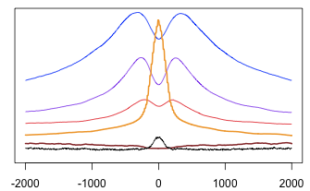
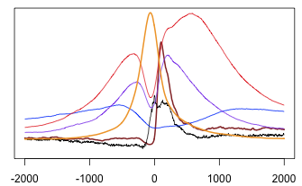
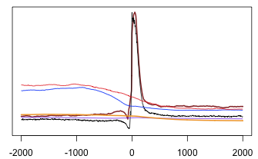
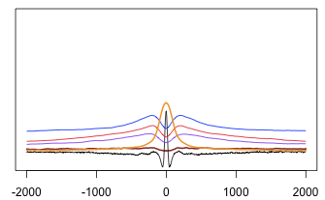
Average signals around features
DNAse + H3K4Me1 – Pro - CTCF
Active promoters in GM12878
Start of second coding exon
CTCF Sites
Blue H3K4Me1, purple H3K27Ac, red H3K4Me3, orange DNAse, brown RNA-seq, black conserv.

Slide 13
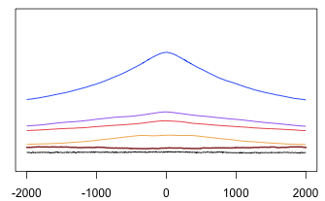
Comparing vs. ChromHMM
DNAse + H3K4Me1 – Pro - CTCF
Jason Ernst’s Chromatin HMM: 60,000 Stringent Enhancers.
Blue H3K4Me1, purple H3K27Ac, red H3K4Me3, orange DNAse, brown RNA-seq, black conserv.

Slide 14
Outside browser core
Medical sequencing: we are designed to be open, medical sequencing is a private concern. It badly _needs_ our core work, and so our core work can and should be funded by medical groups, but for many reasons I don’t think our group should focus on it.
10,000 genomes – this is very interesting, but to be done properly needs a group about our size, and needs funding from the ecologically concerned more than NIH.

Slide 15
Rearchitecting?
I’ll save most of this for another talk.
In general the 2000-2001 base design has been stretched and stretched and is growing brittle.
I would like to simplify the UI, and separate the display from the database a bit more.
This rearchitecture will take more than a week….
Biggest rearchitecture so far was table browser, which took 2 months.
Realistically rearchitecture will end up dropping features, and so will have a mixed reception.

Slide 16
Funding Stability?
Next year is a “triple witching” time as the main browser grant, ENCODE, and David H’s HHMI all come up for renewal or for ENCODE grant rearchitecture.
On the other hand a lot of medical related money is coming in, and browser group will get a piece of that.
Much less of a stretch to consider browser medical than you might think. Compare us to work in yeast funded by medical agencies!
Truly for medicines developed 10 years from now, the browser is likely to play more of a role than most more explicitly medical project do
We are likely to get renewals in any case.
In worst case, 2012 promises to be a much better year to find a job than 2010 was!

Slide 17
Conclusions & Discussion
Keeping the core browser going is an _important_ job.
The browser staff is doing an admirable job at it, a job that may sometimes be taken for granted but shouldn’t be.
Maintaining good social interactions and other ways keeping the job fun is important.
Our work is mature enough that while no piece of it may be _urgent_ most of it is _important_.
While there is too much work people want us to do, we have the ability to select what we consider most important and interesting to work on.
Let us know what _you_ find important and interesting, so we can write them into the next grants!

