Slide 1
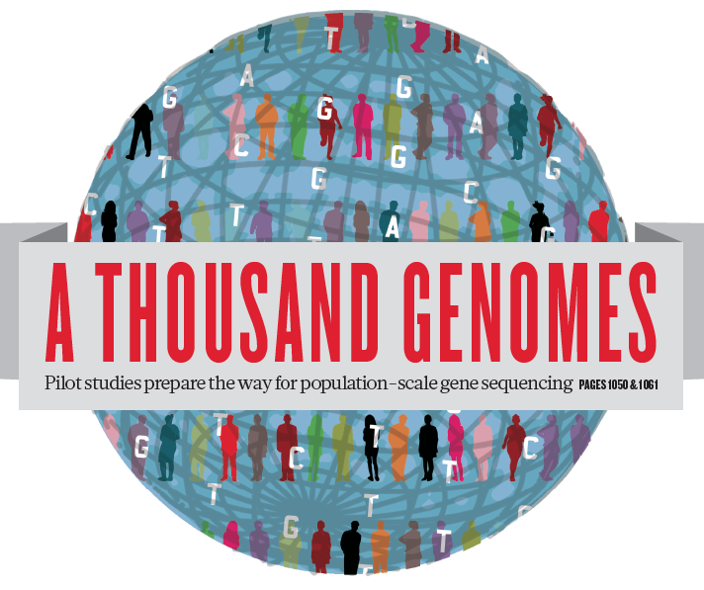
Toward a unified view of human genetic variation
Gabor Marth
Boston College Biology Department
on behalf of the International 1000 Genomes Project

Slide 2
Goals

Slide 3
The 1000 Genomes Project goals
Discover population level human genetic variations of all types (95% of variation > 1% frequency)
Define haplotype structure in the human genome
Develop sequence analysis methods, tools, and other reagents that can be transferred to other sequencing projects

Slide 4
How far have we come in the PAST year?

Slide 5
Finalized project design
Based on the result of the pilot project, we decided to collect data on 2,500 samples from 5 continental groupings
  Whole-genome low coverage data (>4x)
  Full exome data at deep coverage (>50x)
  Hi-density genotyping at subsets of sites
Moved from the Pilot into Phase 1 of the project

Slide 6
New data from new populations
Sample origin | Pilot | Phase 1 (now)
Africa | YRI | LWK, ASW
Asia | JPT, CHB | CHS
Europe | CEU | GBR, FIN, IBS, TSI
Americas (admixed) |  | MXL, PUR, CLM
Data type | Pilot | Phase 1 (now)
Deep genomes | 6 | -
Low coverage genomes | 179 | 1,094
Deep exonic | 697 (1,000 genes) | 977 (full exomes)
Chip genotypes | - | 1,542 (OMNI2.5)

Slide 7
Detected new variants
Variant | Pilot | Phase 1 (now)
Total SNP | 15.2M | 38.9M
Known SNP | 6.8M | 8.5M
Novel SNP | 8.4M | 30.4M
Short INDELs | 1.3M | 4.7M**
ftp://ftp.1000genomes.ebi.ac.uk
**Estimated from chromosome 20. Credit: Gerton Lunter

Slide 8
Improved completeness and accuracy
Call set | Samples | Sensitivity (HapMap3.3) | Sensitivity (OMNI polymorphic sites) | FDR (OMNI monomorphic sites)
Pilot | 179 | 97.65% | 98.49% | 73.02%**
ASHG’10 | 629 | 98.45% | 97.55% | 5.41%
Phase 1 | 1,094 | 98.87% | 98.41% | 2.11%
**Fraction of the 59,721 sites on the OMNI2.5 chip, designed based on early Pilot data variant call sets, that turned out to be monomorphic

Slide 9
Exome sequencing data
data volume [TB]
time
Paul Flicek

Slide 10
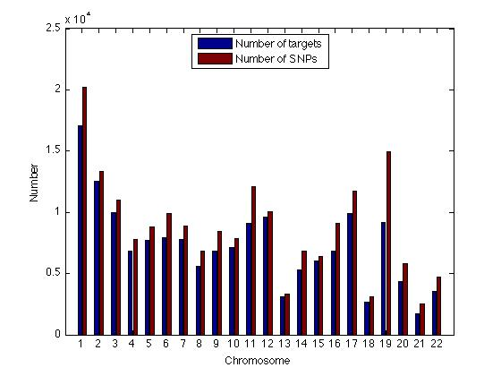
Exome variants
~30Mb aggregate exon target length
+/-50bp beyond exon boundaries analyzed
Based on ~half the data analyzed (458 samples)
  ~400,000 SNPs
  ~15,000 INDELs
Alistair Ward, Kiran Garimella, Fuli Yu

Slide 11
Sensitivity of low coverage whole genome data measured against exomes
number of sites
Number of sites in exome data
Number of sites also found in low coverage whole genome data
AF > 0.5%
Erik Garrison
count of alternate allele in exomes (in 688 shared samples)

Slide 12
Site concordance is very high above 1% allele frequency
number of sites
Number of sites in low coverage data
Number of sites also found in exome data
AF > 0.5%
Erik Garrison
count of alternate allele in low coverage (in 688 shared samples)

Slide 13
Genotypes are accurate
Average low coverage depth is ~5x
We obtain genotypes by sharing data between samples (using imputation-related methods)
 | HomRef | Het | HomAlt | Overall
Error rate | 0.16% | 0.76% | 0.39% | 0.37%

Slide 14
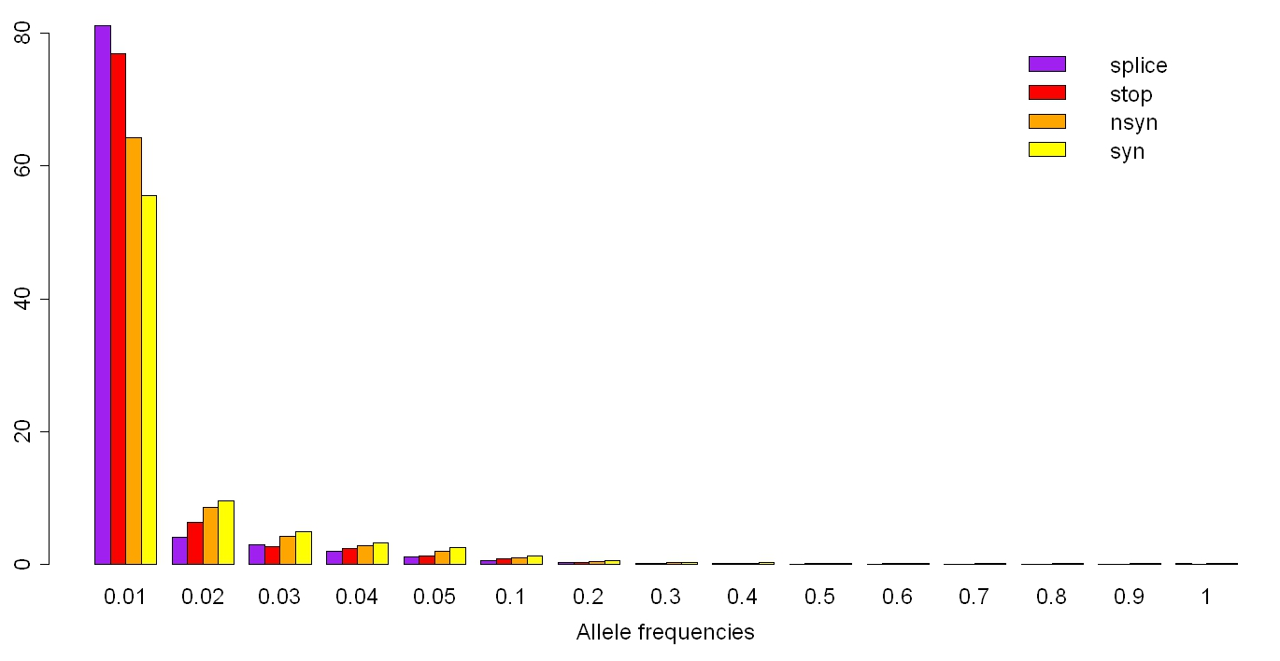
Newly discovered SNPs are enriched for functional variants
12M
  splice-disrupting 621
  stop-gain 1,654
  non-synonymous 84,358
  synonymous 61,155
10M
number of sites
8M
6M
Ryan Poplin
4M
Daniel MacArthur, Suganti Balasubramaniam
2M
0
0.001
0.01
0.1
1.0
frequency of alternate allele

Slide 15
NON-SNP Variants

Slide 16
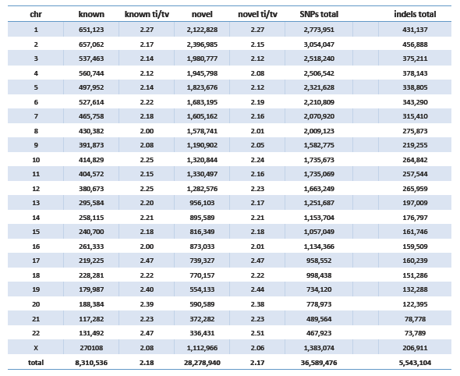
Short INDEL variants

Slide 17
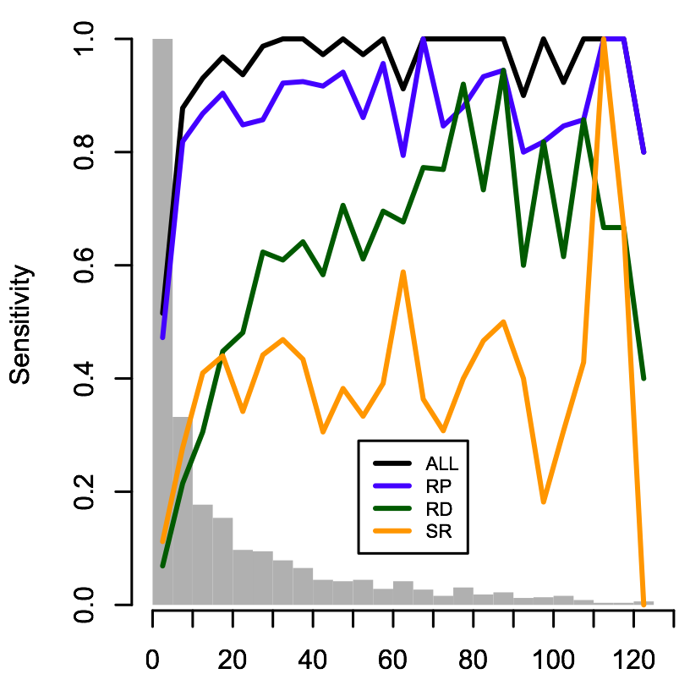
Finding structural variants
Discovery with a number of different methods
Several types (e.g. deletions, tandem duplications, mobile element insertions) now detectable with high accuracy
We are pulling in new types for the Phase I data (inversions, de novo insertions, translocations)

Slide 18
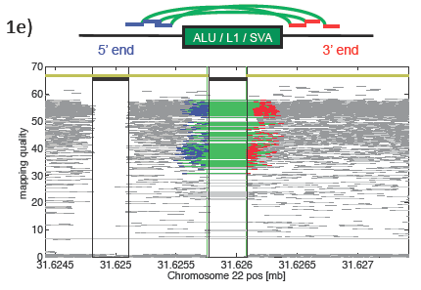
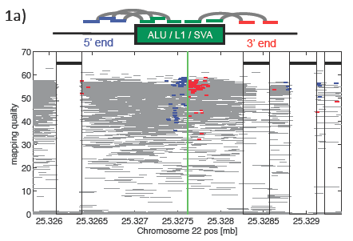
Finding Mobile Element Insertions
Chip Stewart

Slide 19
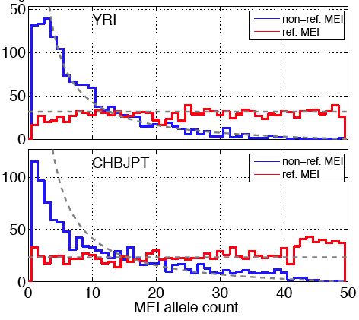
Detection of non-reference mobile element insertion (MEI) events
Chip Stewart

Slide 20
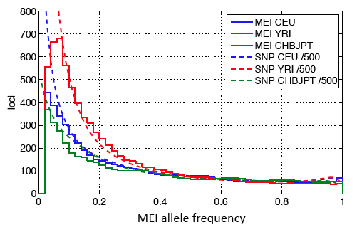
MEI allele frequency behavior
Segregation properties of MEIs are very similar to SNPs
Chip Stewart

Slide 21
Current AIM: Integrating Datasets and variant types

Slide 22

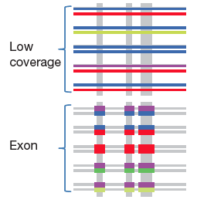
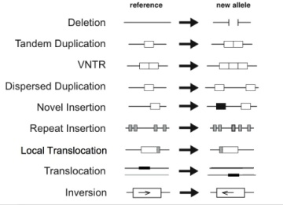

Datasets & variant types
GCGTGCTGAG
GCGTGATGAG
SNP
GCGTGCCTGAG
GCGTGAGTGAG
MNP
GCGTGCCTGAG
GCGTG--TGAG
INDEL
SV
SNP array data

Slide 23
Reconstruct haplotypes including all variant types, using all datasets
Deletion
Indels
SNPs (from LC, EX, OMNI)
Goncalo Abecasis

Slide 24
ADDITIONAL POPULATIONS

Slide 25
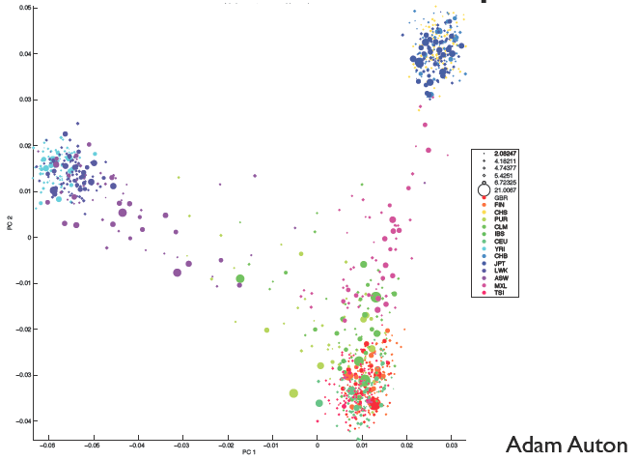
Continental & admixed populations

Slide 26
Local ancestry deconvolution
Columbian child 1
Columbian child 2
Simon Gravel

Slide 27
What are we delivering?

Slide 28
Data and resources
Comprehensive catalog of human variants
  SNPs, short INDELs
  MNPs, structural variations
Sites and allele frequency estimates in “normal” genomes that can be used in interpreting rare and common variants in medical sequencing projects
Imputation panels to help accurate genotype calling in medical sequencing projects
Genotyping chips based on new variants

Slide 29
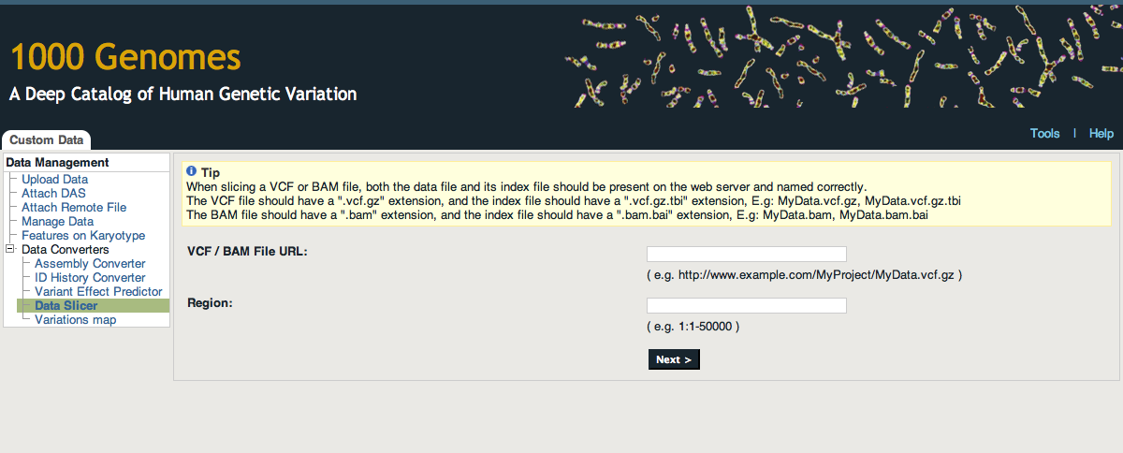
Data delivery
Bulk downloads
Browser
  Currently based on August 2010 data (to be updated)
  Allows retrieval of data “slices” (both VCF and BAM)

Slide 30
The 1000GP is a driver for method and tool development
New data formats (BAM, VCF) developed by the 1000GP are now adopted by the entire genomics community
Tools (read mappers e.g. BWA, MOSAIK, etc; variant callers including those for SVs)
Data processing protocols (BQ recalibration, dup removal, etc.)
Imputation and haplotype phasing methods

Slide 31
Fraction of variant sites present in an individual that are NOT already represented in dbSNP
Date | Fraction not in dbSNP
February, 2000 | 98%
February, 2001 | 80%
April, 2008 | 10%
February, 2011 | 2%
May 2011 (now) | 1%
Ryan Poplin, David Altshuler

Slide 32























Phase I (1,150)
Phase II (1,721)
Phase III (2,500)
CDX 17S
CDX (100S); DNA: 17 DNA from Bld, 83 from LCL
GIH vs. Sindhi (target – 100T)
CLM (70T); DNA from LCL
18 (5-10 trios)
Tamil (target – 100T)
KHV (82/100) – 15 trios; DNA Bld
CHS (100T); DNA from LCL
Sri Lankan (target – 100T)
45
99 (29T)
23 (7T)
51 (11 trios; 39S)
ACB (28/79T) – 14 trios; DNA Bld
Bengalee (target – 100T)
PUR (70T); DNA from Blood
13
20
26
26
9
39
27
26
22
Nigeria (target – 100T); DNA from LCL
FIN (100S); DNA from LCL
PEL (70T); DNA from Blood
Sierra Leone (target – 100T); DNA from LCL
GBR (96/100S); DNA from LCL
3
1
MAB (target – 100T); DNA from LCL
IBS (84/100T); DNA from LCL
16 (8T)
AJM (target – 80T); DNA from Bld
PJL (target – 100T); DNA from Blood
15
6
6
195
GWD
GWD
GWD
GWD (target – 100T); DNA from LCL
15
15
9
12
15
270
15
April 2009
Aug 2009
June 2009
Oct
2009
Dec
2009
Feb
2010
April 2010
June 2010
Aug 2010
Oct 2010
Dec 2010
Feb 2011
April 2011
June 2011
Aug 2011
Oct
2011
Dec 2011
Feb 2012
April 2012

Slide 33
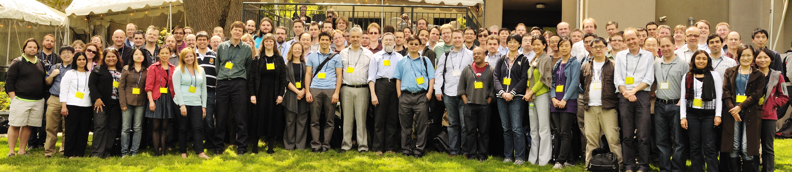
Credits
★ 1000G Tutorial at ICHG 2011
★ Community Meeting in Spring 2012

