Slide 1
topics for today
The U.C. Santa Cruz Genome Browser
GenArk collection of genome assemblies
Assembly hubs for your new genome assembly
REST API programmatic interface to extract data
Presenter: Hiram Clawson – U.C. Santa Cruz Genomics Institute
hclawson@ucsc.edu
our work is supported by a number of different grants:
National Human Genome Research Institute U41HG002371
National Human Genome Research Institute U24HG002371
Silicon Valley Community Foundation 2017-171531(5022)
National Institute of Allergy and Infectious Diseases
NIAID 75N93019C00076 AWD100477
Notes:
Topics in this presentation: 1. The U.C. Santa Cruz Genome Browser 2. GenArk collection of genome assemblies 3. Assembly hubs for your new genome assembly 4. REST API programmatic interface to extract data

Slide 2
UCSC Genome Browser
https://genome.ucsc.edu/
Notes:
U.C. Santa Cruz genome browser home page: https://genome.ucsc.edu/

Slide 3
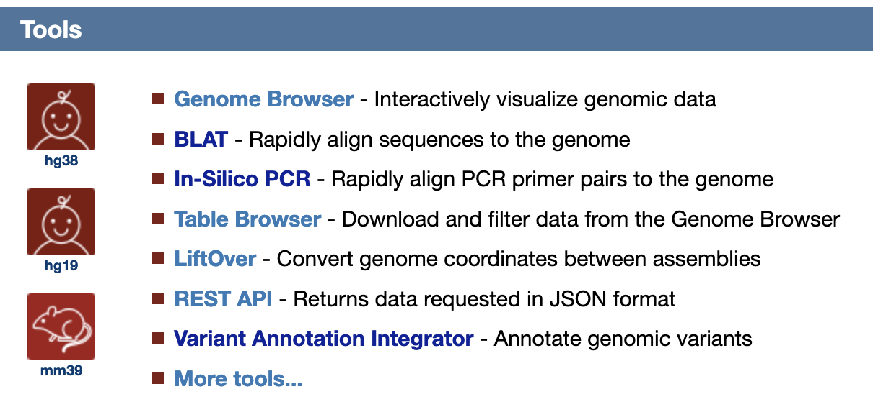
Browser + tool sets
e.g. UShER (for SARS-CoV-2)
Notes:
Many additional tools available with the genome browser.

Slide 4
Browser + Education
Notes:
Training and education outreach are important services from the genome browser team.

Slide 5
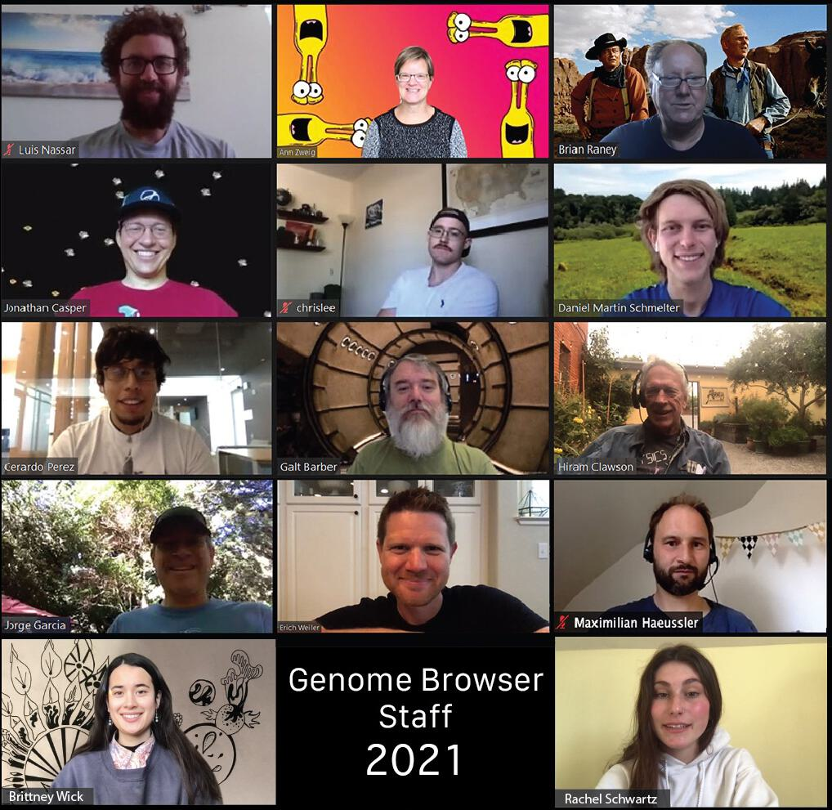
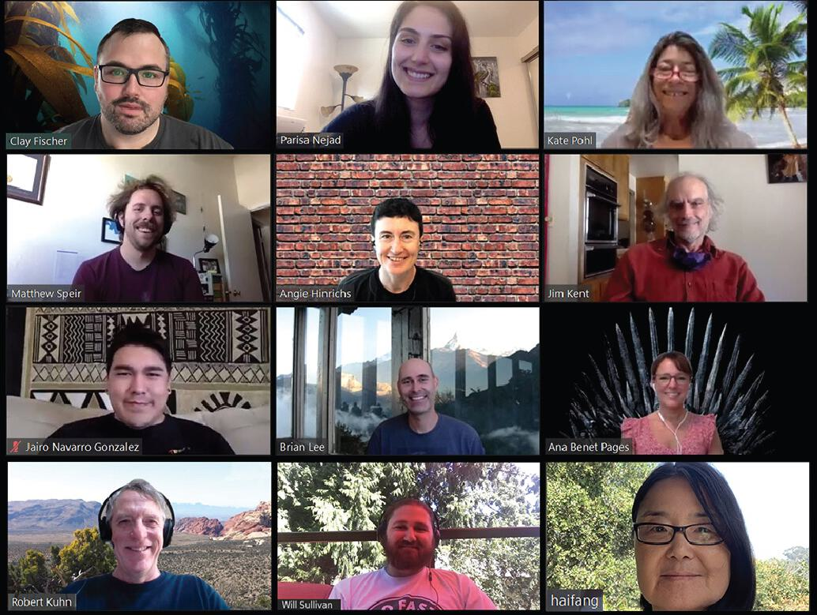
The UCSC Genome Browser Staff

Slide 6
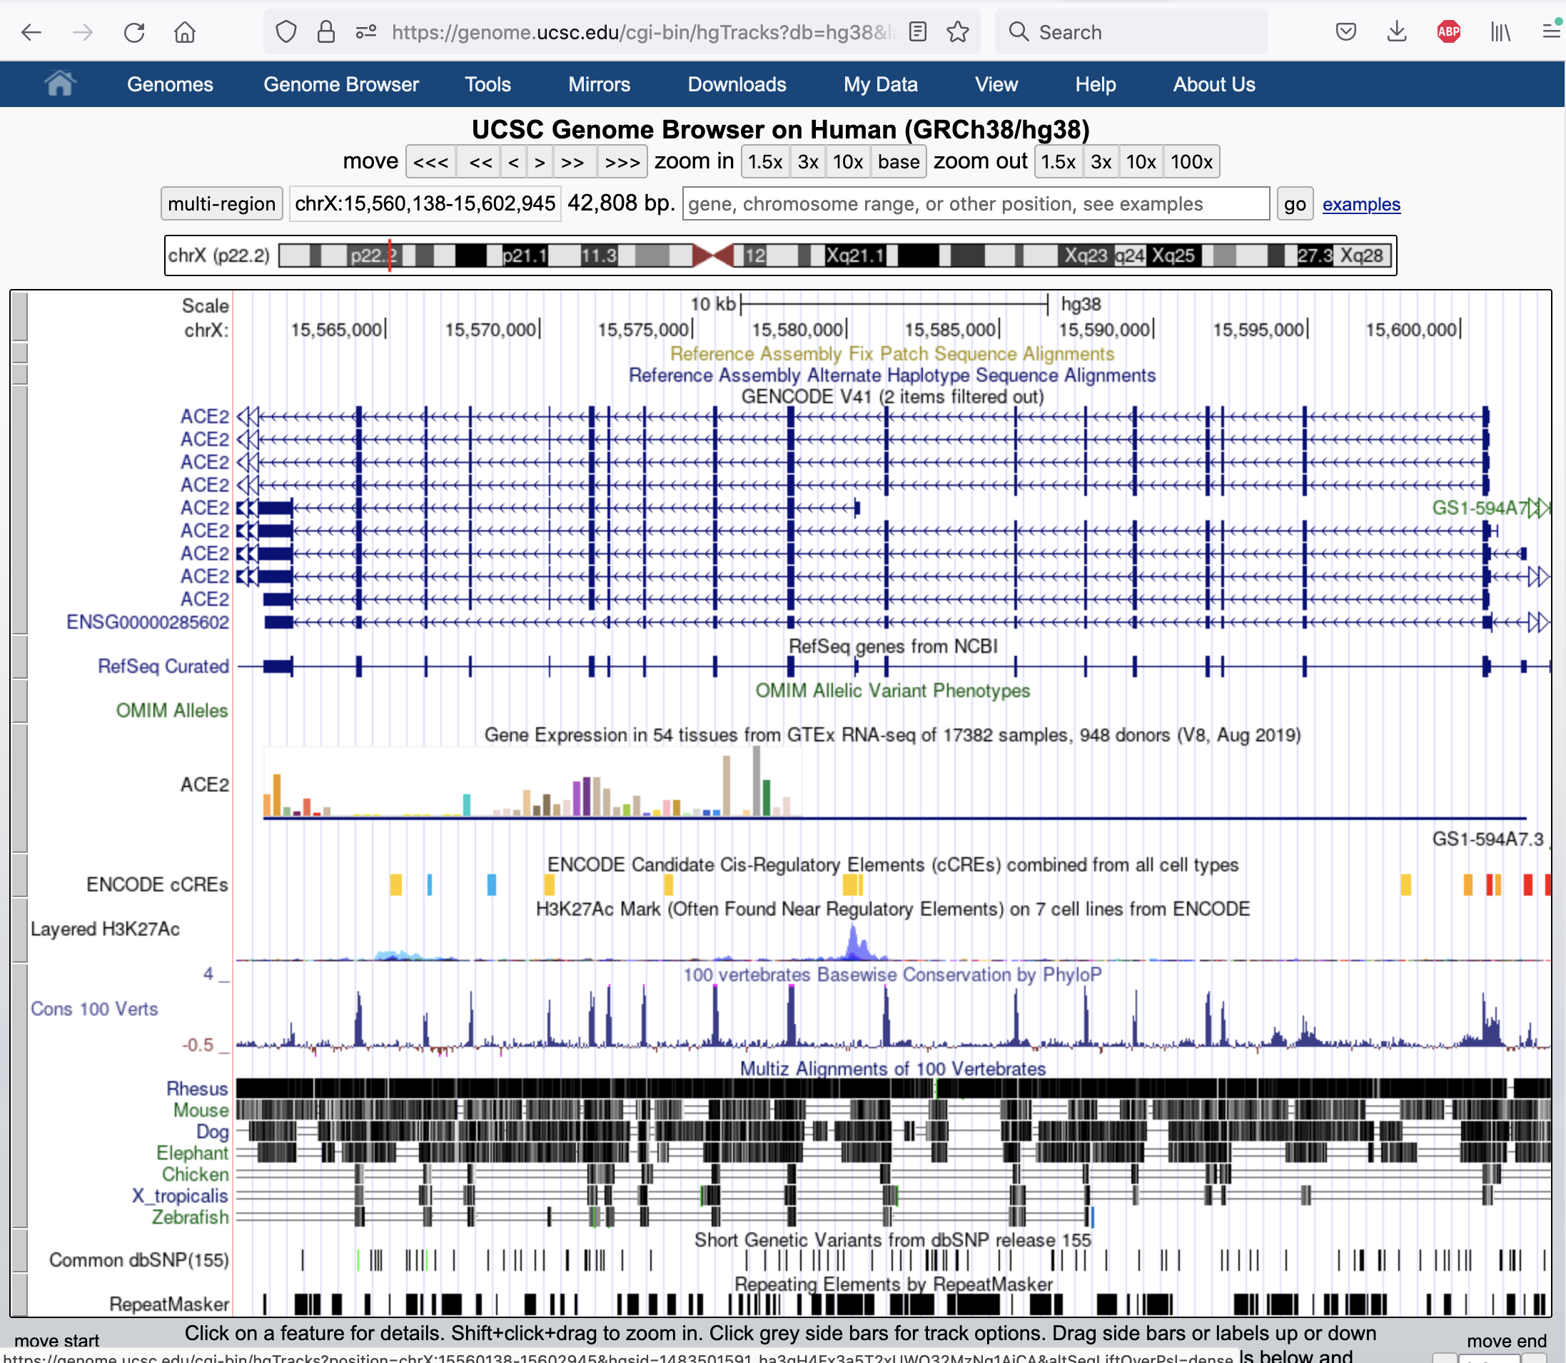
https://genome.ucsc.edu/cgi-bin/hgTracks
cgi-bin/hgTracks
default view
gene tracks
experimental expression data
An annotation set is
referred to as a ‘track’.
There are thousands
of tracks.
evolutionary conservation
variants
repeat annotation
Notes:
The default view of a genome assembly and the annotations on that genome

Slide 7
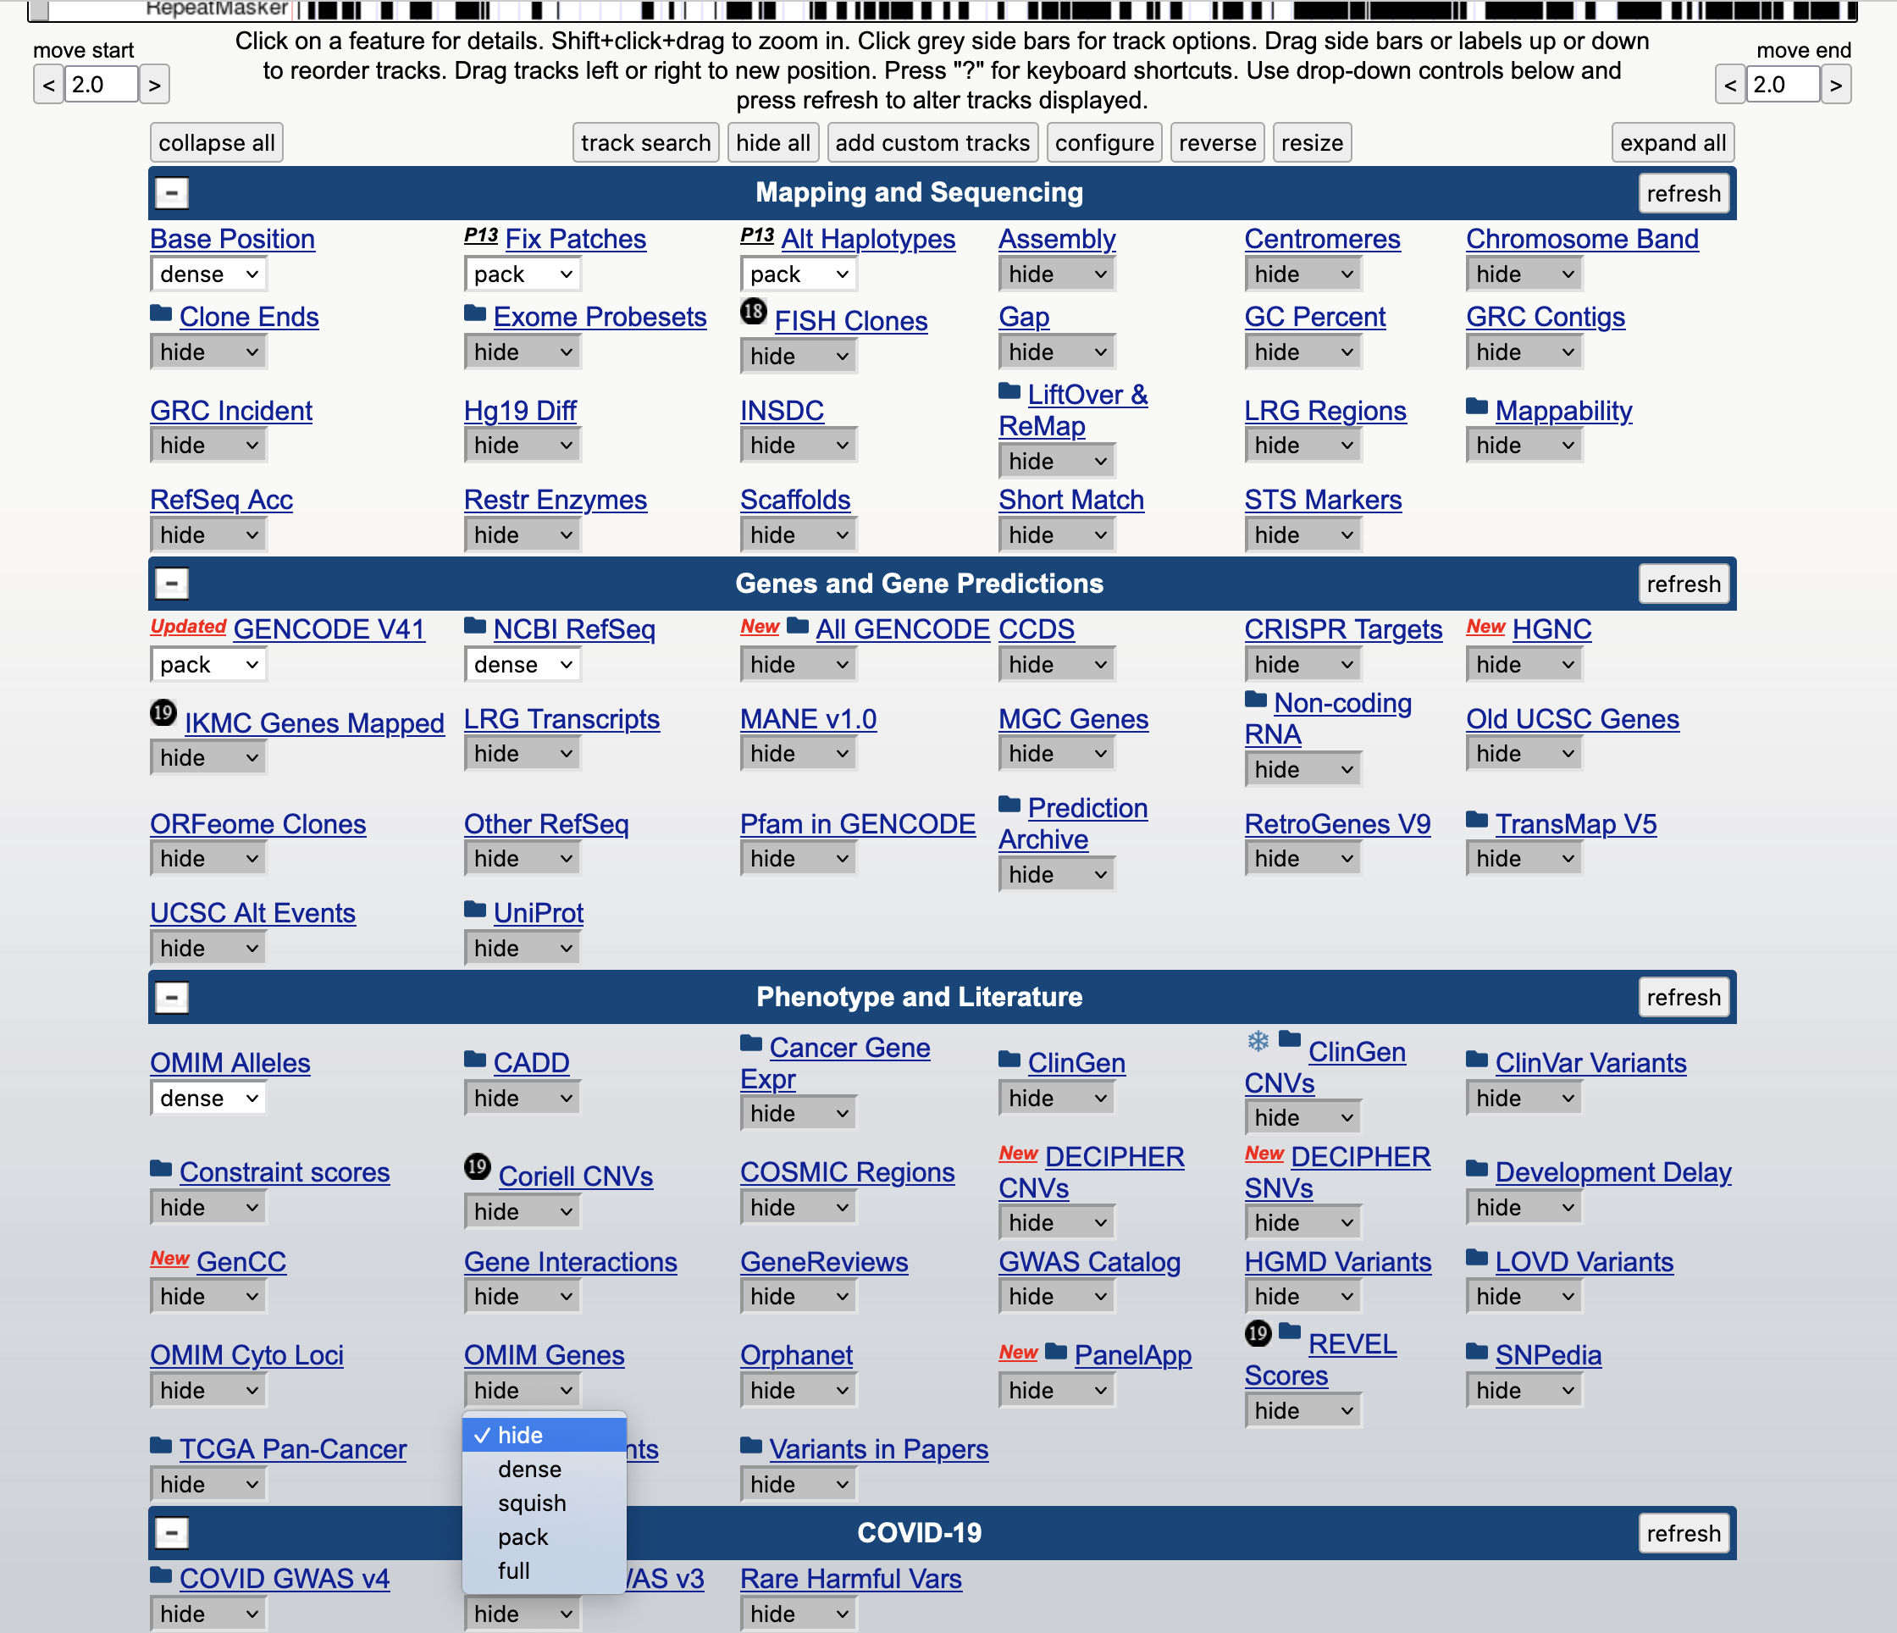
https://genome.ucsc.edu/cgi-bin/hgTracks
‘track’ controls
Under the browser graphic image
are ‘track’ controls to set the visibility
mode to display or hide a track.
‘dense’
‘squish’
‘pack’
Notes:
The track controls below the main graphic image determine what is shown in the genome browser. There are thousands of annotations that can be shown.

Slide 8
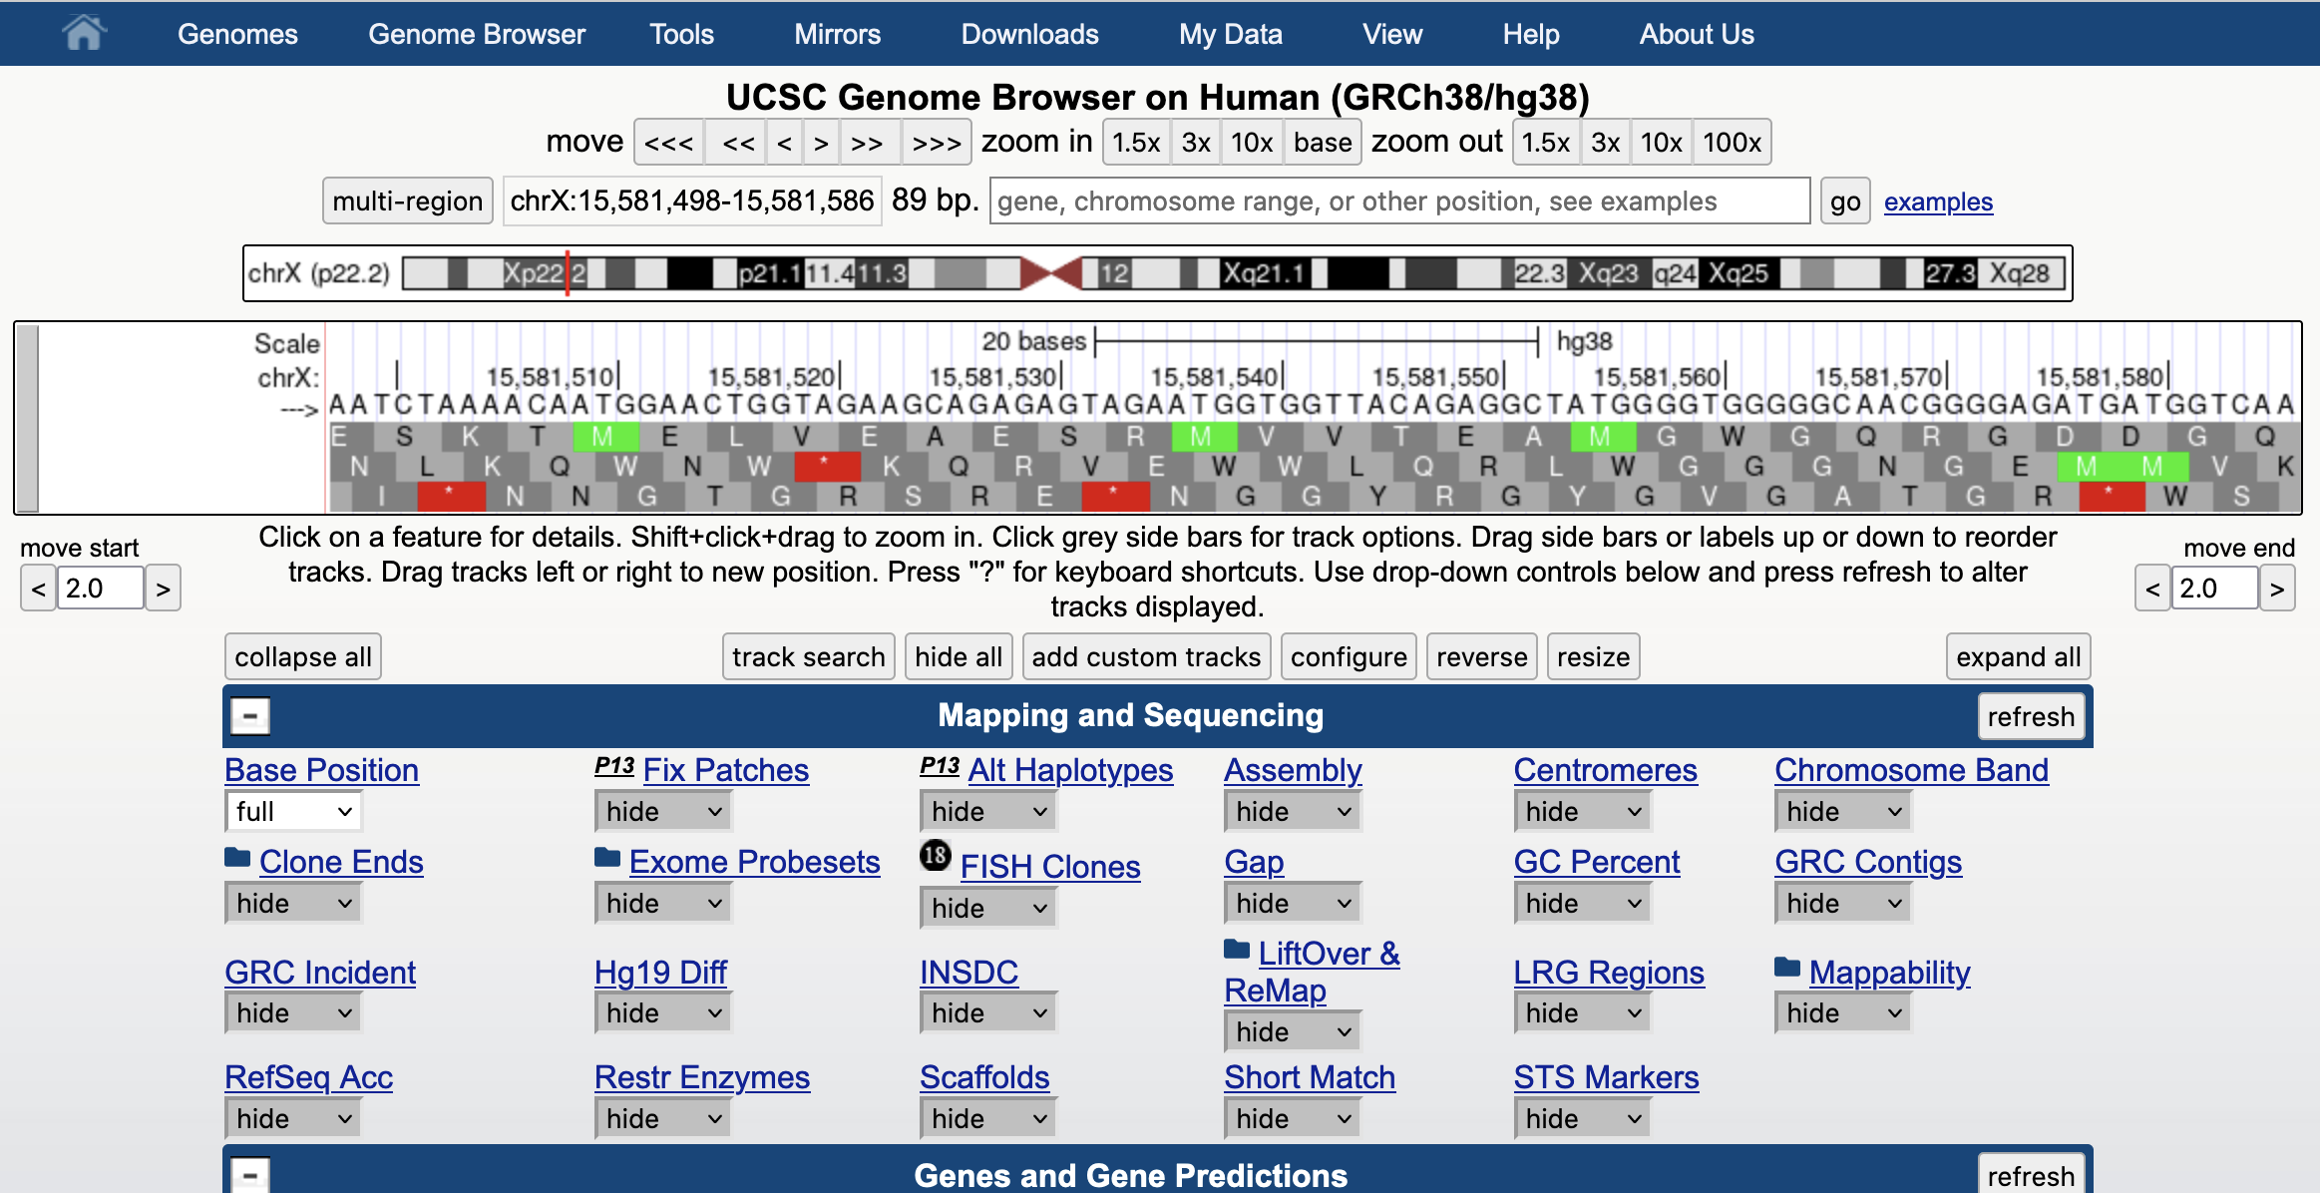
all tracks set to ‘hide’, ‘base’ track set to ‘full’, zoom in to ‘base’
Notes:
All tracks set to ‘hide’. The ‘base’ track set to ‘full’. ‘zoom in’ to ‘base’ view to see the actual nucleotides of the genome sequence.

Slide 9
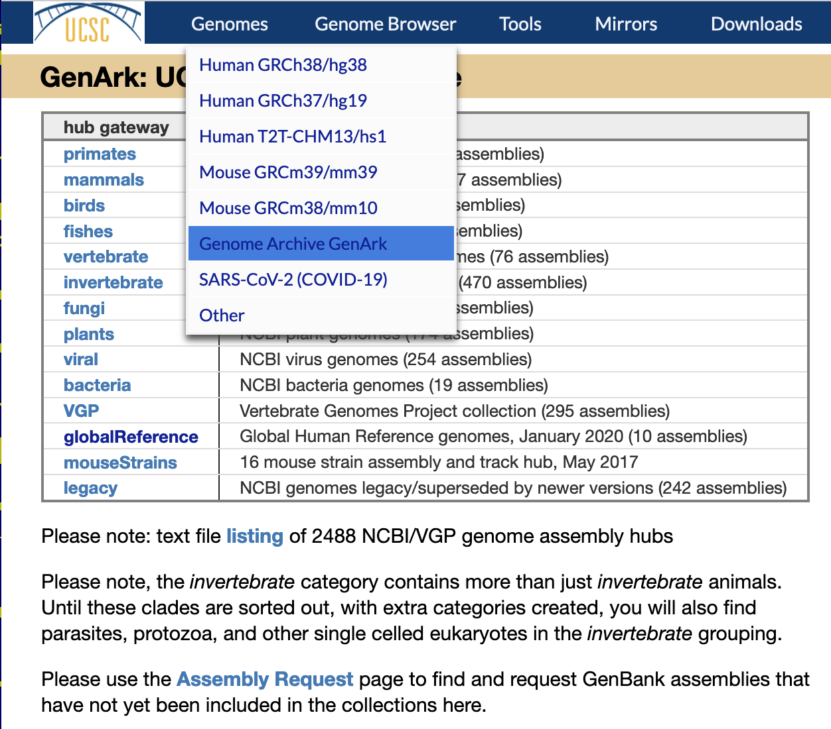
GenArk assembly hubs
https://hgdownload.soe.ucsc.edu/hubs/
Collections of genome
assemblies from NCBI
resources: ‘RefSeq’ and
‘GenBank’ assemblies.
Currently over 2,400
genome assemblies.
New assemblies can be
requested and are usually
ready to use within a week
or two.
Notes:
GenArk assembly hubs – viewing NCBI RefSeq and GenBank assemblies in the genome browser. Constructed with just URL visible files, no MySQL database tables.

Slide 10
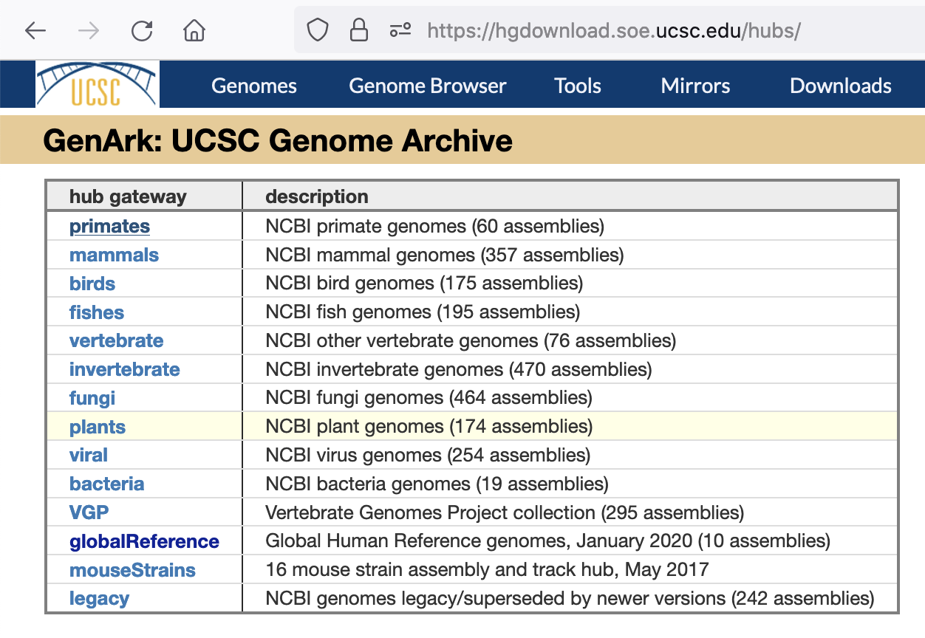
https://hgdownload.soe.ucsc.edu/hubs/
Select a group
of genome
assemblies
Notes:
The GenArk assemblies are separated into a couple of different clades to facility viewing groups of assemblies.

Slide 11
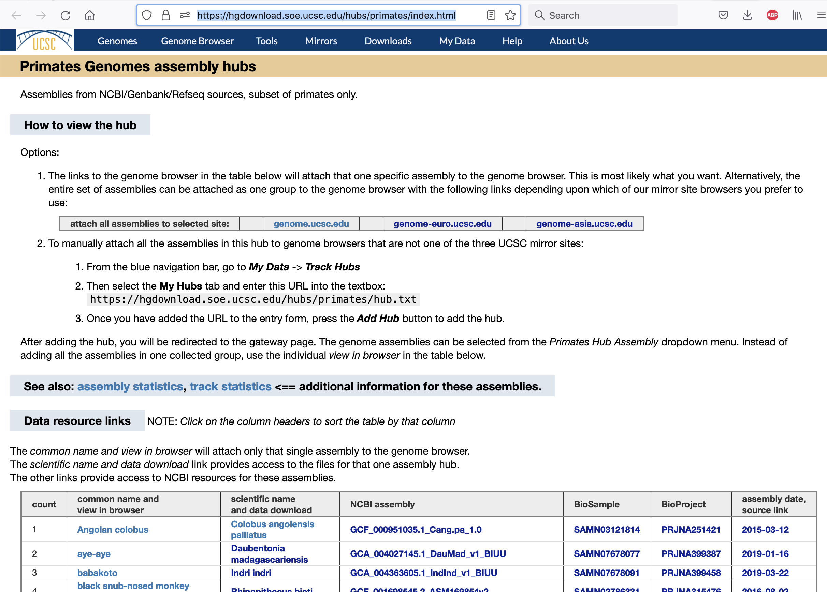
https://hgdownload.soe.ucsc.edu/hubs/primates/
Index page
for a group
of genome
assemblies
Notes:
Each individual ‘clade’ of assemblies in the GenArk collection has three different ‘index’ pages to examine the collection. A ‘primary’ index page is shown here.

Slide 12
https://hgdownload.soe.ucsc.edu/hubs/primates/
Select to view all
this group
in browser
Or select a single assembly to view in browser
Additional statistics
for this set of assemblies
Notes:
The entire group of assemblies can be ‘attached’ to the genome browser for viewing all together. Or each individual assembly can be attached for viewing.

Slide 13
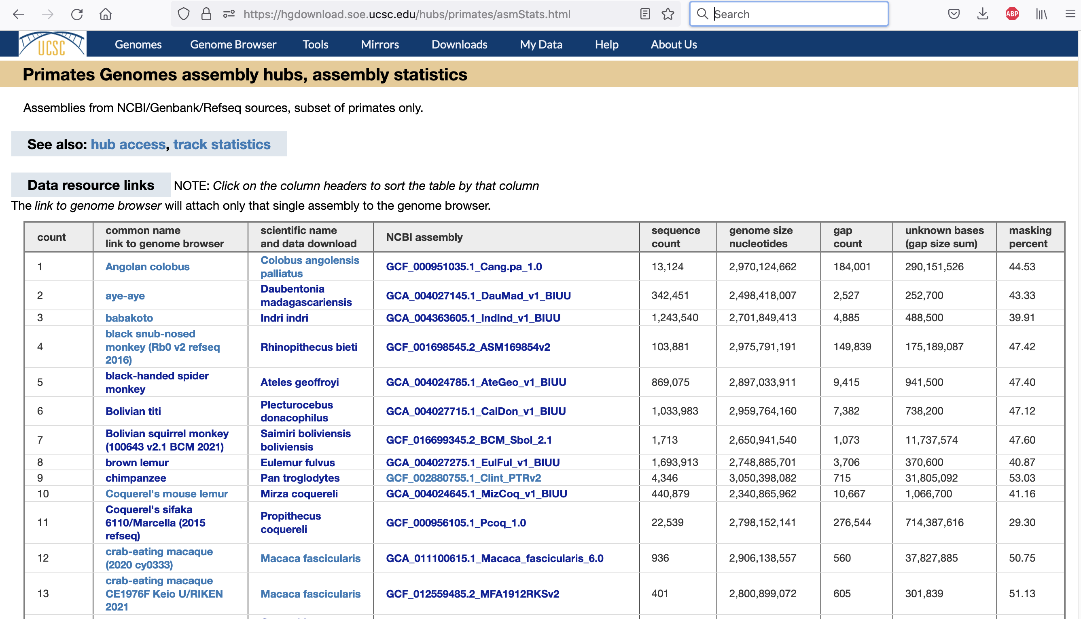
https://hgdownload.soe.ucsc.edu/hubs/primates/asmStats.html
Assembly
statistics
Notes:
A second ‘index’ page for a group of GenArk assemblies. This page showing statistics about the assembly size and construction.

Slide 14
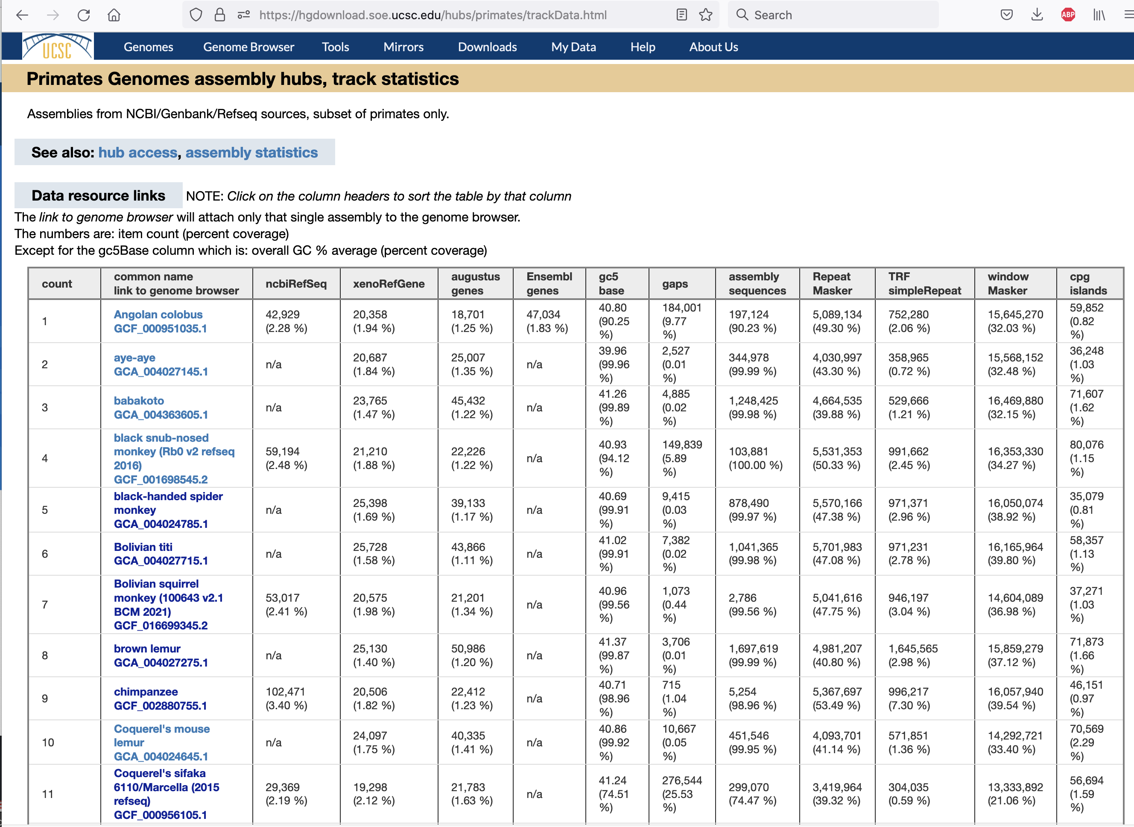
https://hgdownload.soe.ucsc.edu/hubs/primates/trackData.html
‘Track’ aka
annotation
data
statistics
Notes:
A third ‘index’ page for a group of GenArk assemblies. This page showing statistics about the annotation tracks, number of items in a track and coverage on the genome.

Slide 15
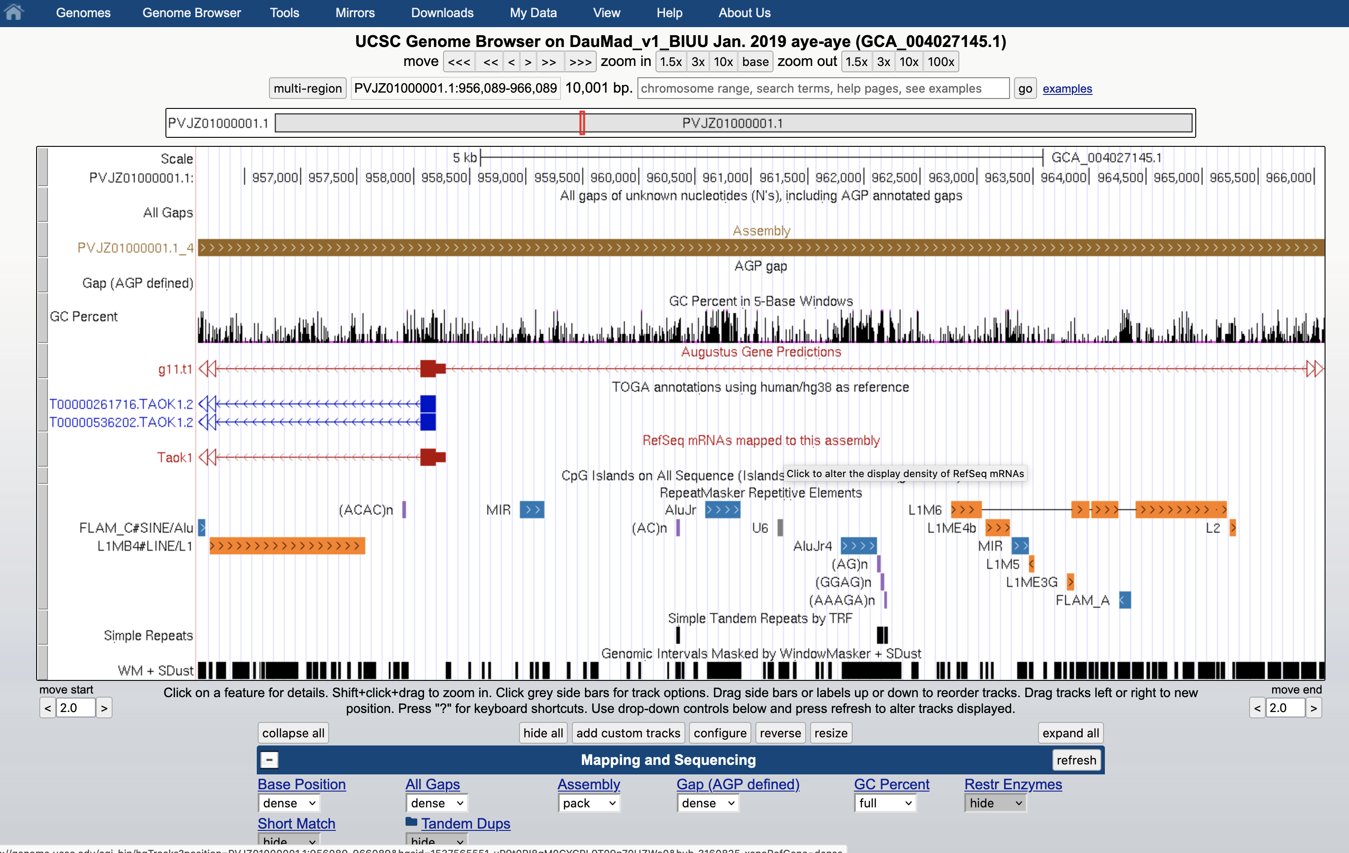
Example GenArk browser, clicked through for the ‘aye-aye’ genome:
https://genome.ucsc.edu/h/GCA_004027145.1
Notes:
The URL from one of the index pages is a short URL: https://genome.ucsc.edu/h/GCA_004027145.1 it will convert to something different when the browser page displays.

Slide 16
Build your own assembly hub
What is an ‘assembly’ hub:
A set of files available to read over the internet via URL pointers
used by the genome browser to display the assembly and associated annotation data. You host your data on a web server, the browser displays the data in the genome browser via the URL references.
See also: https://genome.ucsc.edu/goldenPath/help/hgTrackHubHelp.html
Example:
https://genome-test.gi.ucsc.edu/~hiram/Loa_loa_V3.1/
Notes:
Note the documentation at :https://genome.ucsc.edu/goldenPath/help/hgTrackHubHelp.html

Slide 17
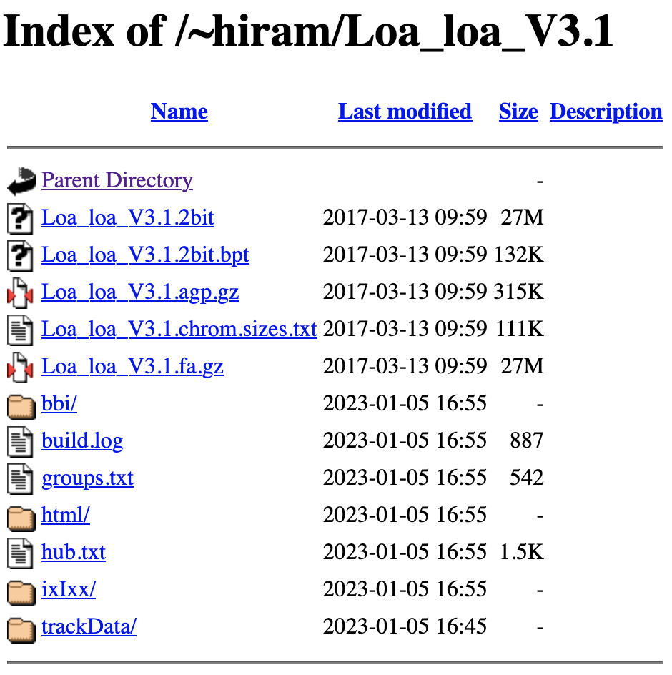
Build your own assembly hub
Example:
https://genome-test.gi.ucsc.edu/~hiram/Loa_loa_V3.1/
Notes:
Example assembly hub set of files at: https://genome-test.gi.ucsc.edu/~hiram/Loa_loa_V3.1/

Slide 18
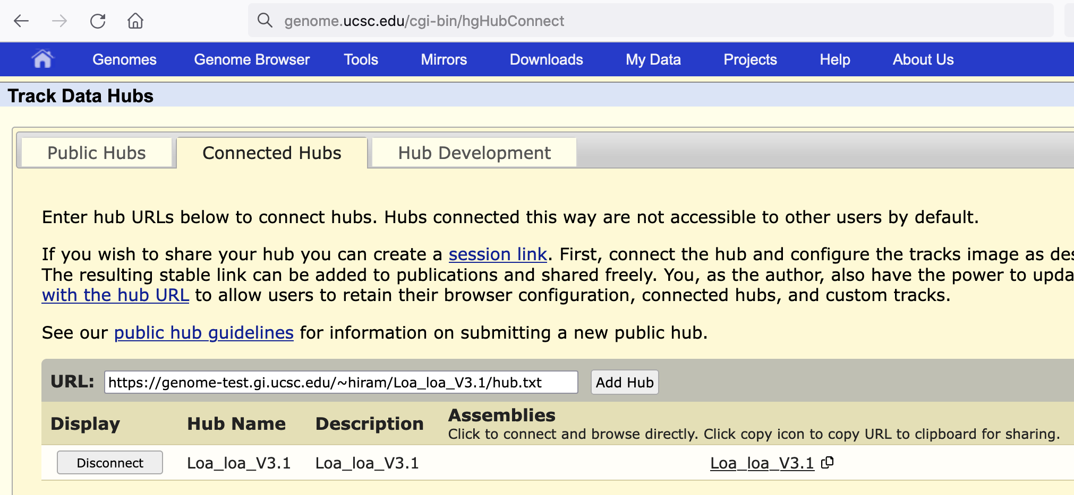
Build your own assembly hub
Submit the URL of the hub.txt file to the genome browser to start the display of this hub
https://genome-test.gi.ucsc.edu/~hiram/Loa_loa_V3.1/hub.txt
https://genome.ucsc.edu/cgi-bin/hgHubConnect
Notes:
Example assembly hub submitted to hgHubConnect: https://genome-test.gi.ucsc.edu/~hiram/Loa_loa_V3.1/hub.txt

Slide 19
One file to rule them all
Create ‘hub.txt’ file to submit this hub to the genome browser
hub Loa_loa_V3.1 genome assembly
shortLabel Loa_loa_V3.1
longLabel Loa_loa_V3.1
useOneFile on
email yourEmail@uni.edu
descriptionUrl html/Loa_loa_V3.1.description.html
genome Loa_loa_V3.1
groups groups.txt
description Loa_loa_V3.1
twoBitPath Loa_loa_V3.1.2bit
twoBitBptUrl Loa_loa_V3.1.2bit.bpt
organism Loa_loa_V3.1
defaultPos NW_018108181.1:441885-451885
scientificName Loa_loa_V3.1
htmlPath html/Loa_loa_V3.1.description.html
First section defines the hub identity.
Next section defines the genome assembly sequence files.
A ‘track’ hub would only have the ‘genome’ line to reference an existing genome in the UCSC browser system.
Notes:
A single ‘hub.txt’ file has pointers to all the individual files that make up the completed assembly hub. A ‘track’ hub would only have the ‘genome’ line and nothing else in this ‘genome’ section.

Slide 20
Build your own assembly hub
continued ‘hub.txt’ file to define the tracks for the assembly hub
track assembly
longLabel Assembly
shortLabel Assembly
visibility pack
colorByStrand 150,100,30 230,170,40
color 150,100,30
altColor 230,170,40
bigDataUrl bbi/Loa_loa_V3.1.assembly.bb
type bigBed 6
html html/Loa_loa_V3.1.assembly
searchIndex name
searchTrix ixIxx/Loa_loa_V3.1.assembly.ix
url https://www.ncbi.nlm.nih.gov/nuccore/$$
urlLabel NCBI Nucleotide database
group map
track gap
longLabel AGP gap
shortLabel Gap (AGP defined)
visibility dense
color 0,0,0
bigDataUrl bbi/Loa_loa_V3.1.gap.bb
type bigBed 4
group map
html html/Loa_loa_V3.1.gap
Additional sections define annotation tracks on this genome assembly.
See also: https://genome.ucsc.edu/goldenPath/help/hgTrackHubHelp.html
Notes:
A single ‘hub.txt’ file has pointers to all the individual files that make up the completed assembly hub.

Slide 21
Build your own assembly hub
What is a ‘track’ hub:
It serves the same function as an ‘assembly’ hub, but it does not include the assembly sequence files. Instead, it refers to an already existing genome assembly in the UCSC genome browser system.
The reference would be a single ‘genome’ line in that section of the hub.txt file.
Notes:
Track hubs are like assembly hubs, they just don’t

Slide 22
Build your own assembly hub
Example script to start construction of the files for an assembly hub from fasta sequence file:
https://genome-source.gi.ucsc.edu/gitlist/kent.git/blob/master/src/hg/utils/automation/faToHub.sh
Requires ‘kent’ command line binaries from:
https://hgdownload.soe.ucsc.edu/admin/exe/linux.x86_64/
Given a fasta file: assembly.fa.gz, example starting commands:
Create 2bit file: faToTwoBit assembly.fa.gz assembly.2bit
this is a compressed indexed file that can be used as a URL
Create bpt file: bptForTwoBit assembly.2bit assembly.2bit.bpt
provides a more efficient index for the sequences in
the 2bit file, important for high sequence count assemblies
Create sizes file: twoBitInfo assembly.2bit stdout | sort –k2,2nr \
> assembly.chrom.sizes.txt
Will be used for construction of annotation tracks
This becomes tedious rather rapidly. The script will help get it started. Annotation track construction requires data processing.
Notes:
You can create your own ‘assembly’ from from your assembled sequence fasta file. The faToHub.sh script expects to find ‘kent’ command utilities available. Binaries for these commands can be downloaded from : https://hgdownload.soe.ucsc.edu/admin/exe/linux.x86_64/

Slide 23
example construction of a data track
Create AGP file to define ‘assembly’ and ‘gap’ tracks
hgFakeAgp -minContigGap=1 -minScaffoldGap=1000 \
-singleContigs assembly.fa.gz stdout | gzip -c > assembly.agp.gz
zgrep -v "^#” assembly.gap.gz | awk '$5 != "N" && $5 != "U"' \
| awk '{printf "%s\t%d\t%d\t%s\t0\t%s\n", $1, $2-1, $3, $6, $9}' \
| sort -k1,1 -k2,2n > assemblyTrack.bed
zgrep -v "^#” assembly.gap.gz | awk '$5 == "N" || $5 == "U"' \
| awk '{printf "%s\t%d\t%d\t%s\n", $1, $2-1, $3, $8}' \
| sort -k1,1 -k2,2n > gapTrack.bed
Notes:
Typical track construction. Generate an annotation in a ‘bed’ file or other standard file type supported by the genome browser.

Slide 24
The annotation ‘bed’ files are converted
Create ‘bigBed’ files for ‘assembly’ and ‘gap’ tracks
bedToBigBed -extraIndex=name -verbose=0 assemblyTrack.bed \
assembly.chrom.sizes.txt assemblyTrack.bb
bedToBigBed -extraIndex=name -verbose=0 gapTrack.bed \
assembly.chrom.sizes gapTrack.bb
Notes:
To use an annotation file in the genome browser, the text files are transformed into indexed binary files to use over the internet via URL reference

Slide 25
REST API – programmatic interface to data resources
Documentation:
http://genome.ucsc.edu/goldenPath/help/api.html
Functions:
Get track data
Get DNA sequence
List public hubs
List browser genomes
List hub genomes
List data tracks
List chromosomes in assembly
List chromosomes in data track
List track schema
Notes:
The REST API system provides a programmatic interface for data access. The return output is JSON formatted data structures.

Slide 26
REST API – programmatic interface to data resources
Access url: https://api.genome.ucsc.edu
Endpoints:
/getData/track
/getData/sequence
/list/publicHubs
/list/ucscGenomes
/list/hubGenomes
/list/tracks
/list/chromosomes
/list/schema
Notes:
We try to keep the interface simple and easy to use. There are only a few endpoints, but they do provide access to just about everything in the genome browser.

Slide 27
REST API – programmatic interface to data resources
Access url: https://api.genome.ucsc.edu
Parameters:
hubUrl=<url>
genome=<name>
track=<trackName>
chrom=<chrN>
start=<123>
end=<456>
maxItemsOutput=1000
trackLeavesOnly=1
jsonOutputArray=1
Notes:
The parameters specify the source genome, track hub, or assembly hub to query. Which track in that source to work with, and limit the data to specific chromosome and range if necessary when too much data would be selected.

Slide 28
REST API – programmatic interface to data resources
Access url: https://api.genome.ucsc.edu
Examples:
/api.genome.ucsc.edu/list/ucscGenomes
/api.genome.ucsc.edu/list/tracks?genome=hg38
/api.genome.ucsc.edu/list/schema?genome=hg38;track=gap
/api.genome.ucsc.edu/getData/sequence?genome=hg38;chrom=chrM
/api.genome.ucsc.edu/getData/track?genome=hg38;track=gold;chrom=chrM
Notes:
Example URLs that you can use in your web browser. If you configure your browser to parse JSON data, it will show the JSON data structures.

Slide 29
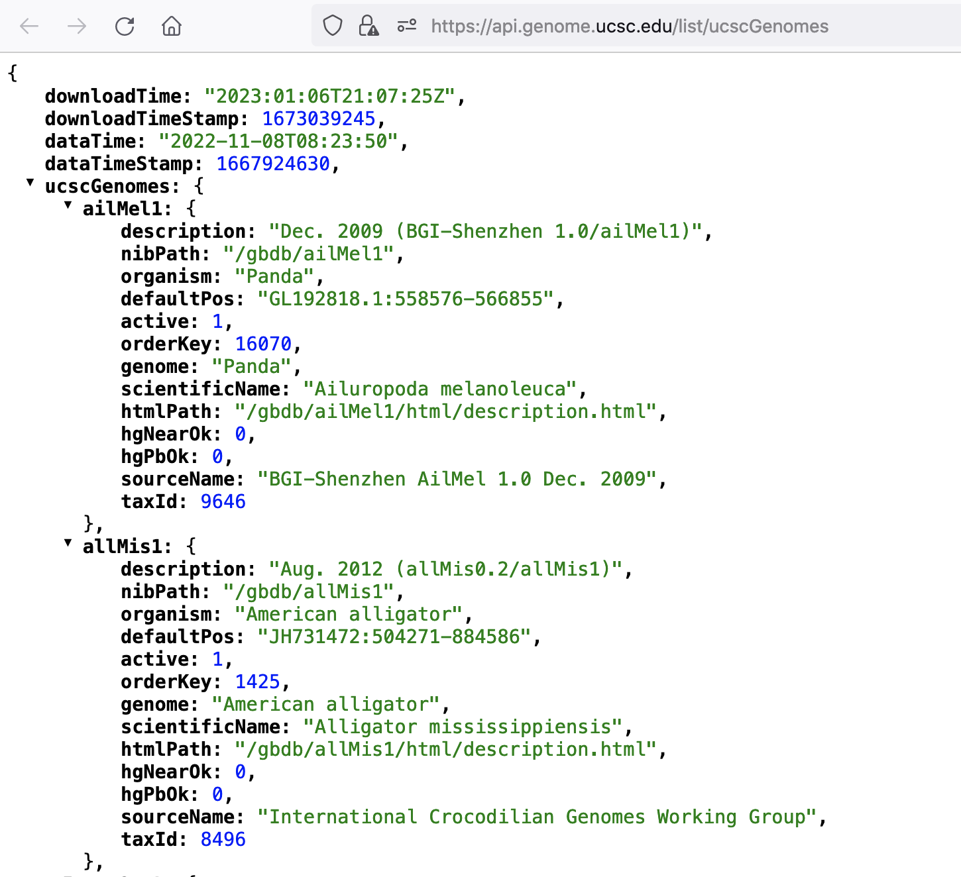
REST API – programmatic interface to data resources
returns JSON data
/api.genome.ucsc.edu/list/ucscGenomes
Notes:
Example data return from the API access: https://api.genome.ucsc.edu/list/ucscGenomes. This web browser view is configured to parse the JSON data structures to show this structured view.

Slide 30
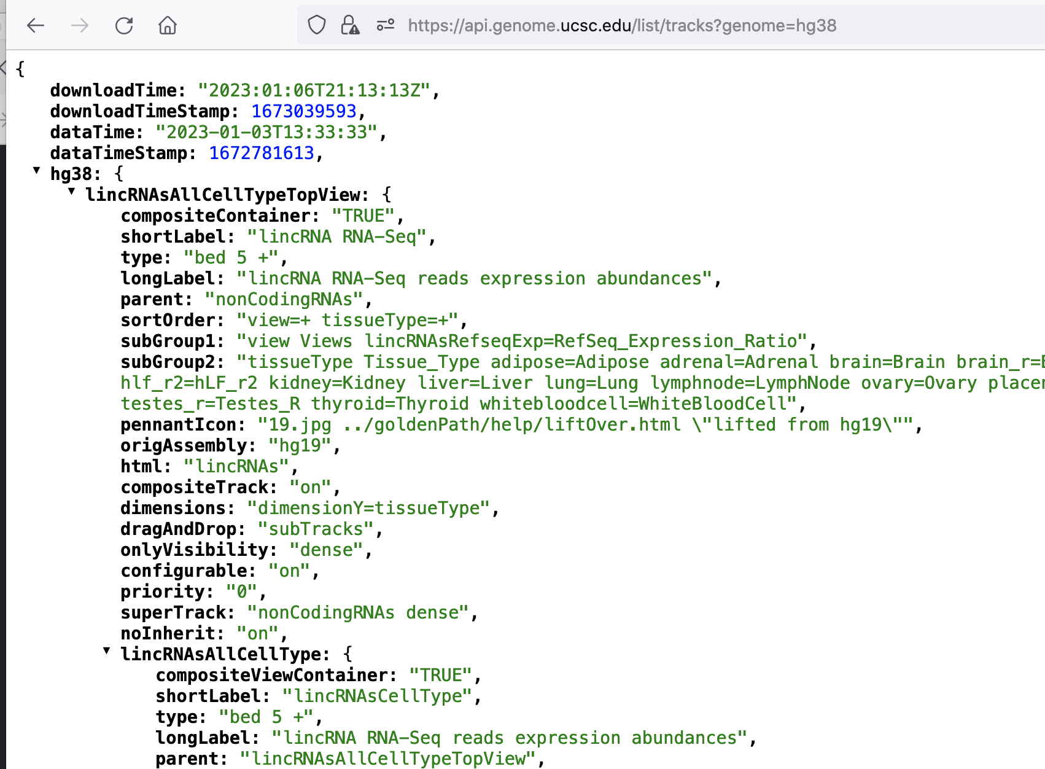
REST API – programmatic interface to data resources
returns JSON data
/api.genome.ucsc.edu/list/tracks?genome=hg38
Notes:
Example data return from the API access: https://api.genome.ucsc.edu/list/tracks?genome=hg38. This web browser view is configured to parse the JSON data structures to show this structured view.

Slide 31
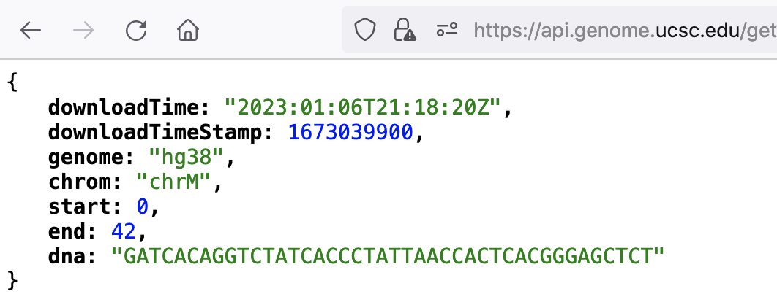
REST API – programmatic interface to data resources
returns JSON data
/api.genome.ucsc.edu/getData/sequence?genome=hg38;chrom=chrM;start=0;end=42
Notes:
Example data return from the API access: https://api.genome.ucsc.edu/getData/sequence?genome=hg38;chrom=chrM;start=0;end=42 This web browser view is configured to parse the JSON data structures to show this structured view.

