Slide 1
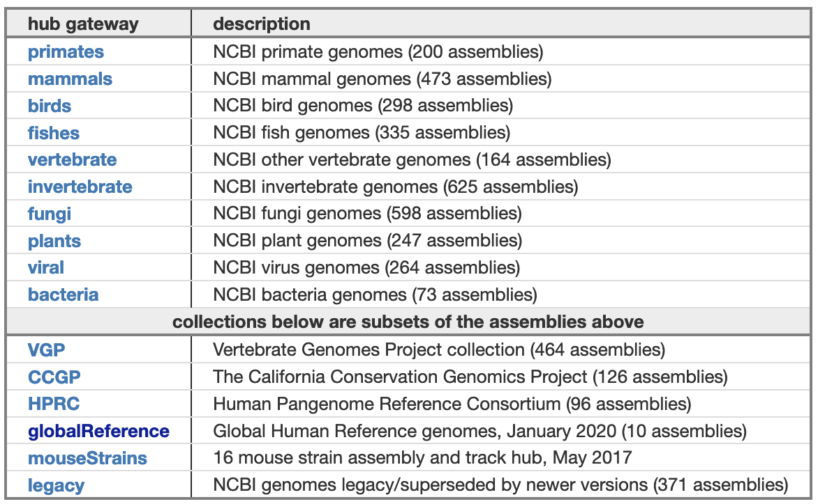
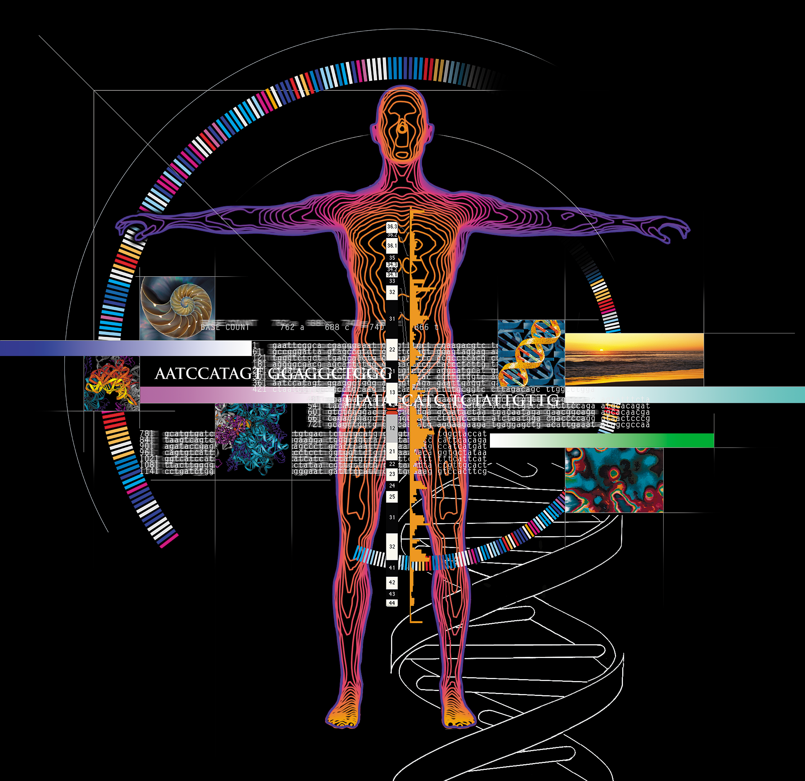
GenArk: NCBI assembly resources
at the UCSC Genome Browser
GenArk: Towards A Million Genome Browsers
GenArk gateway page:
Hiram Clawson, Luis Nassar,
Gerardo Perez, Christopher Lee, Brian Raney, Angie Hinrichs, Michael Hiller, Maximilian Haeussler, Jim Kent
hgdownload.soe.ucsc.edu/hubs/
More than 3,700
assemblies available
Any NCBI assembly can be requested when not found here
Standard set of tracks:
Example index page for ‘primates’:
NCBI RefSeq genes **
Ensembl genes **
Xeno RefGene
Augustus genes
Repeat Masker
TRF/Simple Repeats
window masker
CpG Islands
GC Percent
(** when available)
Genome assemblies:
Primates
Mammals
Birds
Fishes
Other vertebrates
Invertebrates
Fungi
Plants
Viruses
Mouse strains
Global human references
Vertebrate Genomes Project
Display one assembly in the Genome Browser:
genome.ucsc.edu/h/GCF_002880755.1
UC Santa Cruz
Genomics Institute
Funding provided by the National Human
Genome Research Institute [U41-HG002371]
Future additions:
Clawson, H., Lee, B.T., Raney, B.J. et al.
GenArk: Towards A Million UCSC Genome Browsers
Genome Biology 24, 217 (2023)
doi.org/10.1186/s13059-023-03057-x
archaea
bacteria
more viruses

