Slide 1
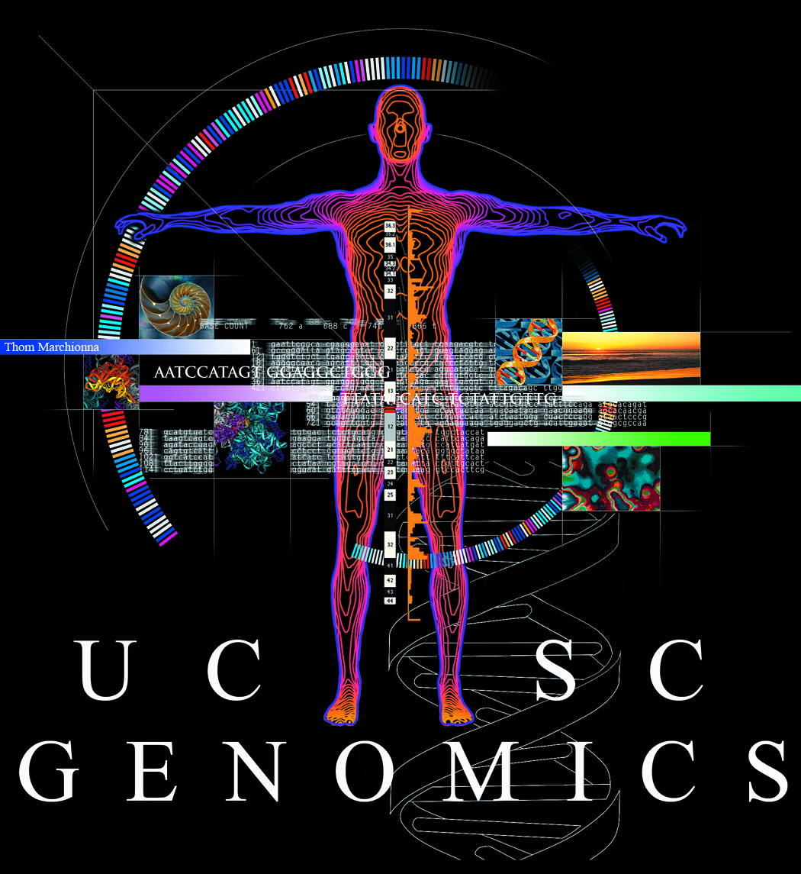
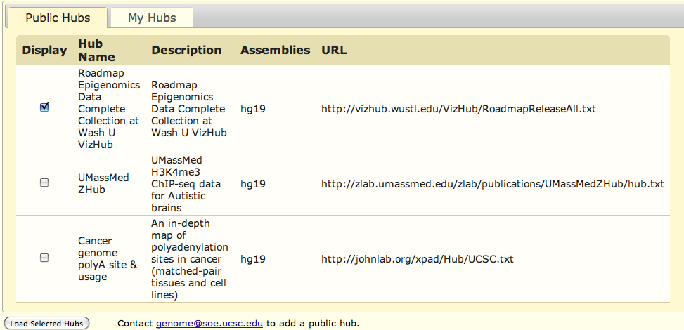
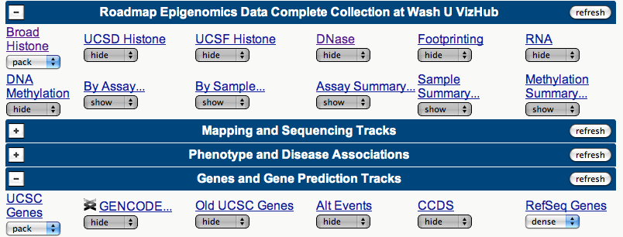
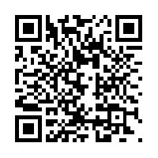
Remote Data Track Storage for Viewing on the UCSC Genome Browser
Brian J. Raney¹, Galt Barber¹, Angie Hinrichs¹, Mary Goldman¹, Greg Roe¹, Brooke Rhead¹, Luvina Guruvadoo¹, Pauline Fujita¹, Venkat S. Malladi¹, Ann Zweig¹, Donna Karolchik¹, David Haussler^{1,2}, W. James Kent¹
¹Center for Biomolecular Science and Engineering, University of California at Santa Cruz, California, USA
²Howard Hughes Medical Institute, University of California at Santa Cruz, California, USA
Your Remote Data Displayed In the Context of Other Annotations
UCSC local data
Public remote data hub
Public
bigBed
bigWig
BAM
VCF
Unlisted remote data hub
Unlisted (need URL)
bigBed
bigWig
BAM
VCF
Track Data Hubs are collections of annotation tracks that can be stored anywhere on the Internet, and can be accessed by the UCSC Genome Browser as if they were stored locally. The file types supported in Track Data Hubs are BAM, VCF/tabix, bigBed, and bigWig, all of which are random access. Only the data being viewed is uploaded to the UCSC Genome Browser, which caches the data locally; therefore, the upload need only occur once when repeatedly viewing the same area. Track Data Hubs are supported by the Genome Browser graphical interface, as well as by the UCSC Table Browser, which allows for intersections between tables, filtering on table fields, and collating data from several different tables.
UCSC lists public hubs, but private hubs can be added too
Hub track controls appear with other tracks
Formatting your Data
Coming Soon: Assembly Data Hubs
Data files must be in one of the following formats: bigBed, bigWig, BAM or VCF indexed by tabix. Database information is stored in text files with the following structure:
myHub/ - directory for the hub as a whole
hub.txt – text file containing a short description of the hub
genomes.txt – text file containing a list of genome assemblies
hg19/ - directory for a recent human assembly
trackDb.txt – text file containing track display details including names, colors, data types, etc.
dnase.html – (example) HTML file describing a DNAse track to users
dnaseSignal.bw – (example) wiggle plot of DNAse Signal
dnaseReads.bam – (example) BAM file of DNAse Reads
To address the increasing need for researchers to annotate sequence for which UCSC does not provide an annotation database, we will be introducing Assembly Data hubs. These will allow researchers to include the underlying reference sequence, as well as data tracks that annotate that sequence. Sequence will be stored in the UCSC twoBit format, and the annotation tracks will be stored in the same manner as Track Data Hubs.
Acknowledgements
This work was funded by National Human Genome Research Institute award 5P41 HG002371-12 to UCSC Center for Genomic Science.
See our wiki for more information:
http://genomewiki.cse.ucsc.edu/index.php/GI2012TrackHubsPoster

